Slide 1






The Role of the Universities in Strengthening Local and National Innovation Ecosystems: Experiences from Ss. Cyril and Methodius University in Skopje
Prof. d-r Radmil Polenakovikj
Faculty of Mechanical Engineering, Ss. Cyril and Methodius University, Skopje, N. Macedonia
+
Business Start-up Centre, FME, UKIM
+
National Centre for Development of Innovation and Entrepreneurial Learning
+
Micro HEL-EX
Regional Collaboration for Innovation and Growth. 16-17 April 2026, Litomyšl, Czech Republic

Slide 2
Content
I will speak about:
Influence vs. Impact
My University and me
University level vs. personal level influence/impact
Mistakes to avoid
Lessons learned and recommendations

Slide 3
Influence vs. Impact
Influence is the process; impact is the result:
Influence refers to the ability to shape opinions, behavior, decisions, or direction.
Impact refers to the actual change or effect that happened because of that influence.
Influence is often gradual and subtle; Impact is visible, stronger, and measurable.
For stakeholders:
Influence => power to affect decisions
Impact => degree to which the stakeholder is affected by the actions
Notes:
Influence usually works through: persuasion, trust, role modelling, communication, networking, etc. It may happen over a longer period and is not always immediately visible.
Impact is usually: concrete, observable, easier to measure, linked to outcomes and long-term change. In project management and research, impact is often associated with economic, social, policy, or behavioural change.

Slide 4
In order to make influence and impact
You need team, support and right environment !
Influence and impact
You
Students
Chair within your Institute
Institute within you Faculty
Faculty within your University
University
Local environment
Regional level
National level
International level
YOU
Notes:
Influence usually works through: persuasion, trust, role modelling, communication, networking, etc. It may happen over a longer period and is not always immediately visible.
Impact is usually: concrete, observable, easier to measure, linked to outcomes and long-term change. In project management and research, impact is often associated with economic, social, policy, or behavioural change.

Slide 5
Ss. Cyril and Methodius University in Skopje
Established in 1949
Now: 23 faculties, 5 scientific institutes and 12 associate members
Currently: 23.738 – 1st cycle students, 1.458 – 2nd cycle students, 1.745 - 3rd cycle students; and 3.100 professors, assistants and administration
Until now: 195.547 graduated on a 1st cycle of studies, 22.487 obtained master degree and 5.933 are with PhD degree
Faculty of Mechanical Engineering (9 undergraduate programs, 15 MSc programs and 3 PhD programs, with 1000 students, 70 staff)
I am coming from Institute for Production and Industrial Engineering

Slide 6
Who is Radmil?
At the Faculty of Mechanical Engineering, UKIM since 1991
Lecturing Entrepreneurship (since 1997) and Innovation management (2001) at UKIM
350+ papers (including 20 textbooks), but only few impact factor journals
160 + projects – supported by EU (cross-border, FP7, Tempus, COSME, Erasmus+, H2020...), OECD, World Bank, ETF, ADA, USAID, GTZ, CEI, UNDP, UNIDO, Macedonian institutions; & evaluator to 10+ programs
Consulting in Serbia, Montenegro, Bosnia & Herzegovina, Albania, Romania, Moldova, Ukraine, Ethiopia, Tunisia, Morocco, Azerbaijan…
Established first University Business Start-up centre & Career Centre(2006), NCDIEL (2009), Centre for excellence in green innovation (2021)

Slide 7
Who is Radmil?
Developed training and mentoring scheme and competitions for creation of 60+ start-up companies (via BSC and NCDIEL)
National SME strategy 2025-2030, National Development Strategy 2024-2044, Regional innovation strategies, National Cluster strategy 2018-2025, National Entrepreneurial Learning Strategy 2014-2020, etc.
Push of the entrepreneurial education in the country (National strategy for entrepreneurial learning + courses Innovation in 9th grade of primary school and Innovation and Entrepreneurship in 1st, 2nd and 3rd year, and Business and Entrepreneurship in 4th year of Gymnasiums; training of > 2500 teachers in primary and secondary schools (Manual: How to teach entrepreneurship?)
Established start-up company Micro HEL-EX in 2023 (with UKIM colleagues)
Organization of the National best business plan competition for high school students (since 2008)

Slide 8
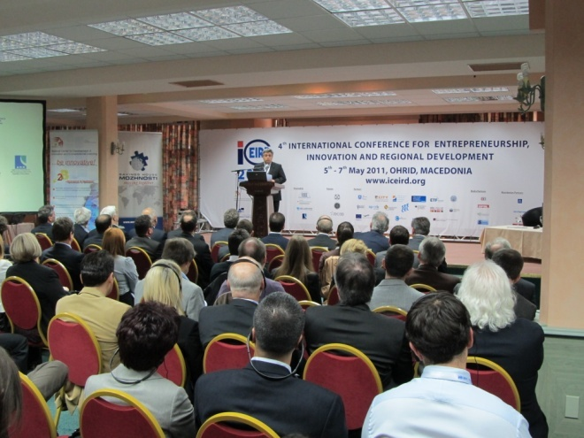
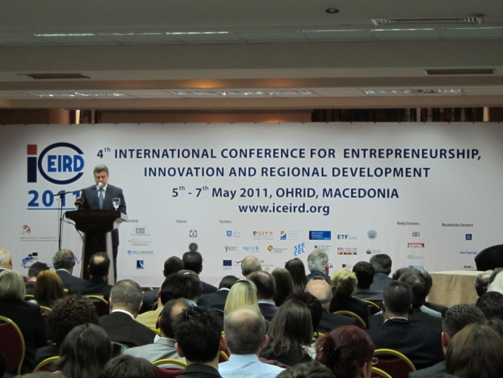
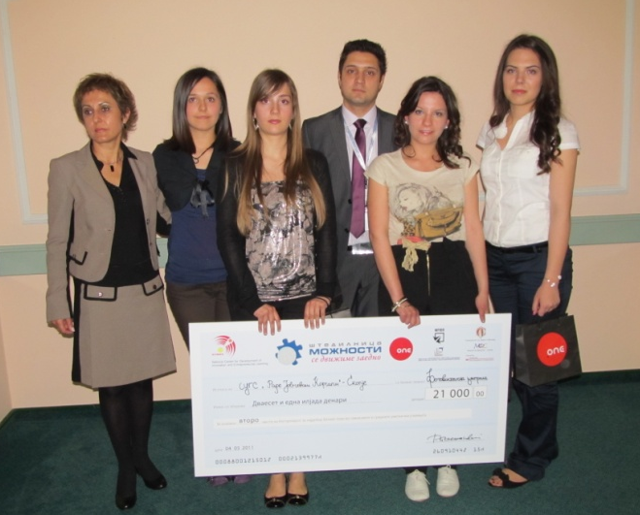
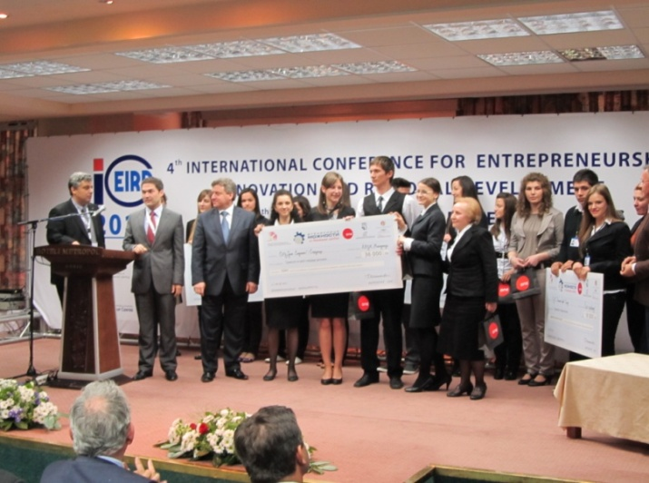
Notes:
With President of the country

Slide 9
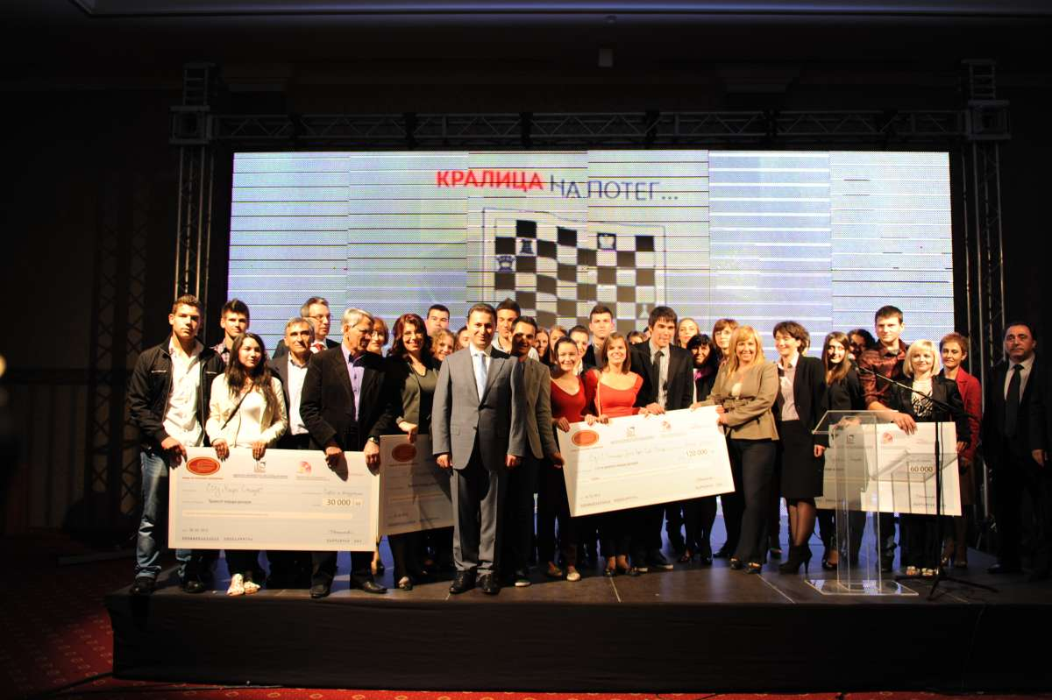
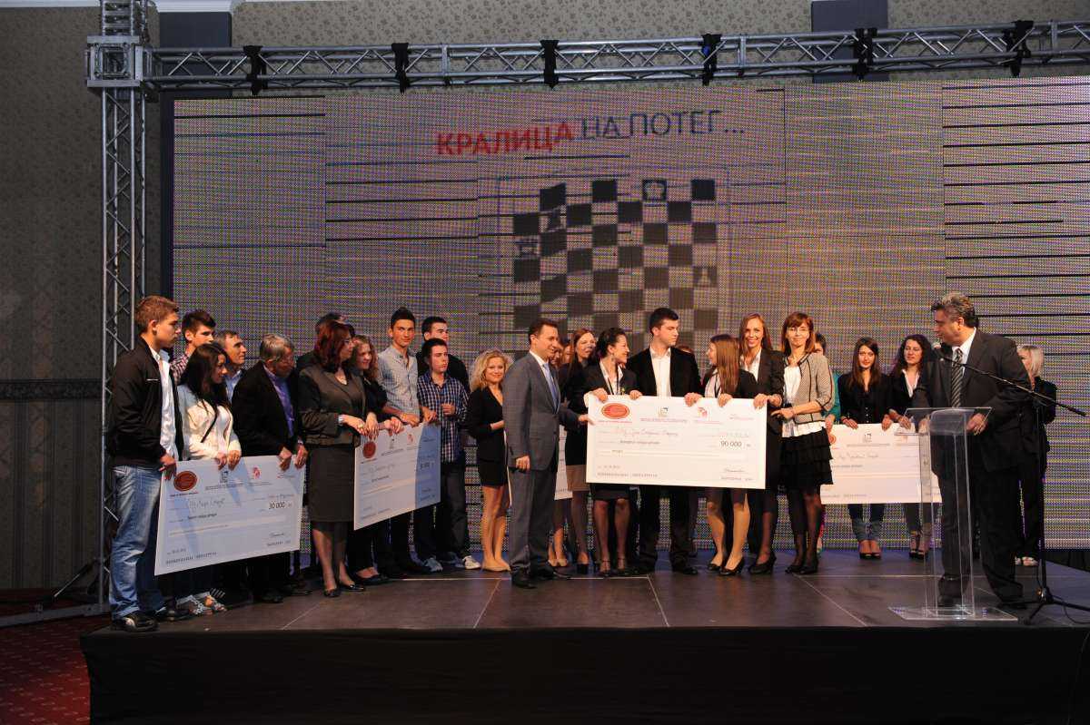
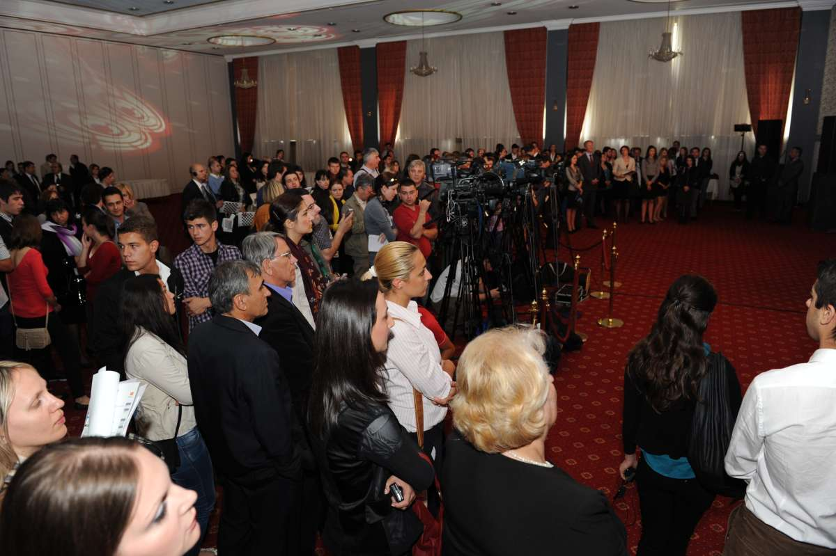
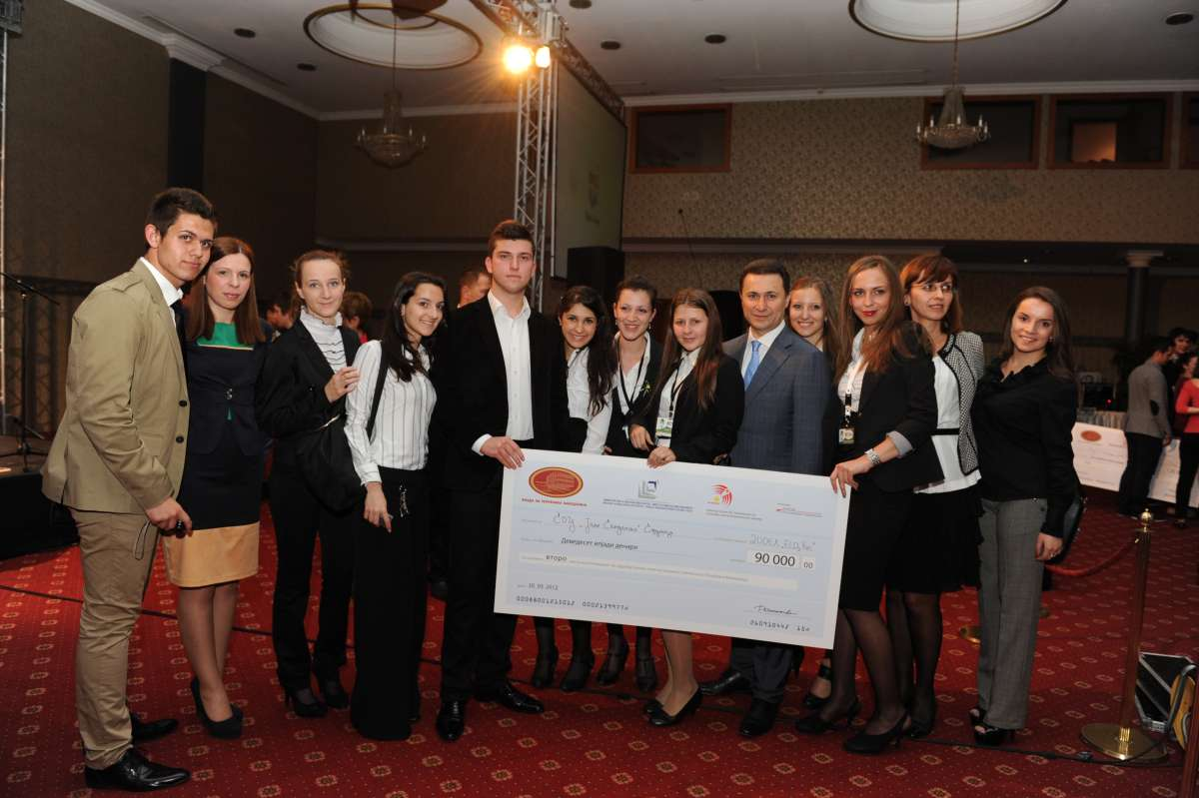
Notes:
With Prime Minister of the country

Slide 10
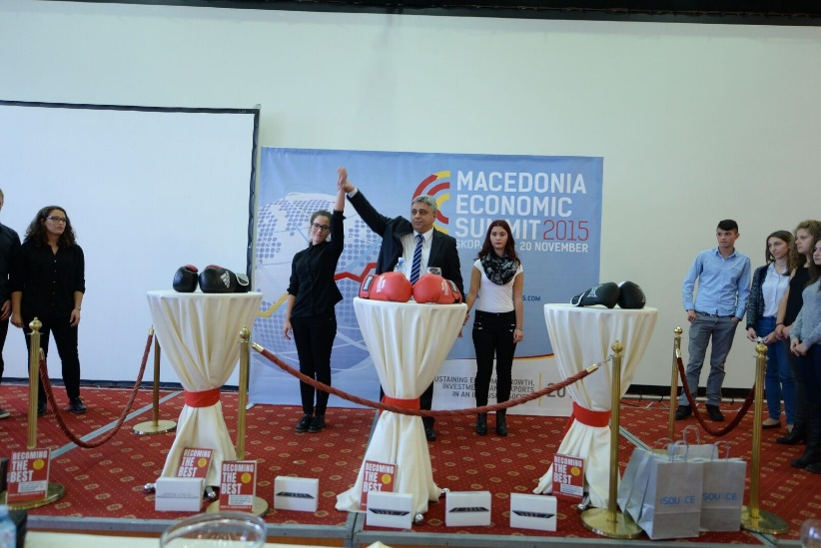
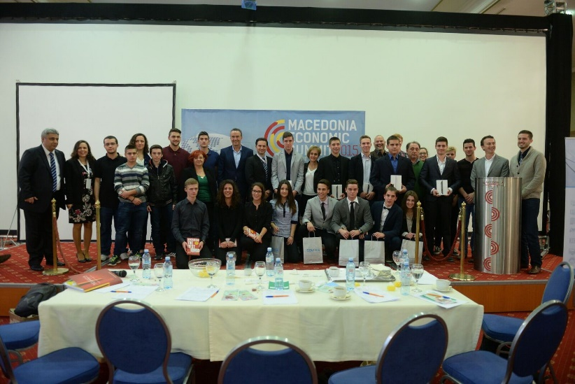
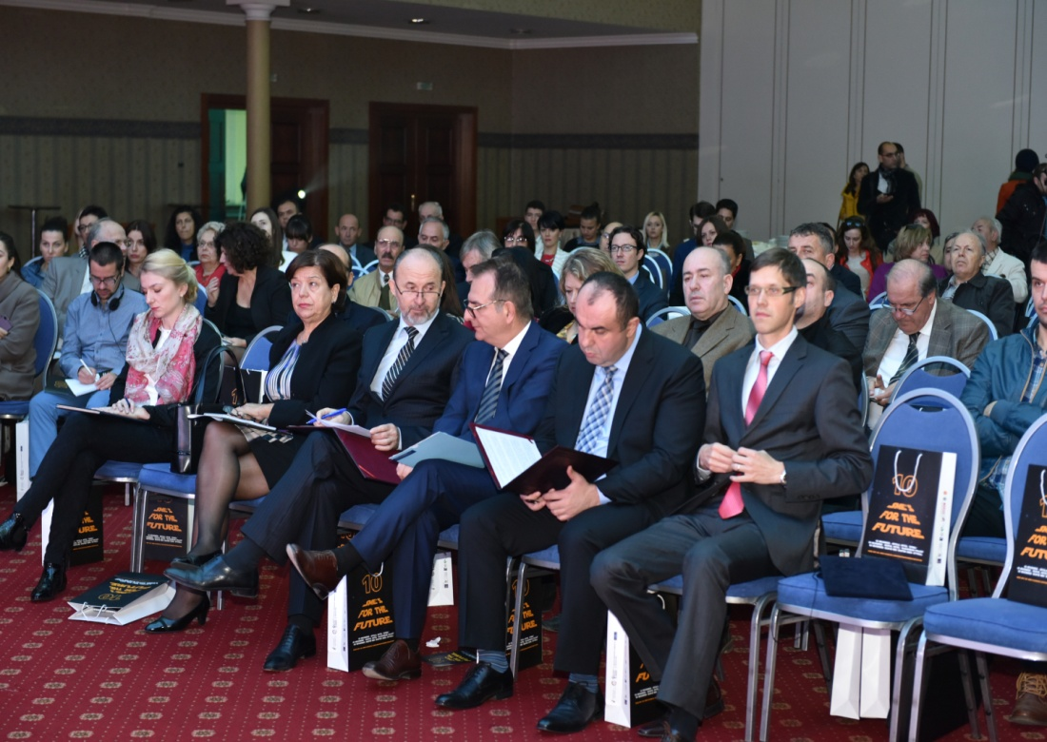
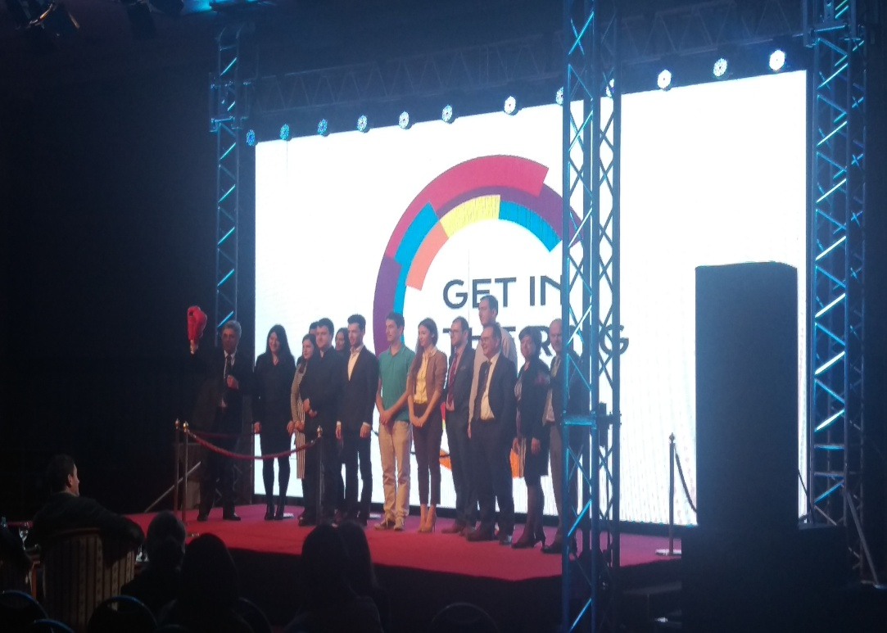
Notes:
With many partners, Ministries, Municipalities, companies, sponsors, donors and diaspora representatives

Slide 11
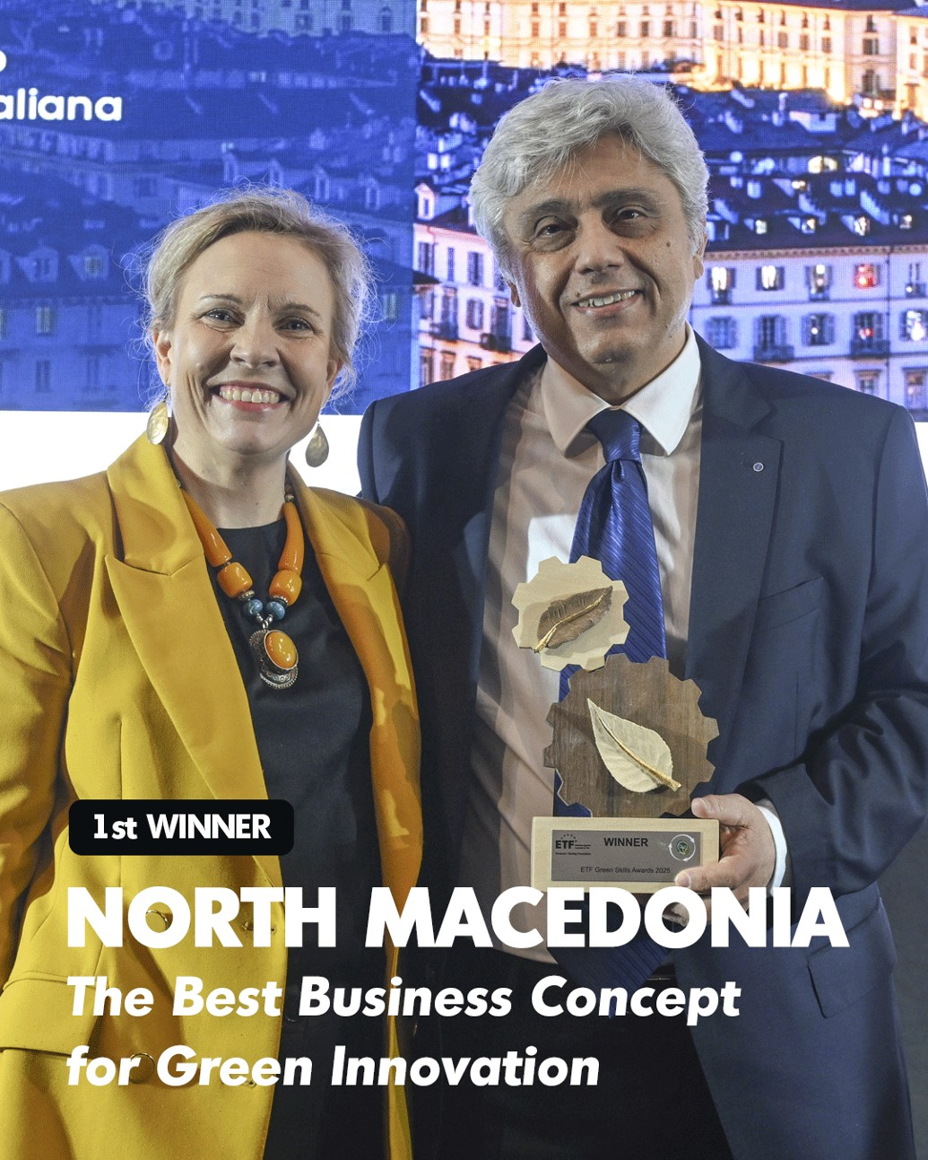
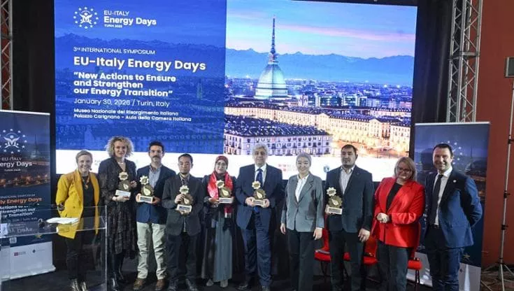
ETF Green Skills Award 2025

Slide 12
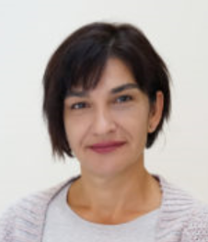
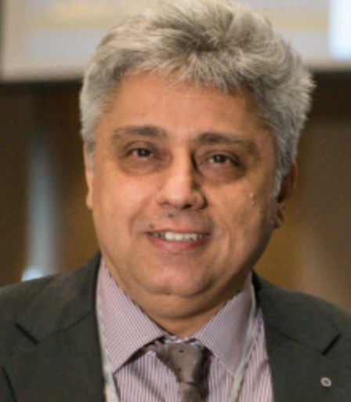
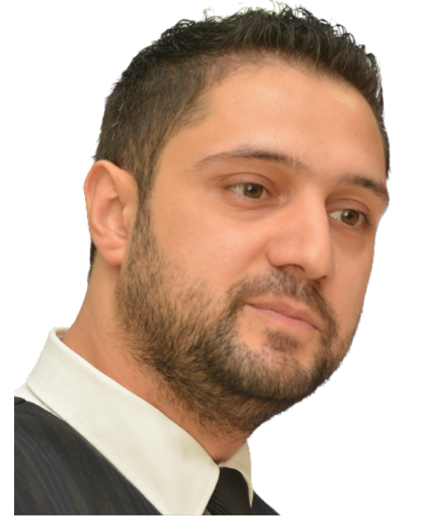
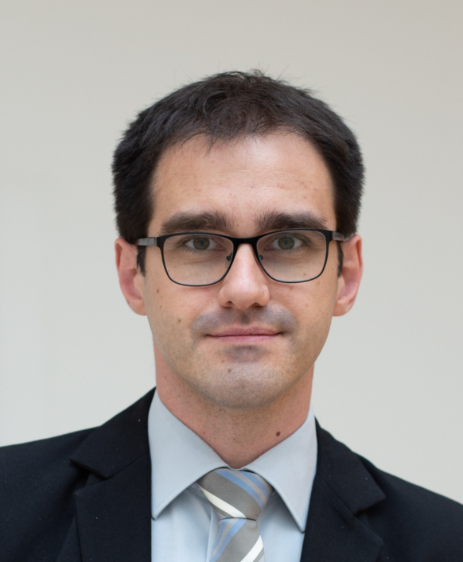
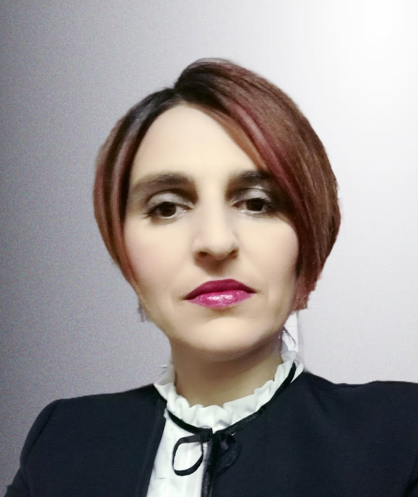
What is our (Micro HEL-EX) story?
Started in 2017
Interdisciplinary team - UKIM researchers:
Faculty of Farmacy
Faculty of Mechanical Engineering
Significant international and domestic support:
International (ADA, EIT Jumstarter, EU4TECH PoC, WBC.RRI competition, AT-MK bilateral program, MES project, etc.)
Domestic (FITD x 2 support)
Main results until now:
2022 - National patent MK/P/2021/853
2024 - European patent EP4316535A1
Prof. Dr.
Radmil Polenakovikj
Ass. Prof. Dr.
Trajce Velkovski
Prof. Dr.
Marija Glavas Dodov
Prof (FH) Dr.
Bojan R. Jovanovski
Prof. Dr.
Maja Simonoska Crcarevska

Slide 13
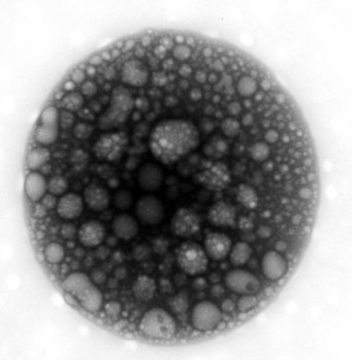
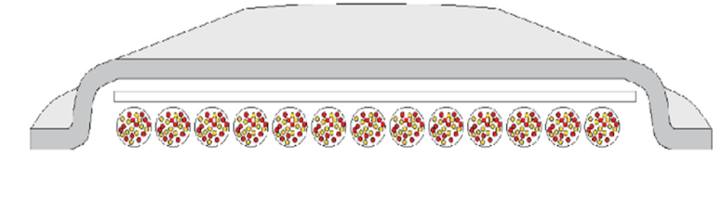
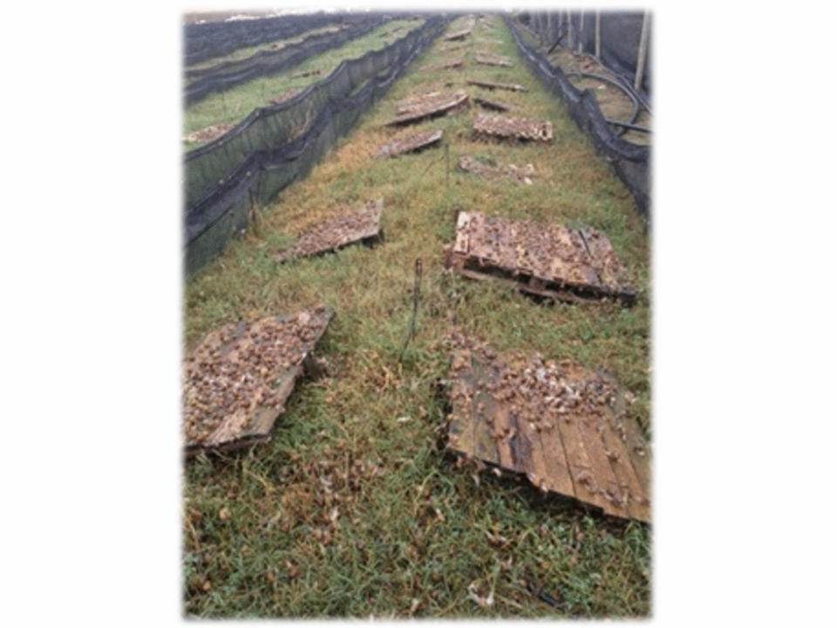

Anti-inflammatory and soothing effect Antioxidant and regeneration activities
Snail mucus powder
Cannabis sativa extract
St. John worth extract
Marigold pot extract
Certificate of
quality established
20-25% faster healing
Spray-dried
microparticles
with snail slime & herbal extracts
EPO patent EP4316535A1
EMA standardized

Slide 14

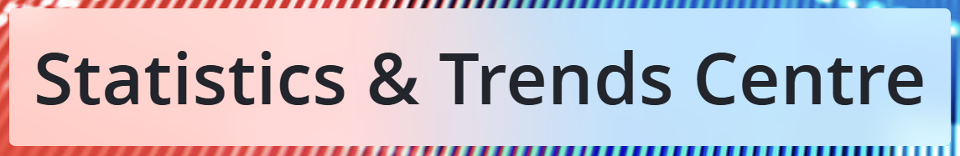
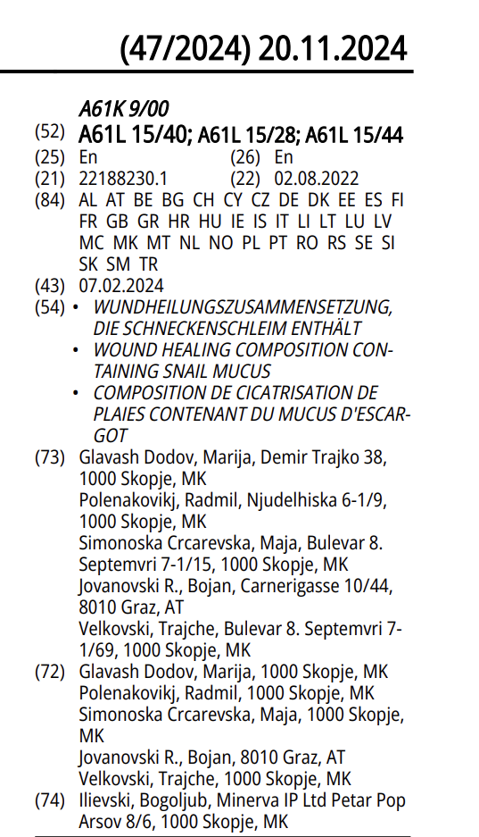
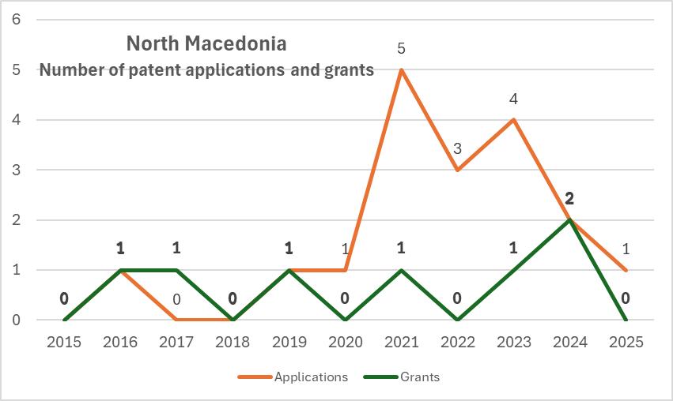
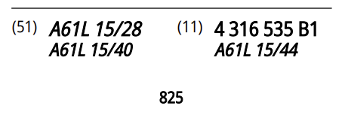

Slide 15


At the beginning
Increasing snail farms
(supported by USAID)
Snail mucus powder production
(FITD supported)
Snail gastronomy
2021 2023
Wound treatment focus on DFU
All types of wound treatment
2025-2026
(looking for EIC or EIT support)
- Health products
- Veterinary use
- Cosmetics
National
Patent 2022
Micro HEL-EX
2024 EPO Patent
Support to snail cluster
(FITD support)
Innovation
management support
Now – smart patches
- EIT Jumstarter
- EU4TECH PoC
2017
Feasibility study
(supported by ADA)
Herbal extracts
Patients (B2C)
Testing formulation
Hospitals & health
administration (B2B)
- MK – AT project
- UKIM project
DFU – Diabetic Foot Ulcer

Slide 16
Regional/National/International influence / impact
Enhancing ESM’s (Power Plants) role in North Macedonia’s Just Transition (project funded by Japan International Cooperation Agency (JICA), managed by EBRD and implemented by PwC North Macedonia together CIRKO – daughter company of the Faculty of Mechanical Engineering, UKIM (Jun 2023 – Mar 2026)
ENTAIL - Entrepreneurship and Digital Learning for VET centres in Albania and Kosovo, ERASMUS-EDU-2025-CB-VET-WB (Jan 2026 -Dec 2027), (North Macedonia, Cyprus, Albania and Kosovo)
INITIATION - Digital Transformation and Green Transition of Higher Education Institutions)”, Erasmus+ Capacity Building for Higher Education 2025 call (Nov 2025 – Oct 2026) (Austria, Cyprus, North Macedonia, Albania, Bosnia and Herzegovina)
GREENSTARS: Choose Science! Building Up Society Through Research and Innovation; Horizon Europe HORIZON-MSCA-2025 CITIZENS-01 (May 2026 – April 2028)

Slide 17
Recommendations for young researchers and scientists
Believe in yourself and your research / idea
You can work for others or can open your own business (sometimes both is possible, but …)
Now – there are numerous opportunities to support transformation of your research to start-up:
EU funding opportunities (EIC and EIT, HORIZON, etc.)
Mentoring support EEN, different project on EU, WB and national level
Domestic funding – INOVA + different VC (Venture Capital) funds and Business Angel Networks (private investors)
Now is the right time - and now is your time - to create both influence and impact.

Slide 18
Thank you very much for your attention
Prof. Dr. Radmil Polenakovikj
radmil.polenakovik@mf.edu.mk
radmilpolenakovik@yahoo.com
mob: +389 70 332 930
LinkedIn: https://mk.linkedin.com/in/radmil-polenakovikj-48195a6

