Slide 1








Czech Diaspora as a Bridge Between Ukraine and the Czech Republic:
Non-Profit Initiatives
Supporting Business Cooperation,
City-to-City Partnerships,
and Educational Collaboration
Doctor of Sciences, Professor Lyudmyla Chyzhevska
Funded by the European Union. Views and opinions expressed are however those of the author (s) only and do not necessarily reflect those of the European Union or European Research Executive Agency. Neither the European Union nor the granting authority can be held responsible for them.

Slide 2

My professional area
  Professor of Department of Information Systems in Management and Accounting of Zhytomyr Polytechnic State University
  Certified Auditor
  Expert of the EU4 PFM project on the implementation of international standards in supreme audit institutions
  Co-authored 20 accounting books

Slide 3


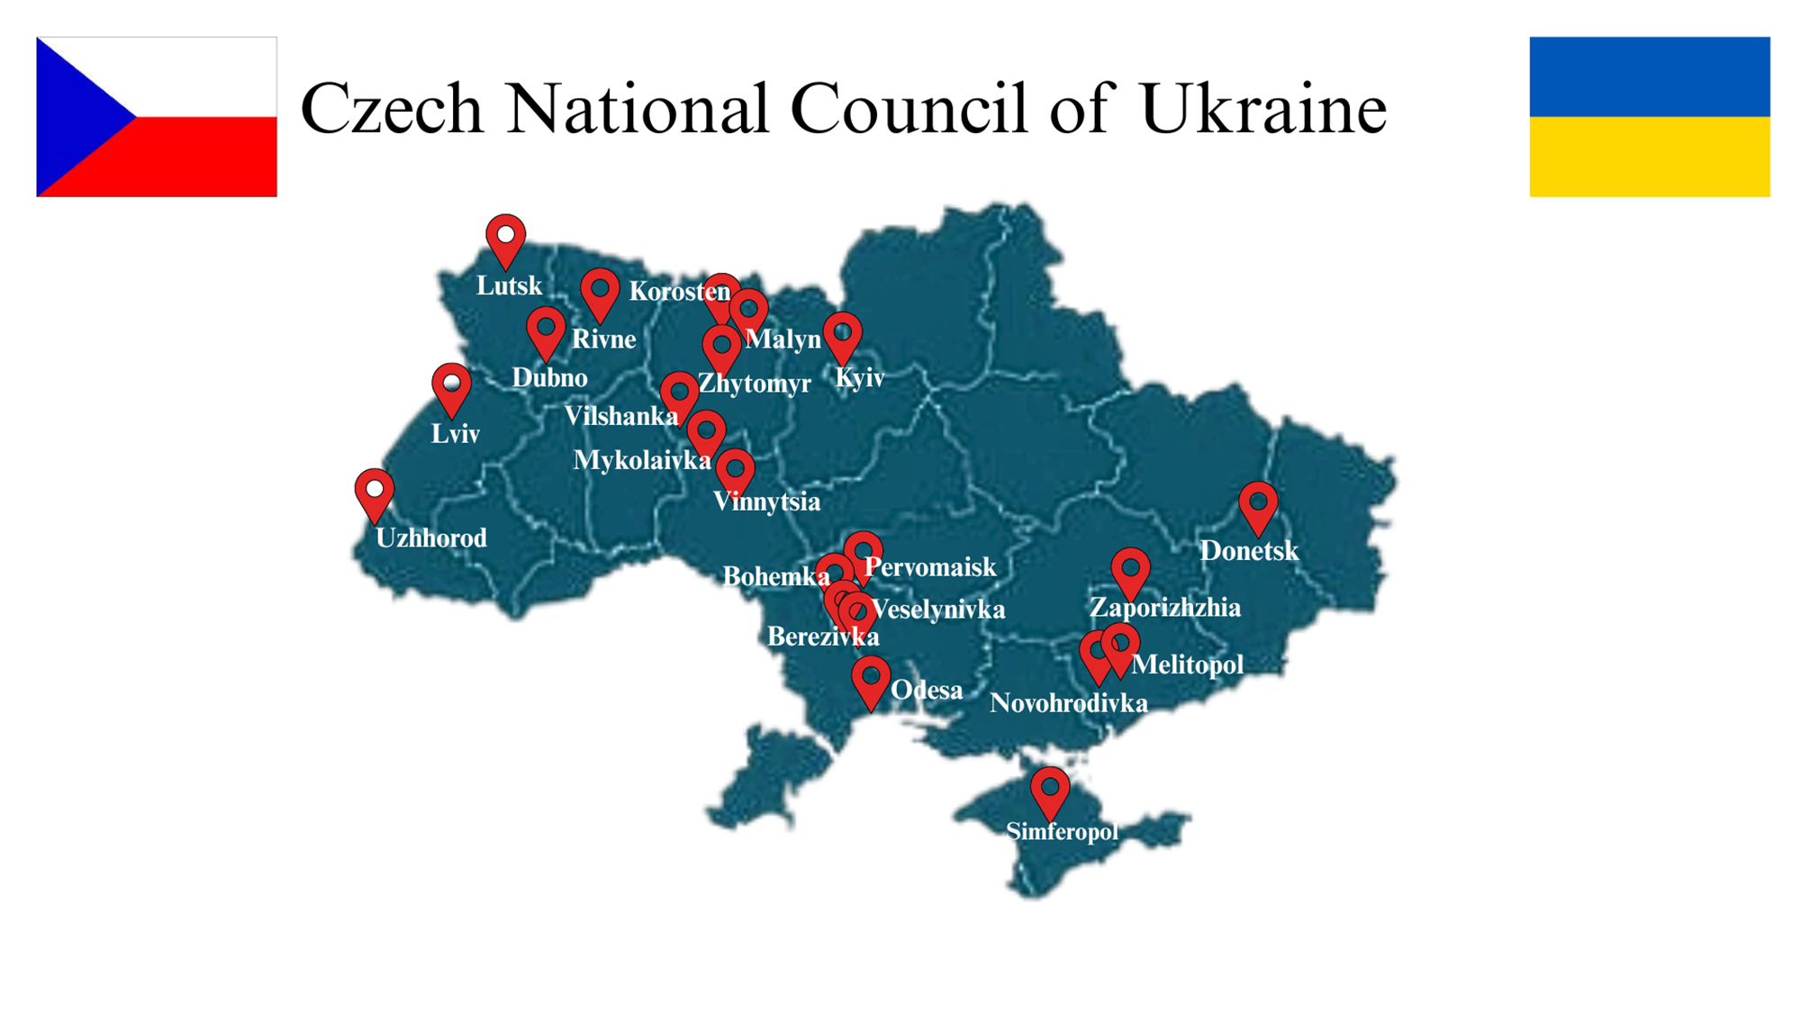

Czech National Council of Ukraine

Slide 4

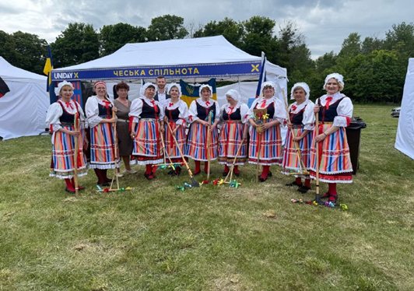
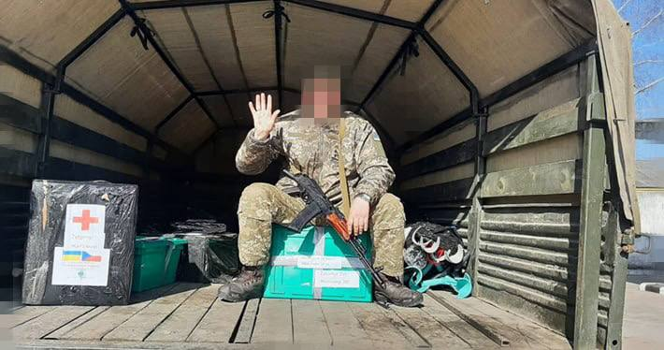
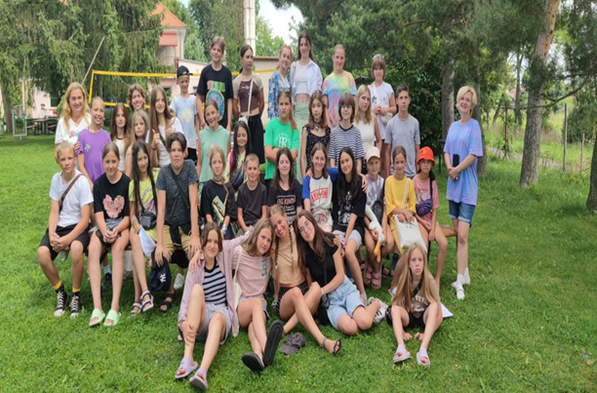
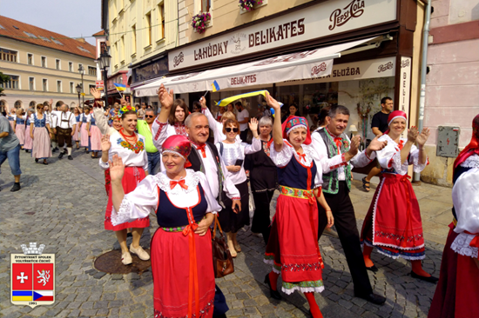
Czech minority of Ukraine

Slide 5
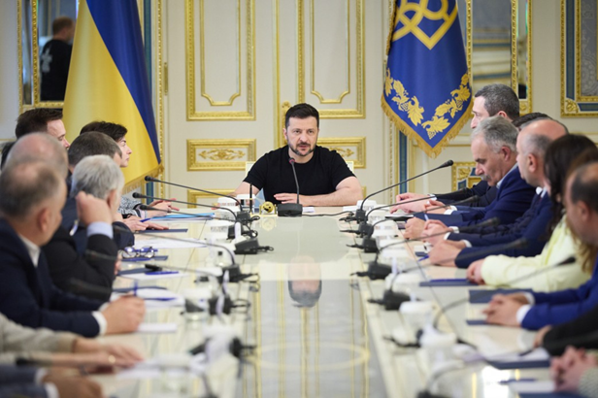
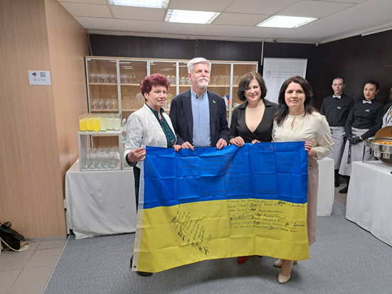
Czech minority of Ukraine

Slide 6
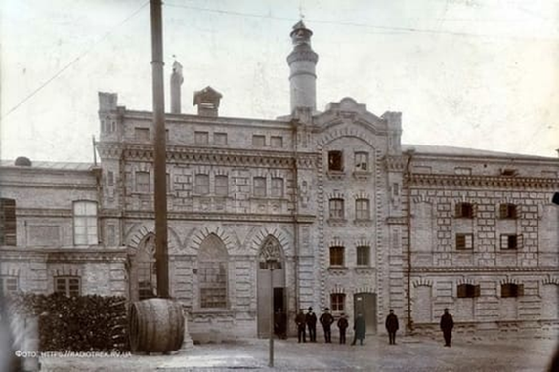
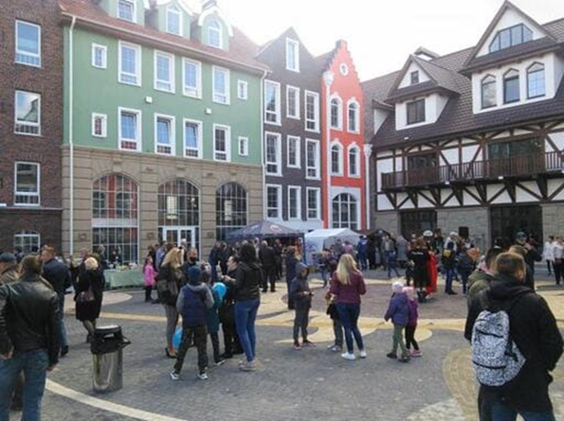

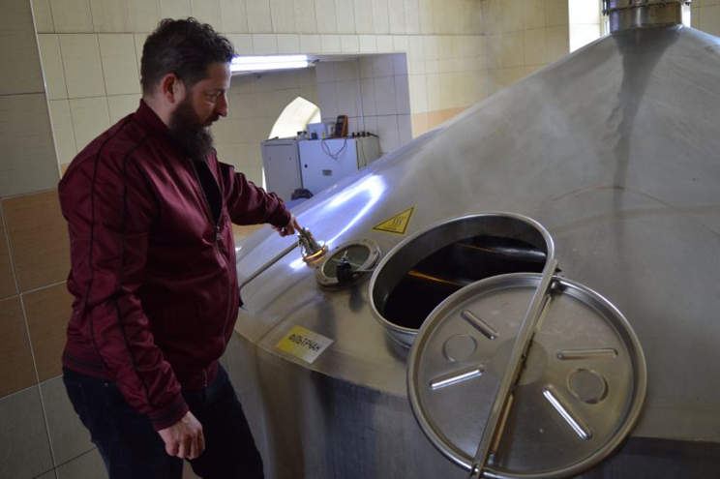
Diaspora and business: the brewery in Rivne

Slide 7
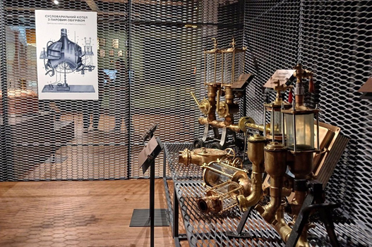
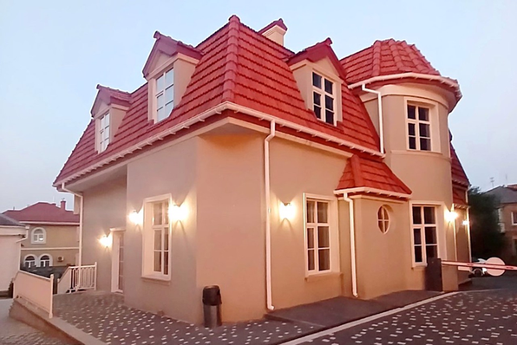
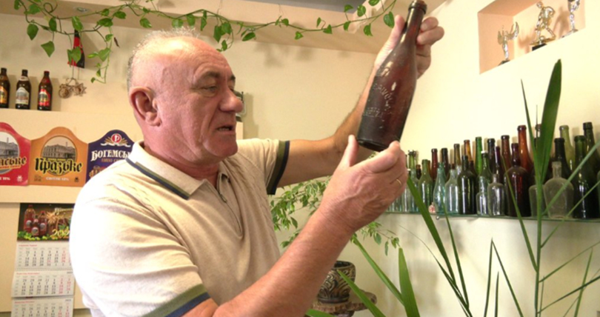
Diaspora and business: the brewery in Rivne

Slide 8
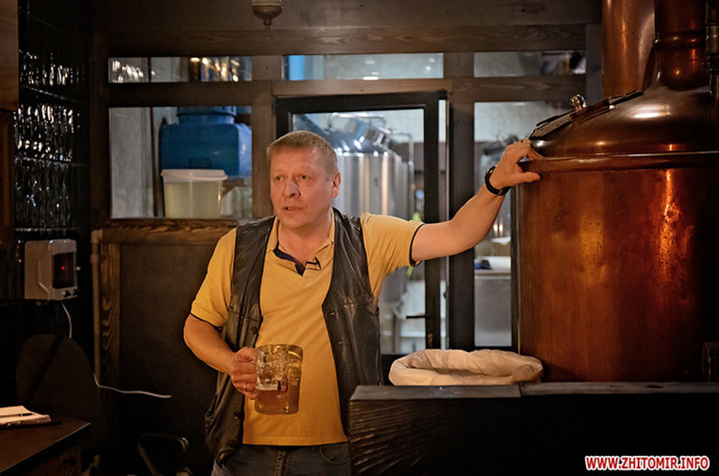
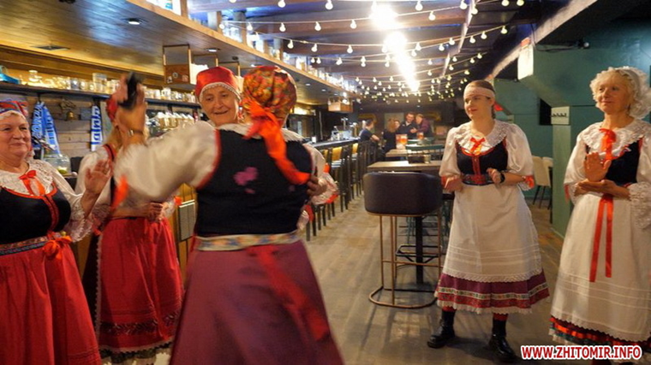
Diaspora and business: the brewery in Zhytomyr

Slide 9
Diaspora and business
Role of the Czech diaspora
  Social trust and reputation
  Cultural and communication advantages
  Corporate social responsibility

Slide 10
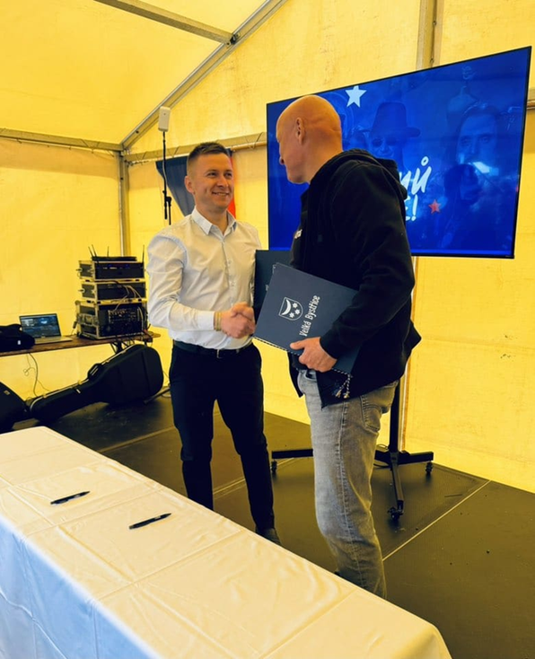
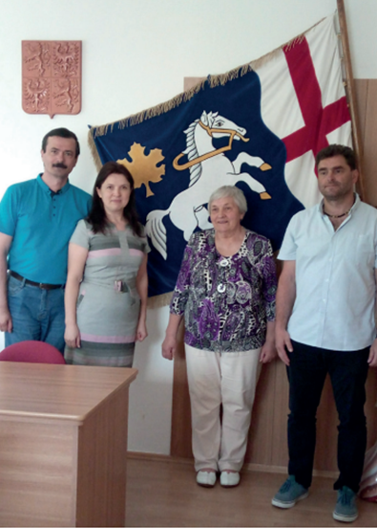
Сooperation agreements
Zhytomyr (UA) – Pardubice (CZ) (2022)
Mykolaivka (UA) – Yavornice (CZ) (2023)
Zboriv (UA) – Velka Bystryce (CZ) (2025)

Slide 11
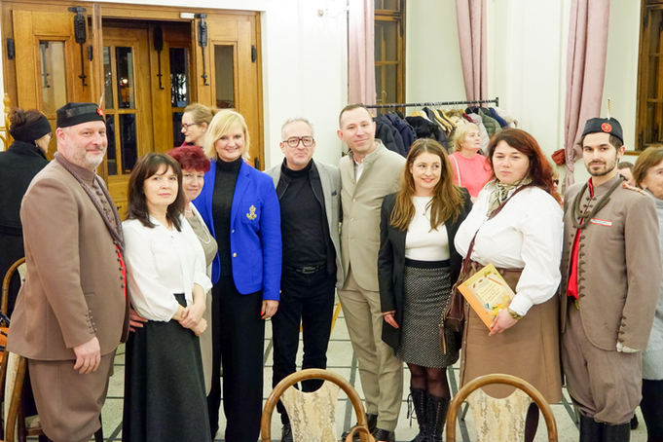
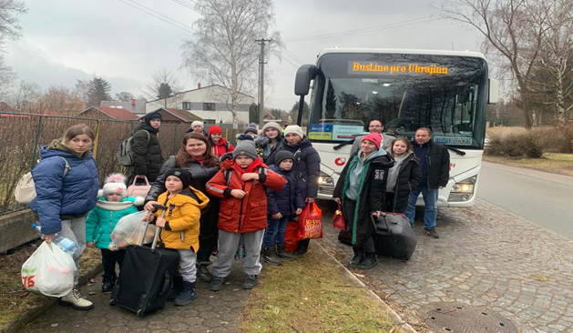
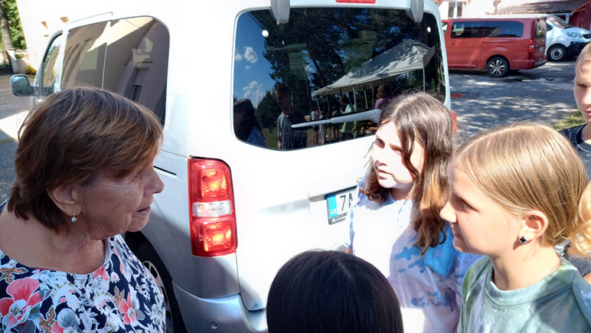
Сooperation agreements: Central Bohemian Region

Slide 12
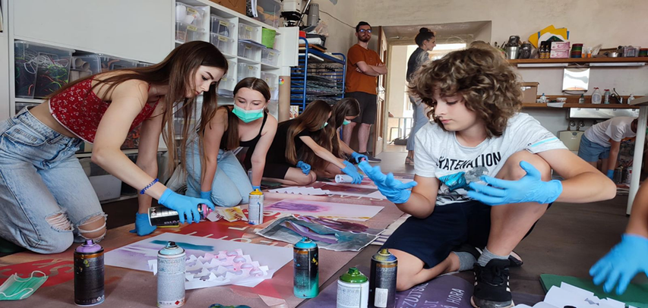

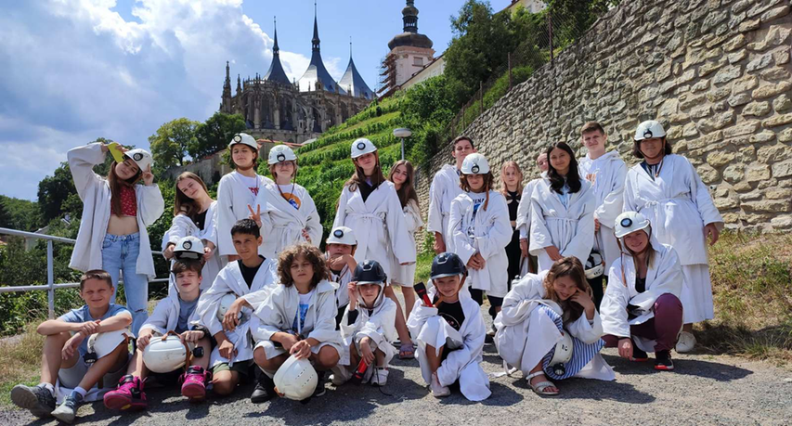
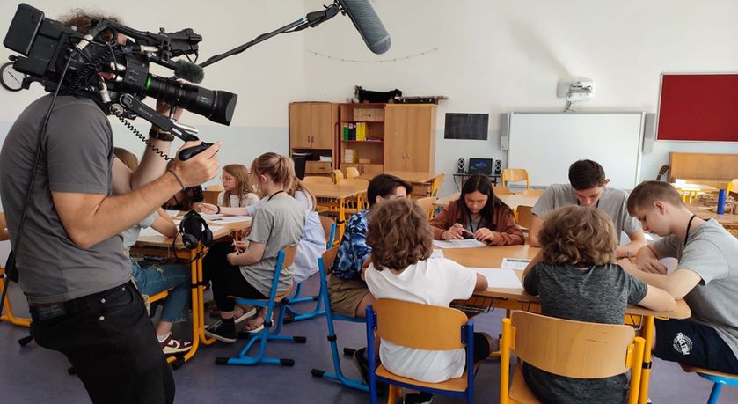

Slide 13
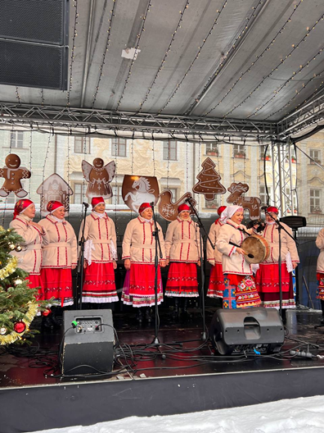
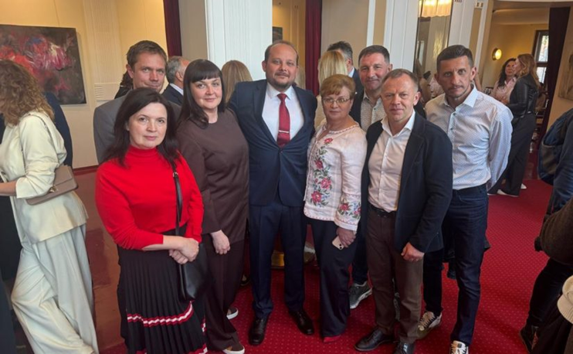
Сooperation agreements
Zhytomyr (UA) – Pardubice (CZ) (2022)

Slide 14
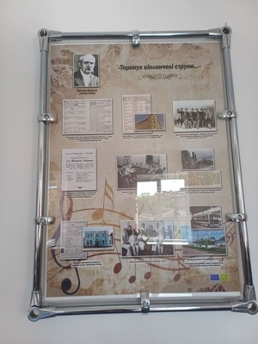
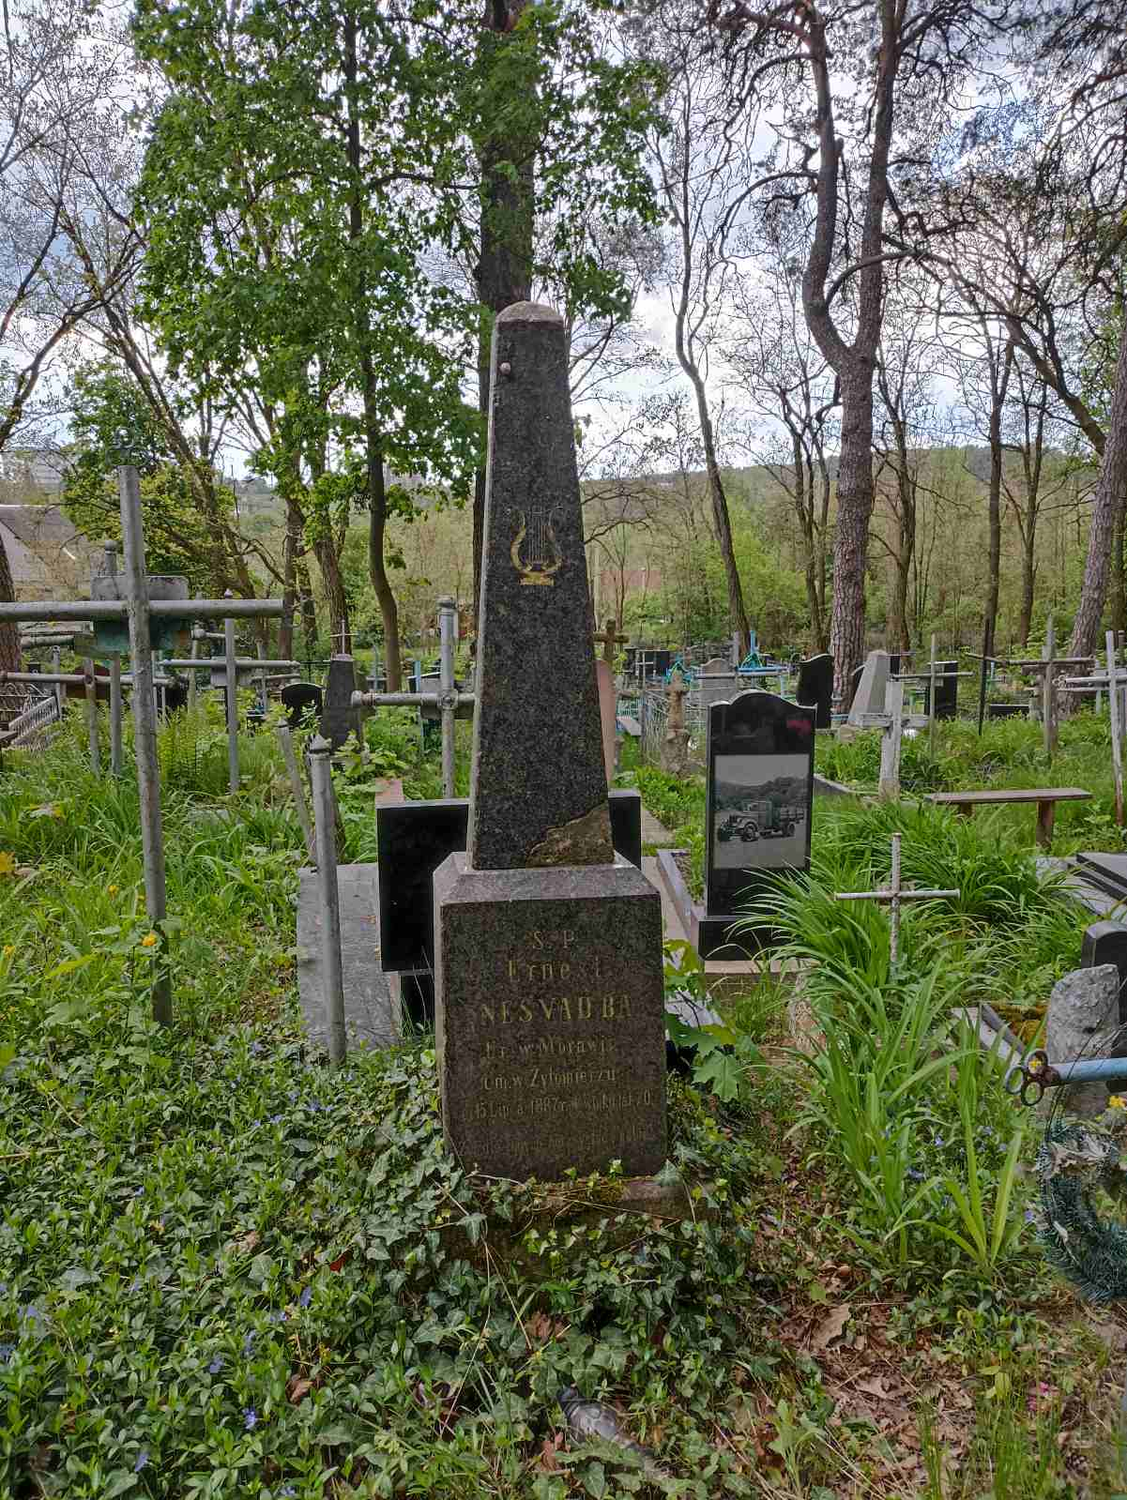
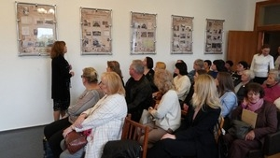
Сooperation agreements
Zhytomyr (UA) – Litomyšl(CZ) (2026?)

Slide 15
Diaspora and municipality
  Serving as a communication bridge
  Initiating joint projects
  Deepening cultural ties
  Supporting economic cooperation

Slide 16
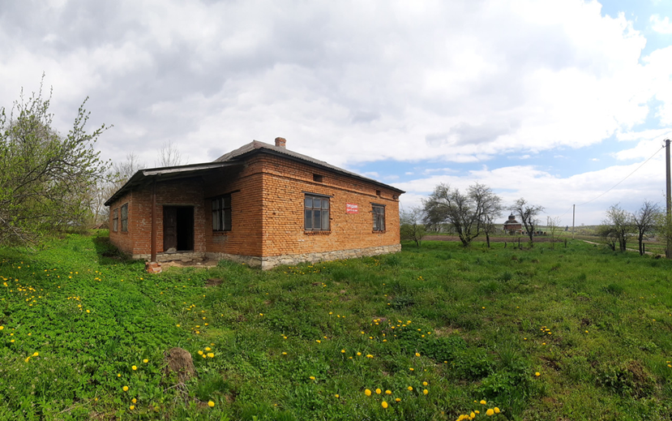

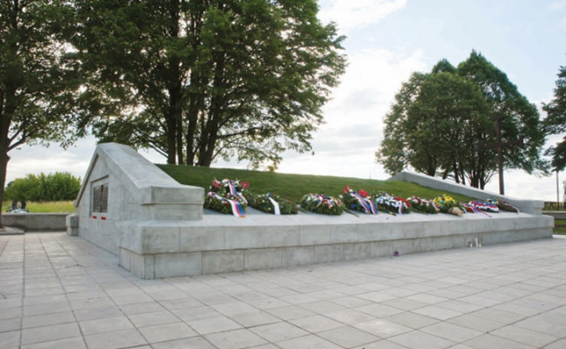
Hotel – museum – smart house
Zboriv, ​​Ternopil region

Slide 17

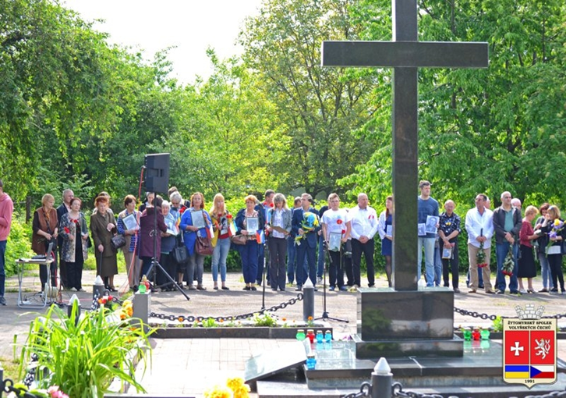
Sokol 1924

Slide 18
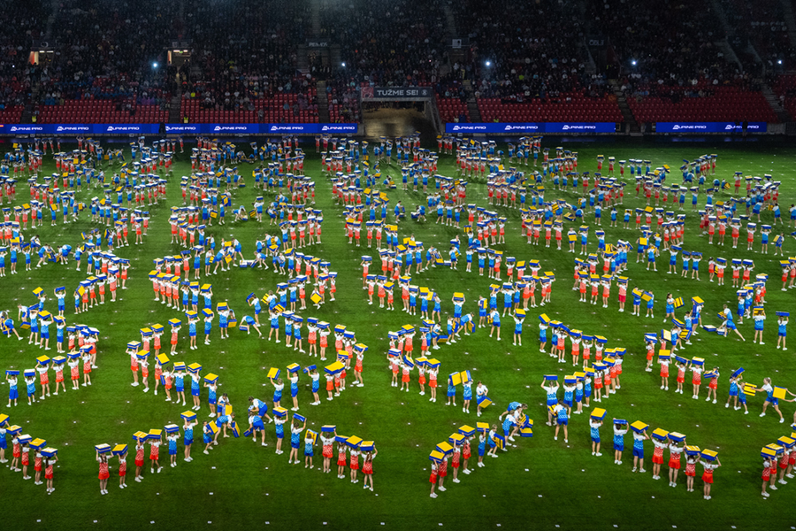
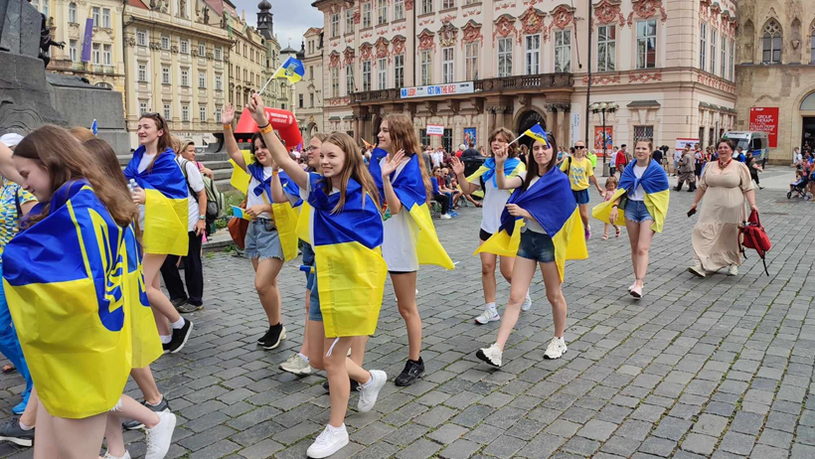
Sokol 2024 Сongress in Prague

Slide 19
Diaspora and the non-profit sector
  Help to establish partnerships
  Facilitate the exchange of knowledge and experience
  Build international civil society networks
  Supports and controls the implementation of projects

Slide 20
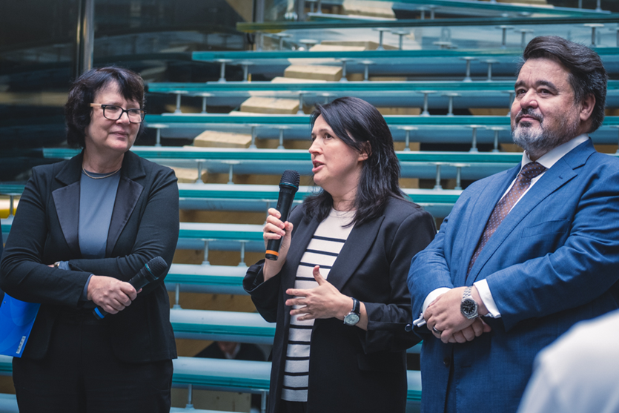
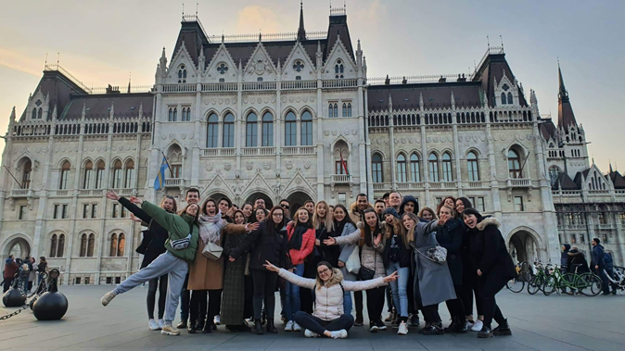
Diaspora and universities:
Vysoká škola ekonomická v Praze

Slide 21
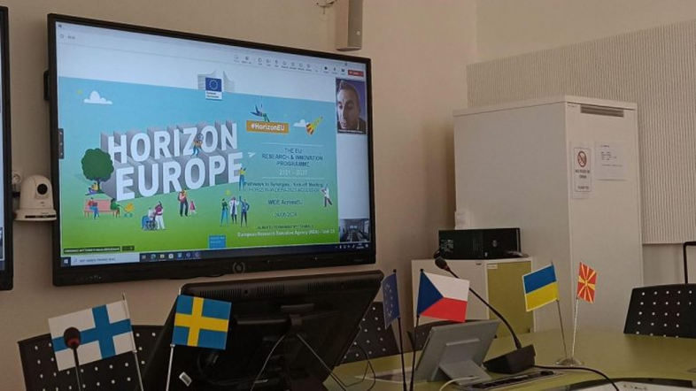
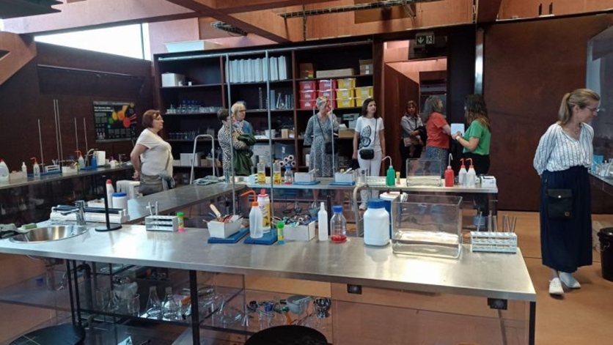
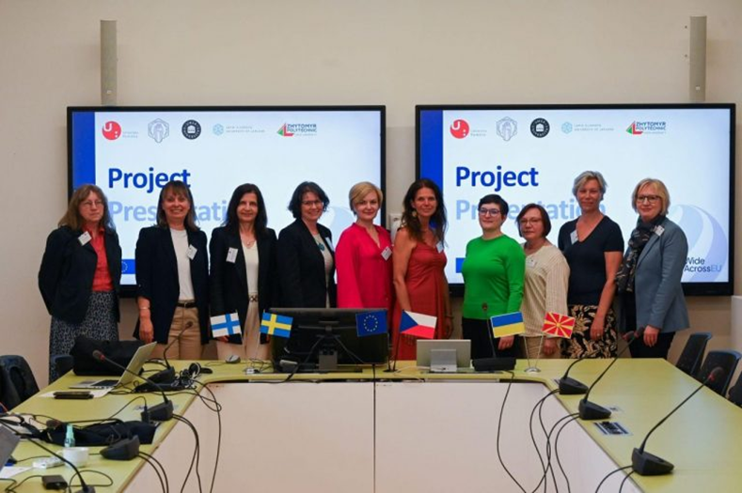
Diaspora and universities:
University of Pardubice

Slide 22
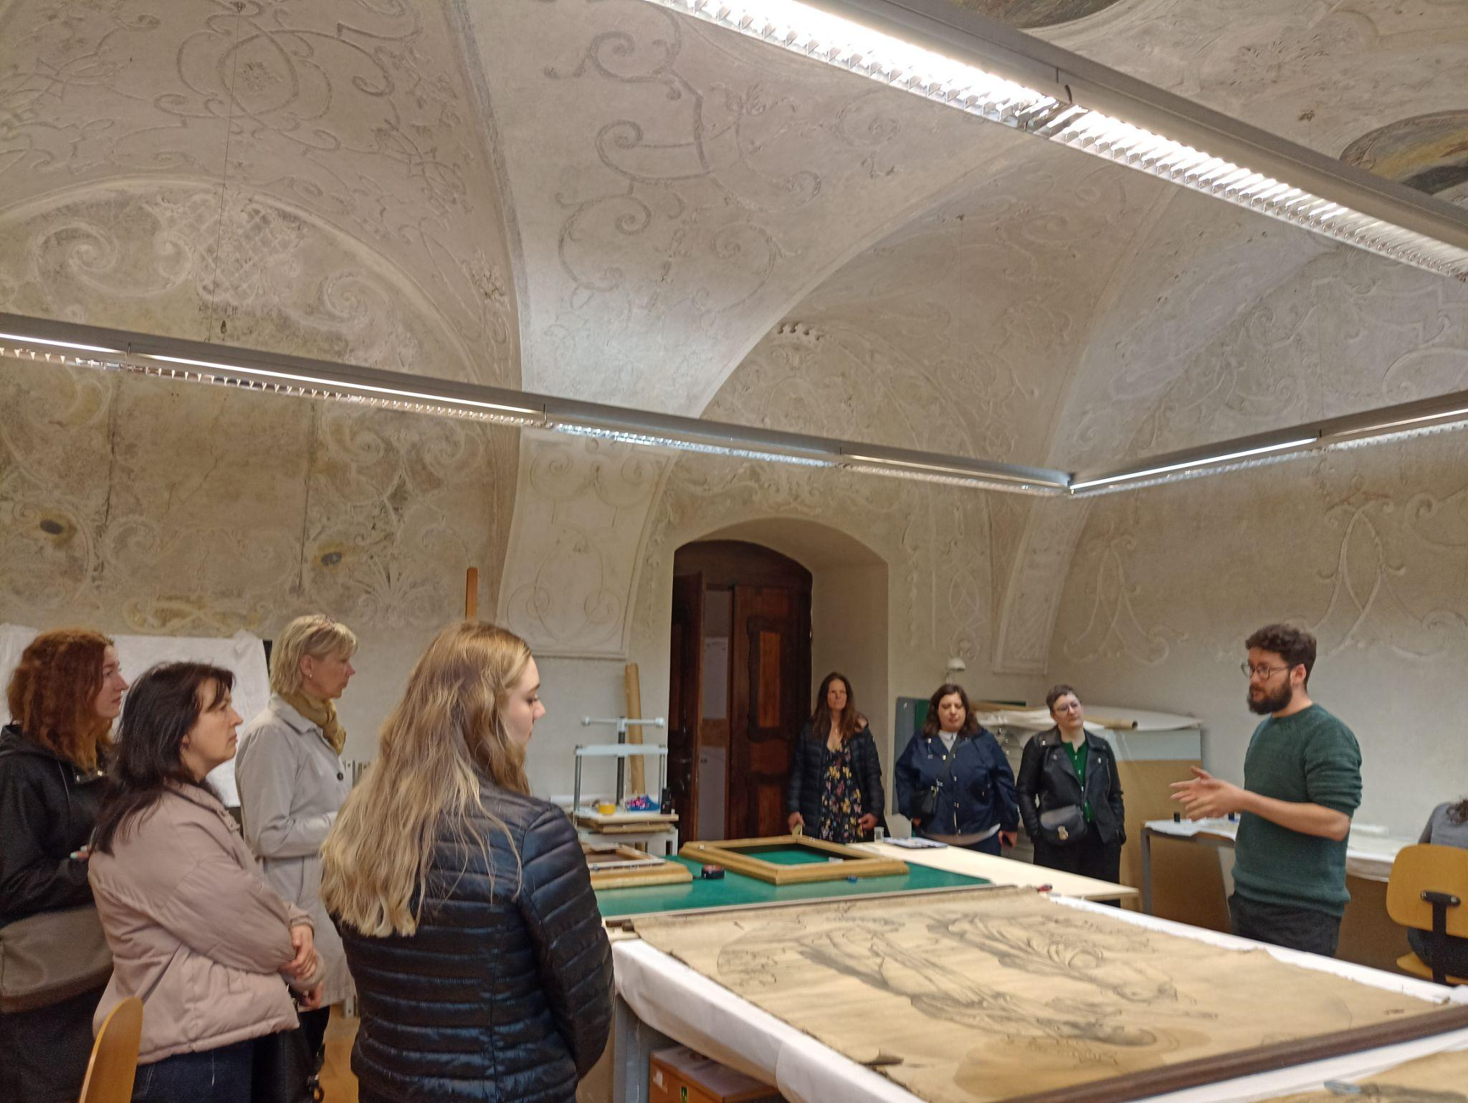
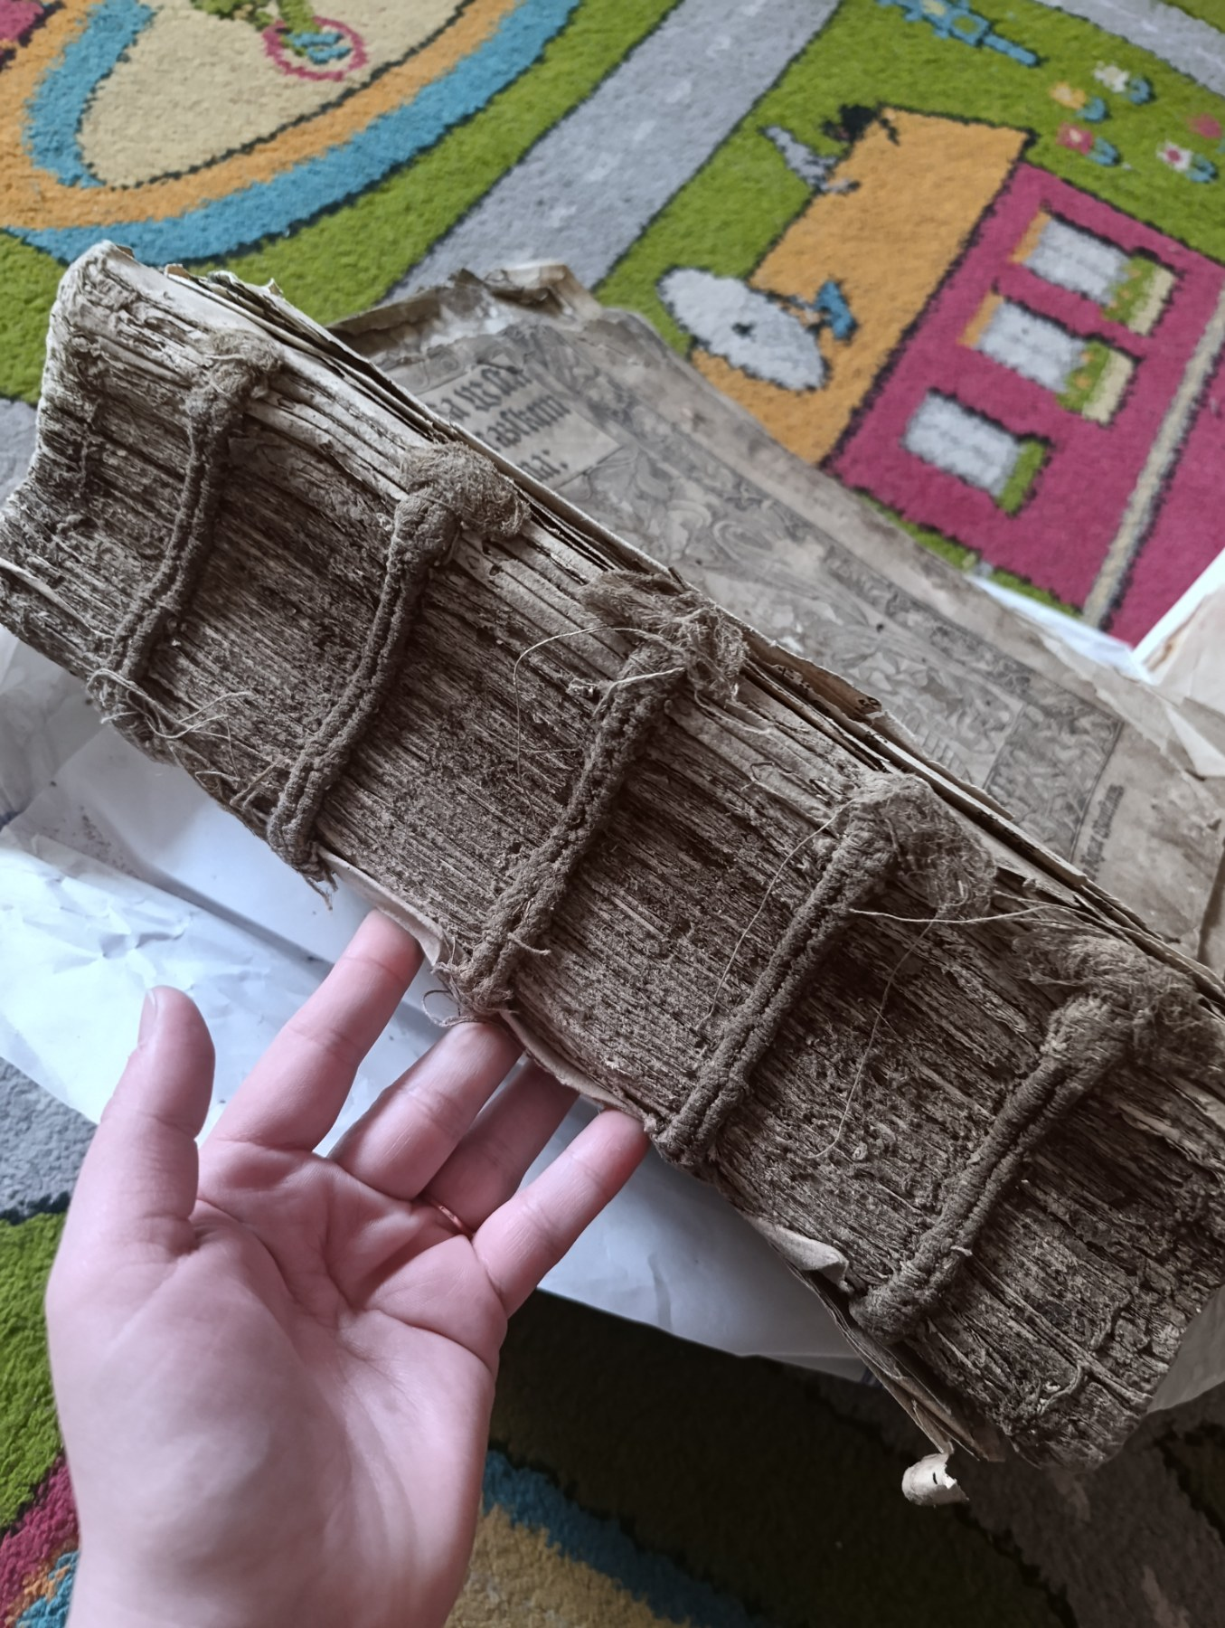

Diaspora and universities:
University of Pardubice

Slide 23
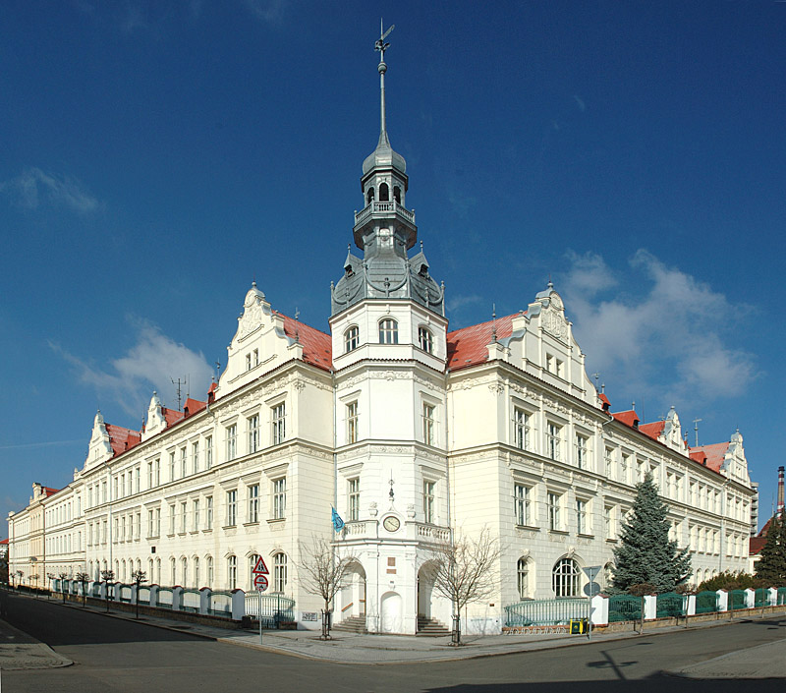
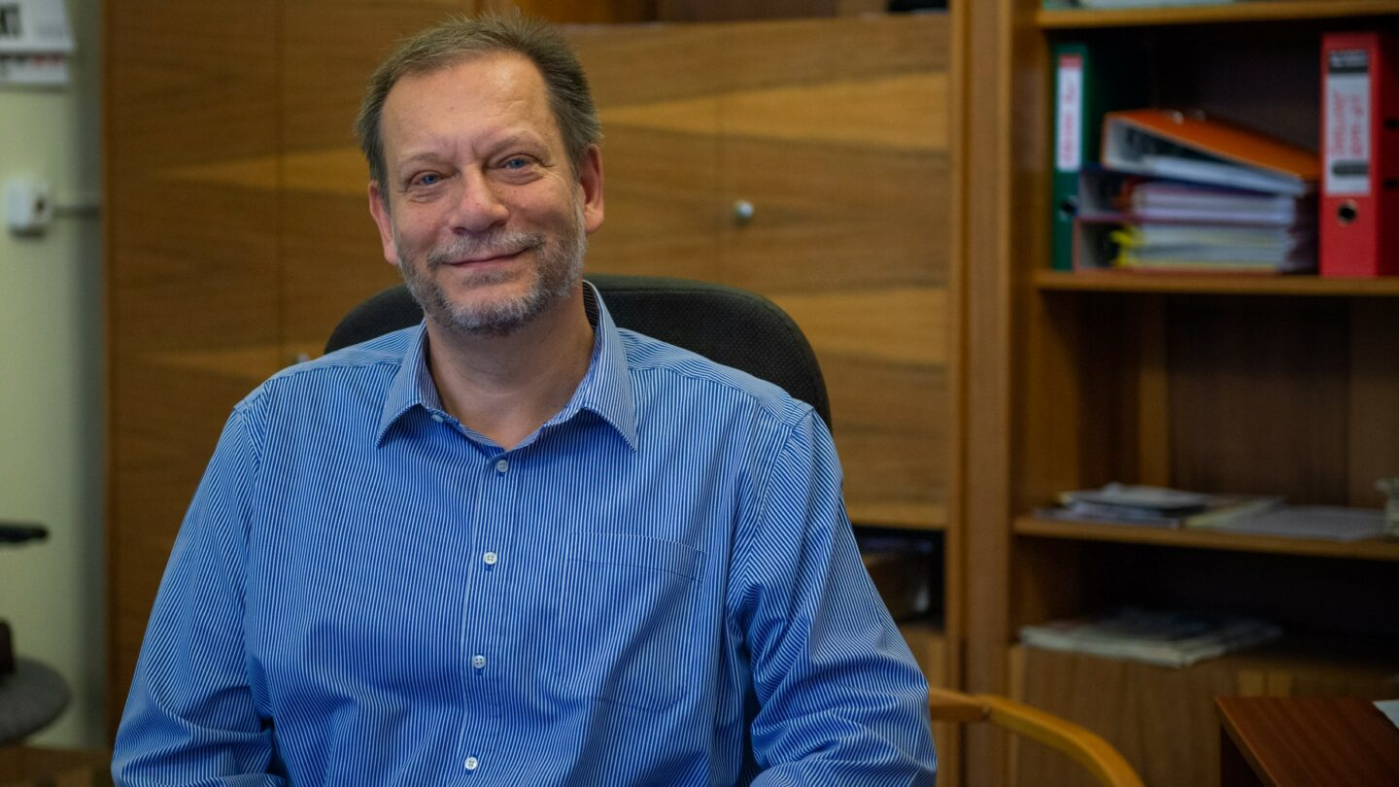
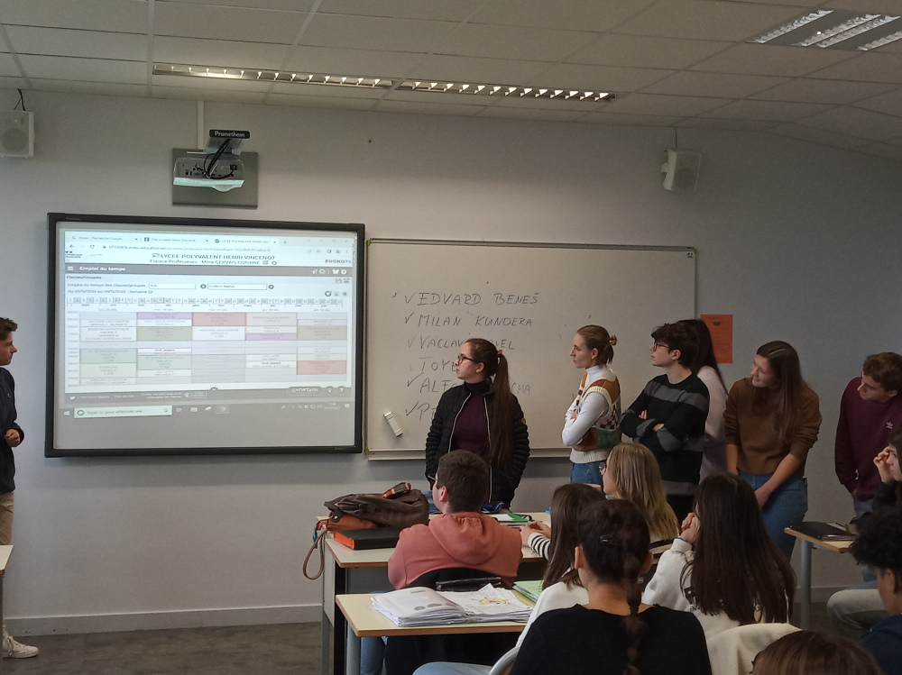

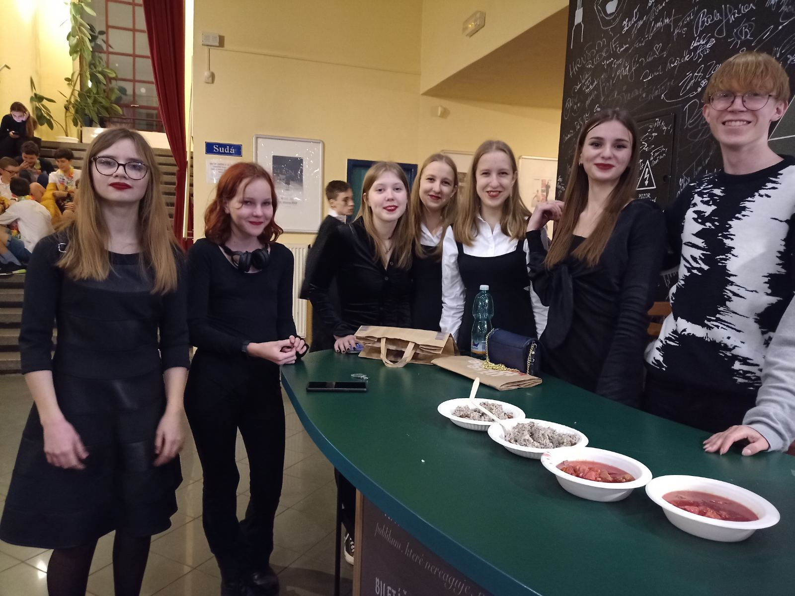
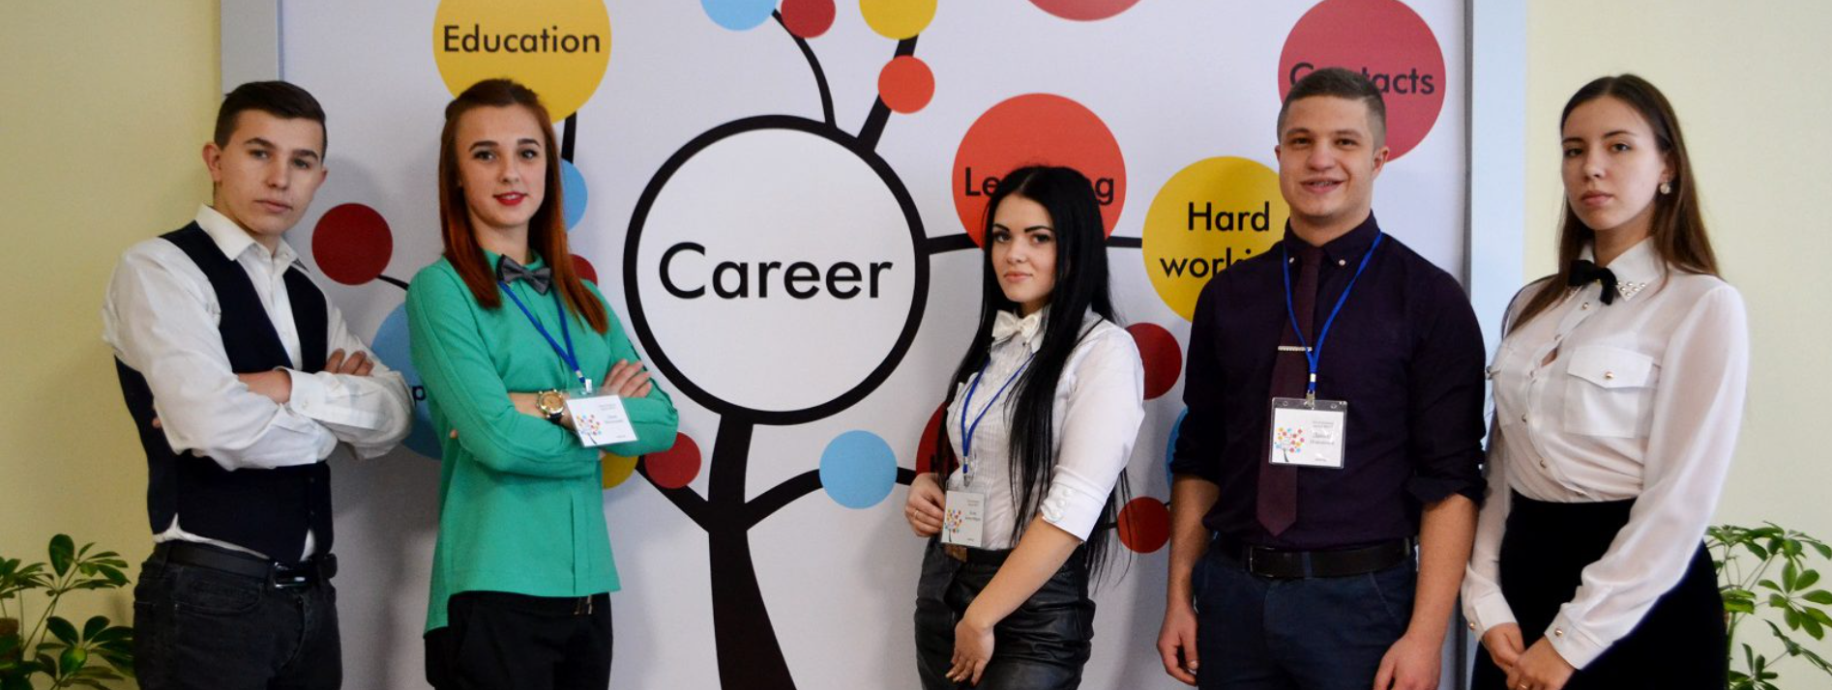
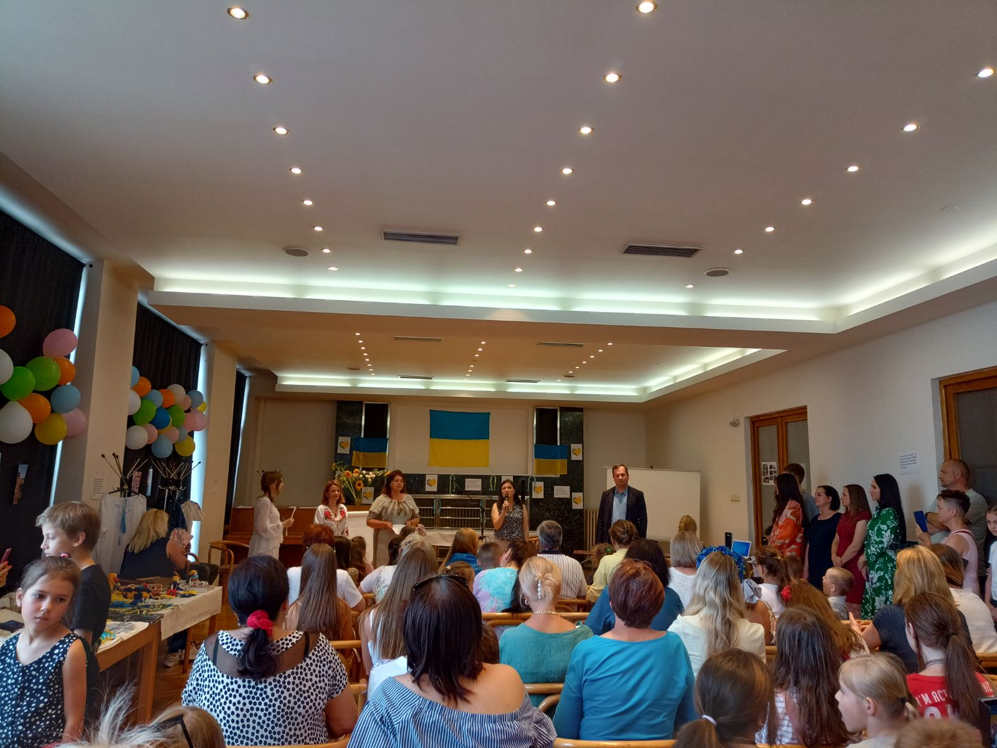
Support for Ukraine by the Gymnasium of Bohumil Hrabal in Nymburk: Humanitarian Aid, Joint International Projects, the Team Behind Initiative

Slide 24
Diaspora and universities
  Initiating partnerships
  Supporting academic mobility
  Promoting language learning

Slide 25
