Slide 1
Regional cooperation from the University view
Annika Nordstrand
Research Support and Collaboration Office
Umeå University, Sweden
April 17 2026, WIDE Across EU, Regional Collaboration for Innovation and Growth

Slide 2
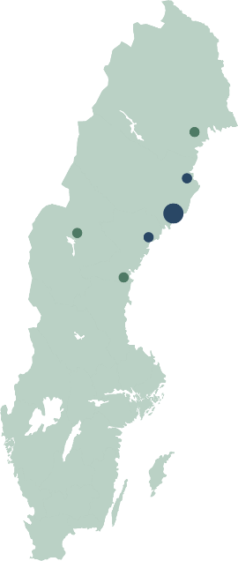
Umeå university
A broad university covering many fields
More than 41,500 students and 4,500 employees
Research, education and collaboration across disciplines
Internationally connected
Working closely with actors in the surrounding region

Slide 3


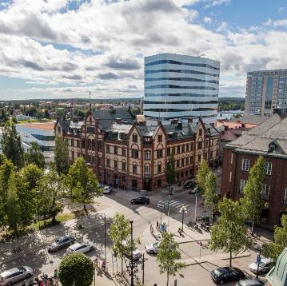
Regional contex
Coastal cities and a sparsely populated inland
Large distances across the region
Skellefteå
75 000
Västerbotten
280 000
Umeå
135 000

Slide 4
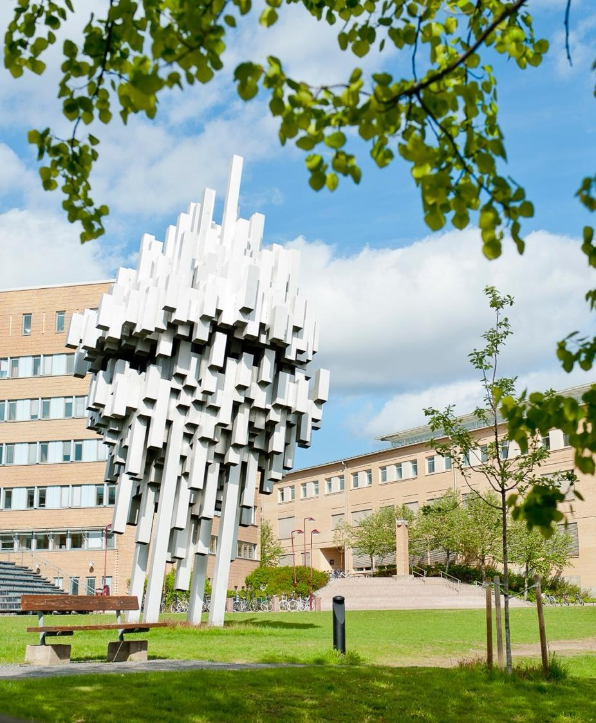
My role
Research Support and Collaboration Office
Work across faculties and disciplines
Supporting collaboration with regional actors

Slide 5
Three ways we support regional collaboration
Lowering thresholds – getting started
Staying connected over time
Supporting the next step

Slide 6
Lowering thresholds – getting started

Slide 7

AIMday – a regional meeting place
Questions from regional organisations
One question – one table – one hour
Focus on dialogue and understanding
Clear thematic focus
Physical meetings

Slide 8

The university’s role in AIMday
Organising the format
Proactive dialogue with external actors
Support in shaping questions for academic discussion
Matching questions and research expertise
Facilitating discussion

Slide 9
Examples of AIMday questions
How can municipalities plan for socially sustainable growth during rapid industrial transition?
What research perspectives can support recruitment and retention of staff in welfare and healthcare?
How can organisations handle major organisational change with limited resources?
What knowledge is needed to support young people’s participation and inclusion in local communities?
How can digitalisation be used without increasing inequality or exclusion?

Slide 10
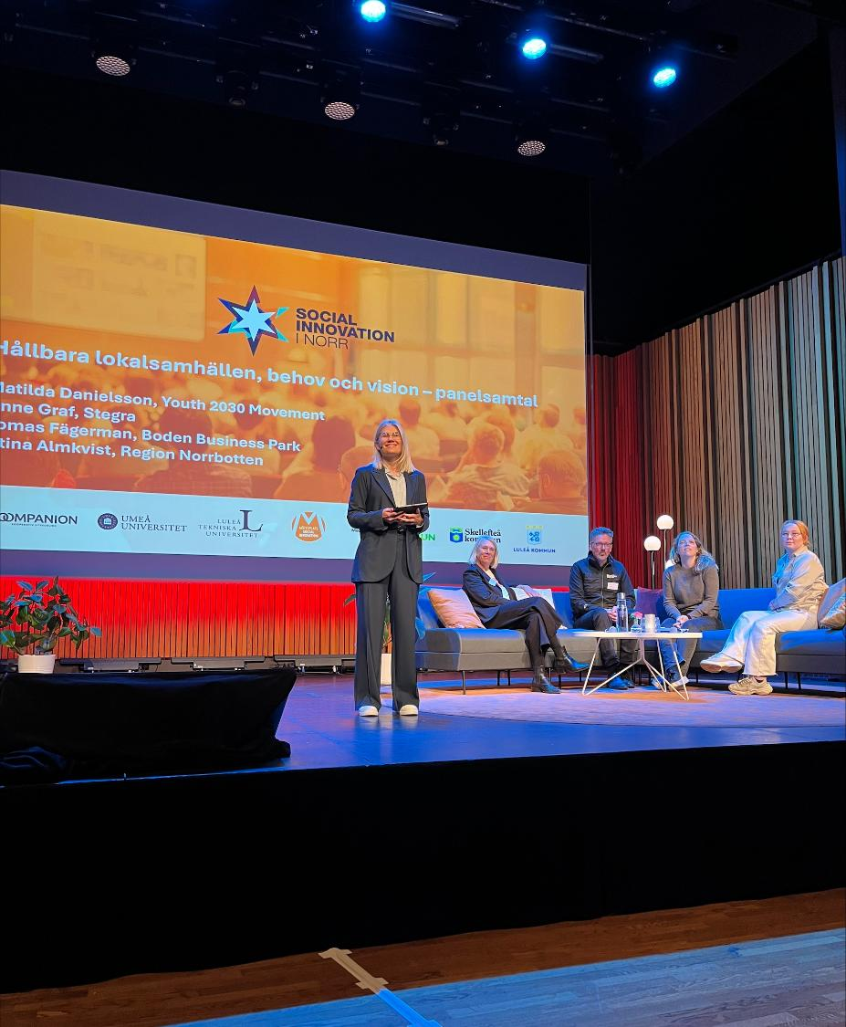
Social Innovation Northen Sweden
A regional platform for cross‑sector collaboration on social innovations
Brings together academia, public sector, civil society and social entrepreneurs
Focus on social sustainability and complex societal challenges
An open meeting place for inspiration, learning and first connections

Slide 11
Staying connected over time
Regional collaboration beyond individual meetings

Slide 12


Strategic partnerships with regional actors
University‑wide, long‑term collaboration
Strong involvement at leadership level on both sides
Shared priorities across education, research and regional development

Slide 13

How our strategic partnerships work
Jointly defined focus areas linked to regional priorities
Annual planning and regular follow‑up within each partnership
Dedicated coordinators on both sides enabling continuous dialogue
Interaction at multiple levels:
  Leadership dialogue
  Coordinating functions
  Operational collaboration in research and education

Slide 14
What strategic partnerships enable
Easier entry points for new collaboration across the university
Continuous dialogue on education, research and shared regional challenges
Joint meeting arenas organised within the partnership
  e.g. partnership days and thematic dialogue meetings
Active engagement in each other’s major arenas and events
  contributing to existing regional meeting arenas
Trust‑based relationships that make it easier to move from ideas to action

Slide 15
Examples of strategic topics discussed at leadership level
How changing economic conditions affect our ability to prioritise
How political decisions, new regulations or funding models impact each organisation’s mission
The role of the university and its campuses in creating an attractive and vibrant city
Long‑term competence supply and skills needs in the region
Demographic change and its implications for welfare, labour markets and education

Slide 16
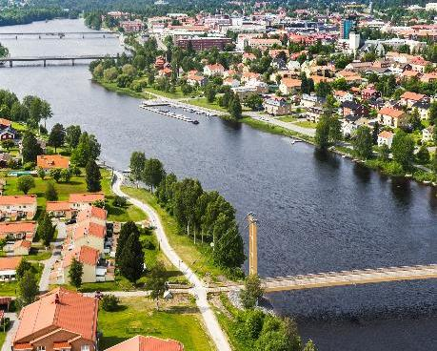
Urban Transition Lab
An example of what long-term collaboration has led to
Joint collaboration platform between Umeå University and Umeå Municipality
Emerged out of a long-term strategic partnership
Creates a continuous interface between research and municipal practice

Slide 17

Urban Transition Lab
Urban challenges are explored together by researchers and municipal staff
Key focus areas:
  Sustainable urban development
  Climate impact and transition
  Competence supply and labour market resilience
  Growth and regional development
Activities:
  Regular workshops and joint meetings
  Co‑creation of research questions
  Joint research applications and funded projects

Slide 18

Partnership days
Thematic meeting days linked to each partnership’s focus areas
Bring together researchers, teachers and partner organisations
Combines:
  Inspiring examples of ongoing collaboration
  Joint discussion of current challenges
  Time for informal meetings and networking

Slide 19

Challenges in working with strategic partnerships
Require long‑term commitment and continuous prioritisation
No dedicated funding
Much of the work relies on coordinators to keep the collaboration moving
Risk of being too leadership‑driven if not well anchored internally

Slide 20
Different levels of partnerships
Strategic partnerships
University‑wide
Leadership‑level engagement
Long‑term, broad scope
Partnerships
More focused scope
May involve a faculty, centre or discipline
Can include one or several external actor

Slide 21

Long‑term cooperation through letters of intent
Shared long‑term commitment
University-wide
Address regional needs such as competence supply and lifelong learning
Provide stable frameworks for cooperation across organisations

Slide 22

Regional key actor meetings
Jointly organised by the two northern universities
Bring together multiple regional actors at the same table
Focus on education, research and regional knowledge needs
Create shared understanding across sectors and organisations

Slide 23
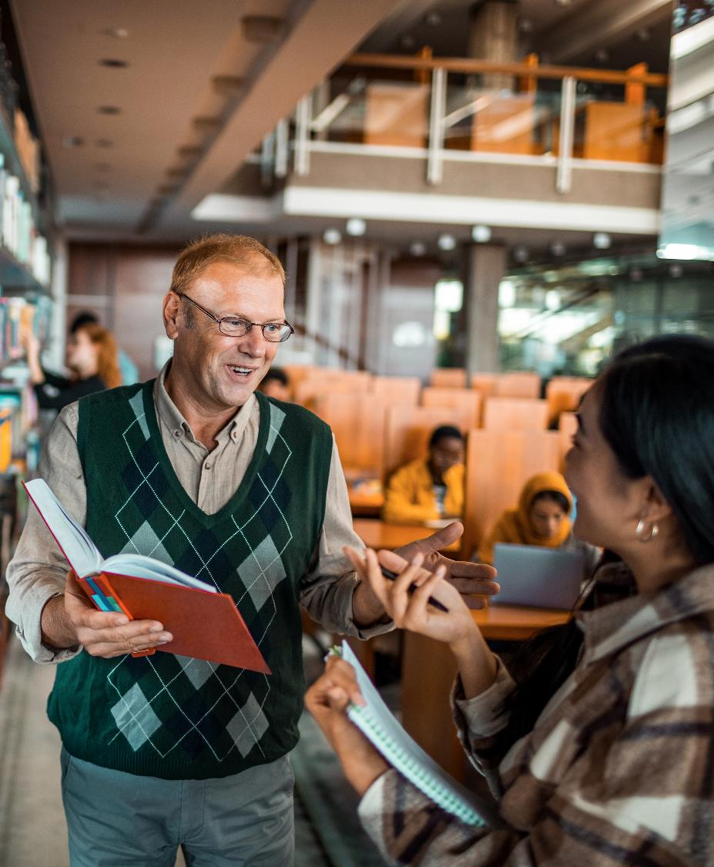
Cooperative education Co‑op
Structured collaboration between education and regional employers
Students alternate between studies and paid work periods
Creates long‑term contact between the university and organisations
An example of education as regional collaboration infrastructure

Slide 24
Supporting the next step

Slide 25

Seed funding for regional collaboration
Small, early‑stage funding
Used to explore ideas and cooperation with regional actors
An appreciated support among researchers and partners
Can create good conditions for applying for external research funding

Slide 26
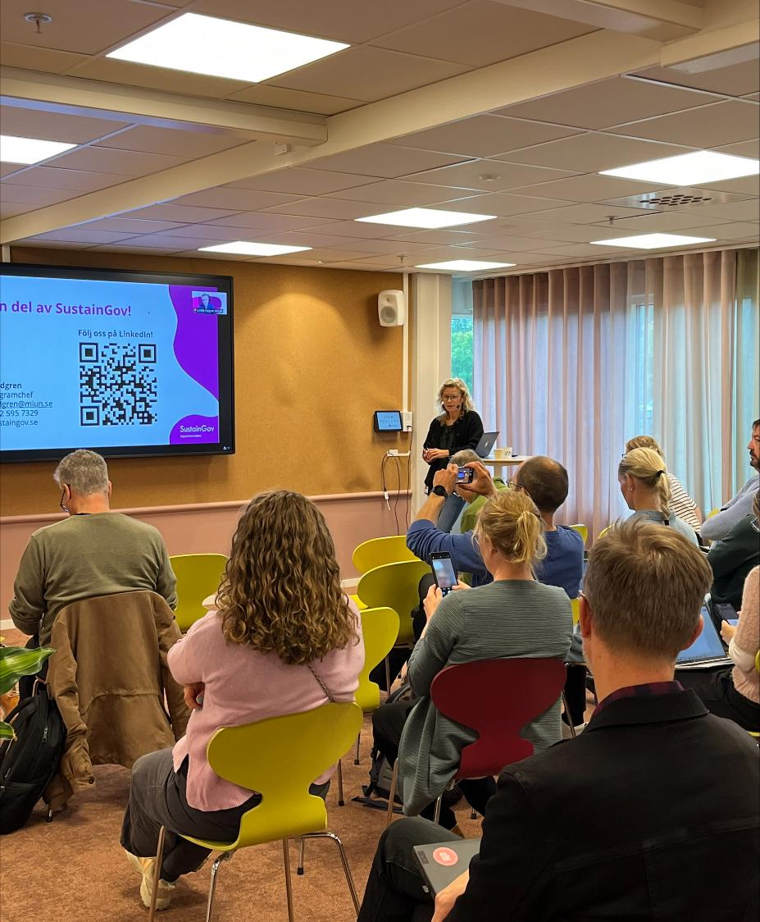
Information and dialogue meetings
Occasional information meetings linked to major collaboration‑oriented calls
Can combine:
  Information about the call and available support
  Dialogue on the thematic focus of the call together with external actors

Slide 27
Three ways we support regional collaboration
Lowering thresholds – getting started
Staying connected over time
Supporting the next step

Slide 28
Thank you!

