Slide 1
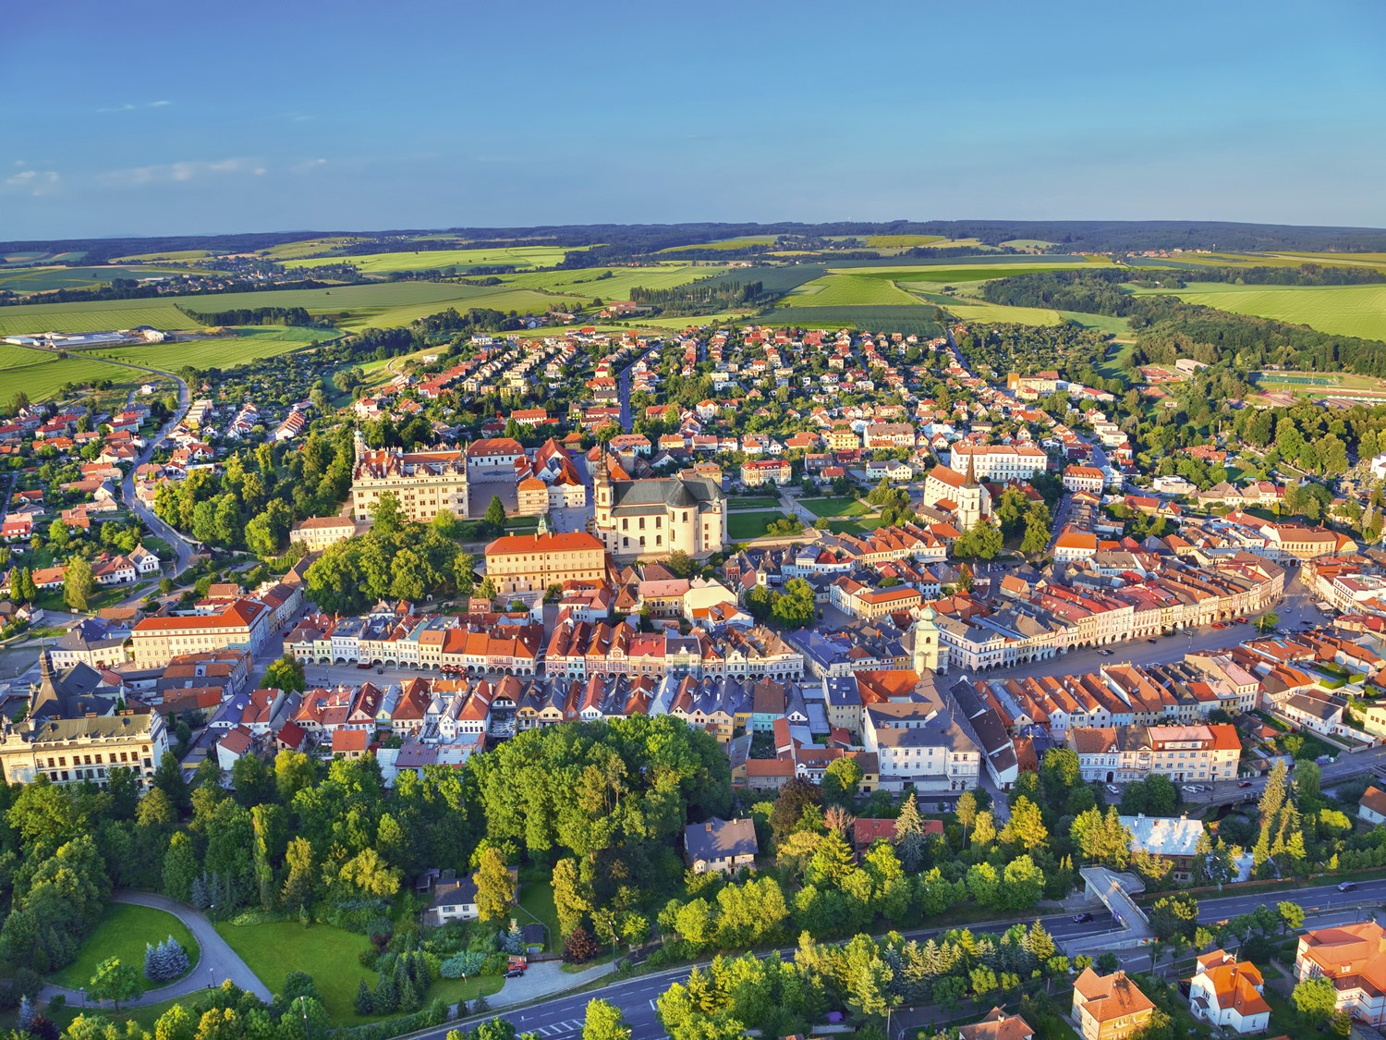


A Modern Historical Town

Slide 2
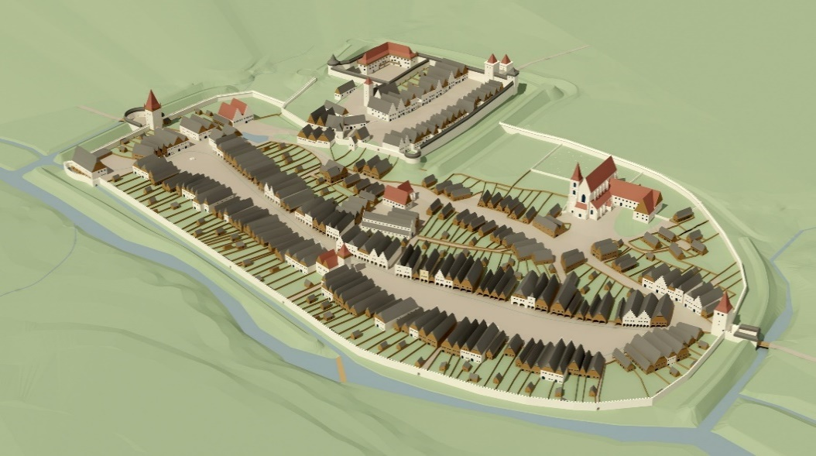
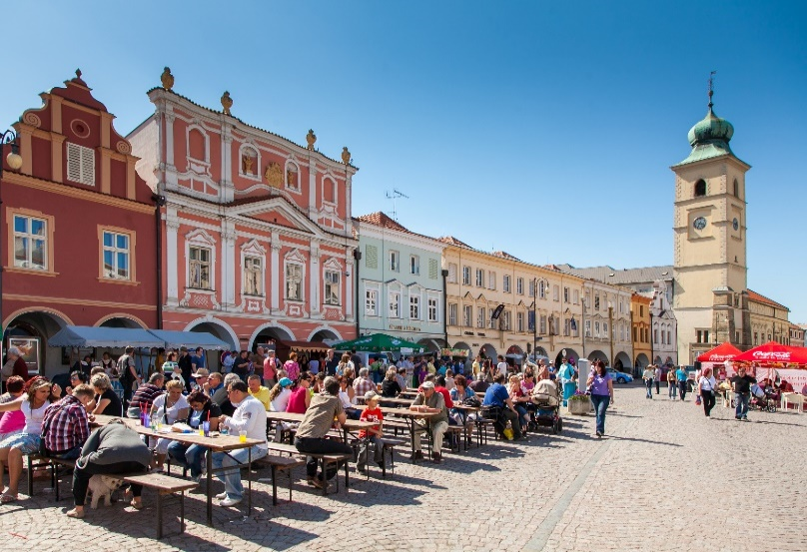
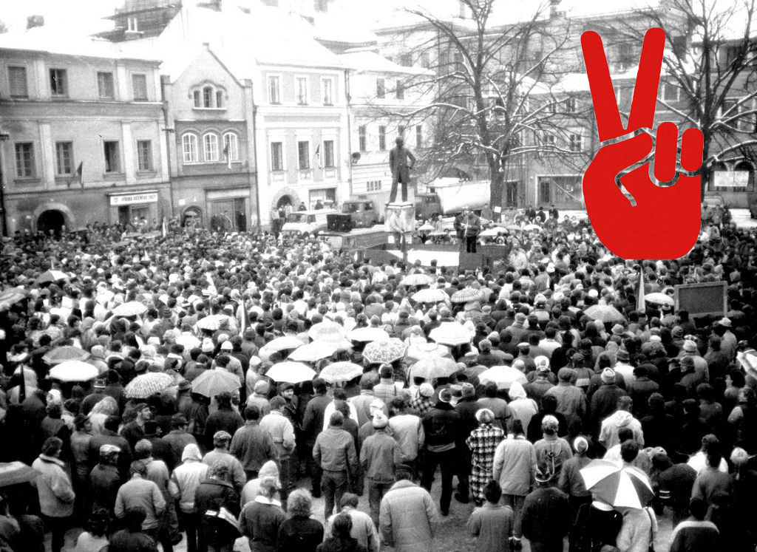
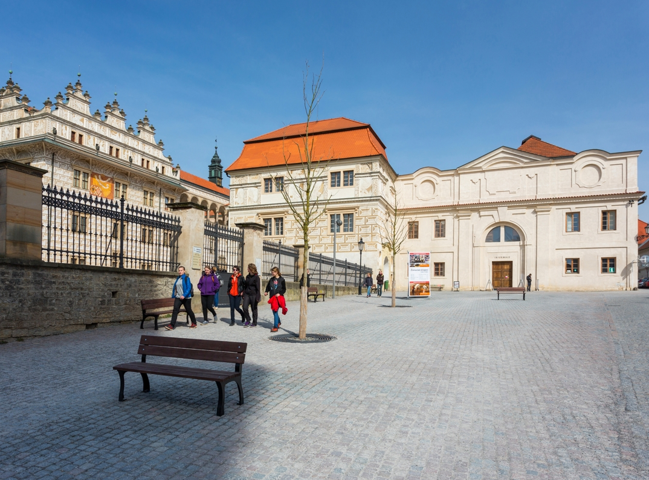

Litomysl – the Town for People
Litomyšl: a traditional Czech small town
Carefully chosen location
Natural, high-quality urban design
The square as the heart of life
Public spaces with attention to detail
Shortcuts, passages
Generosity in urban planning

Slide 3
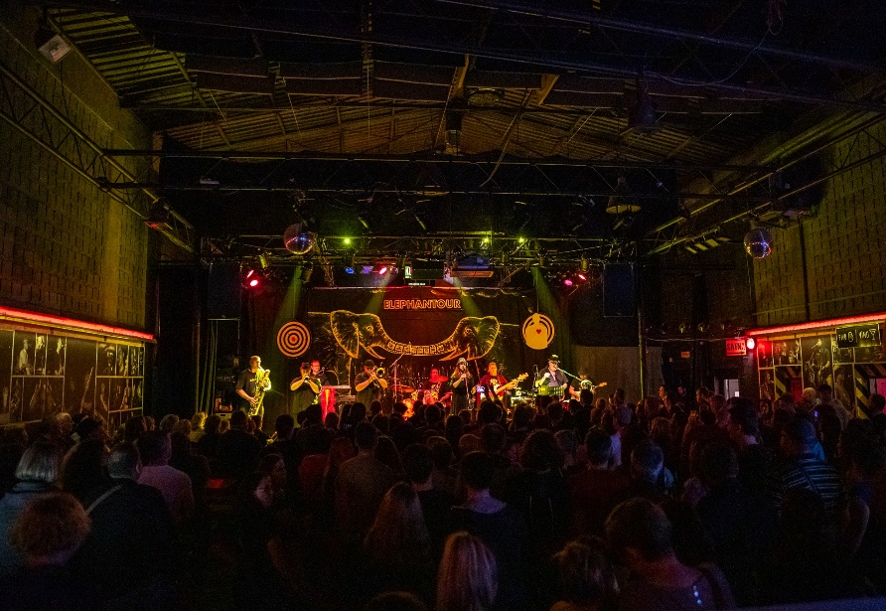
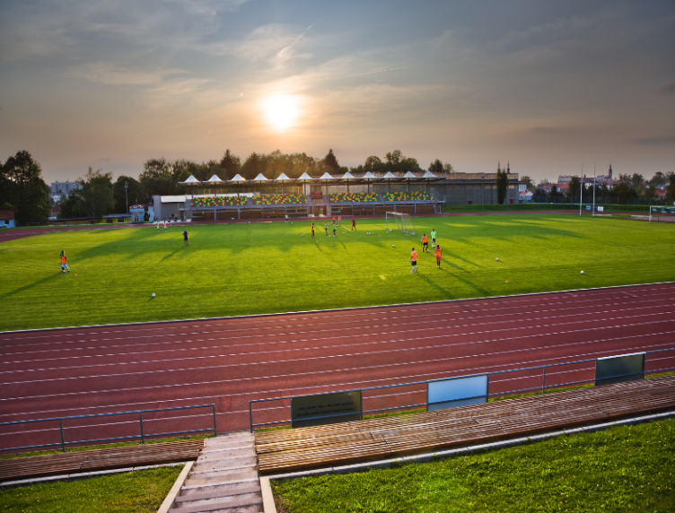
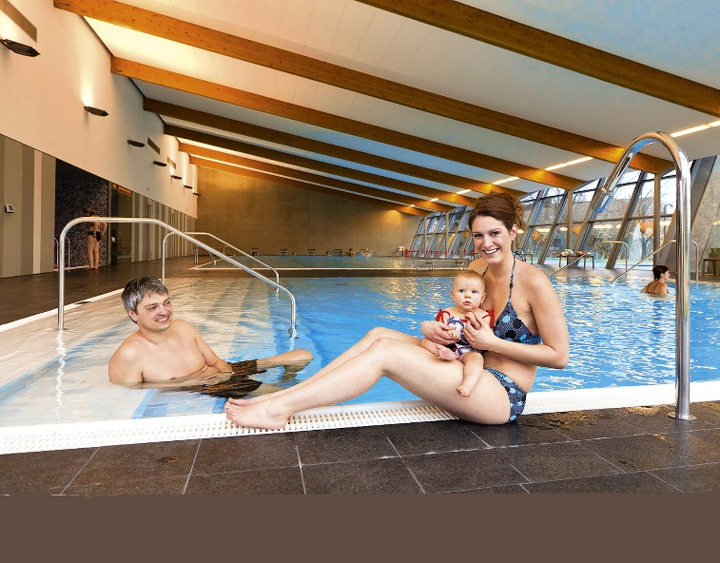
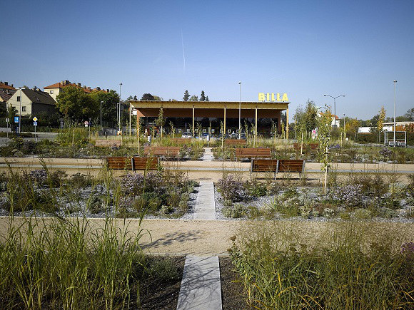
Life in Litomyšl
Culture for all generations (including the city’s family center)
Sports facilities
Hospital
Ecumenical spirit
Safety
Everything within walking distance
A city of education (since 1640!)
Voters with conservative values

Slide 4
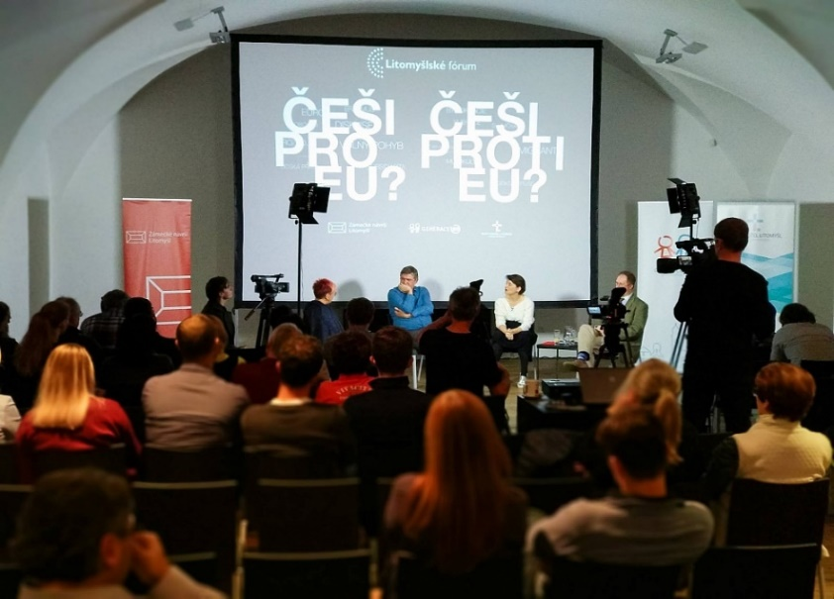
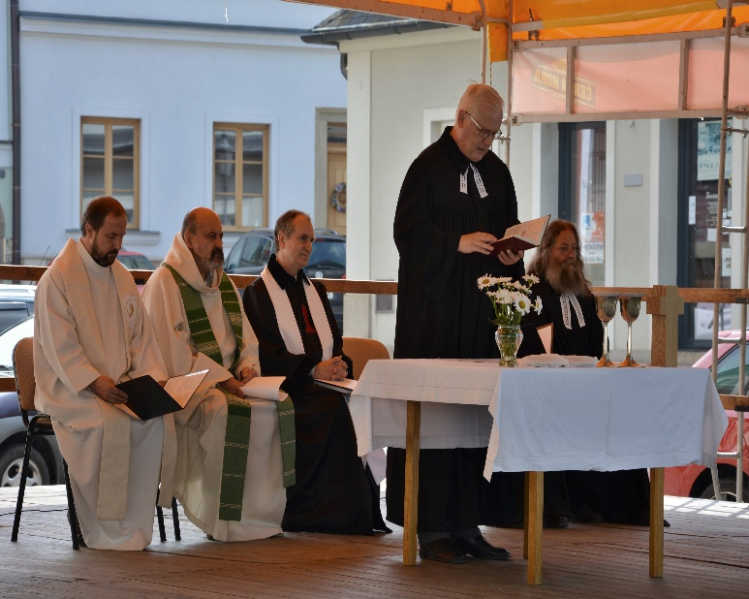
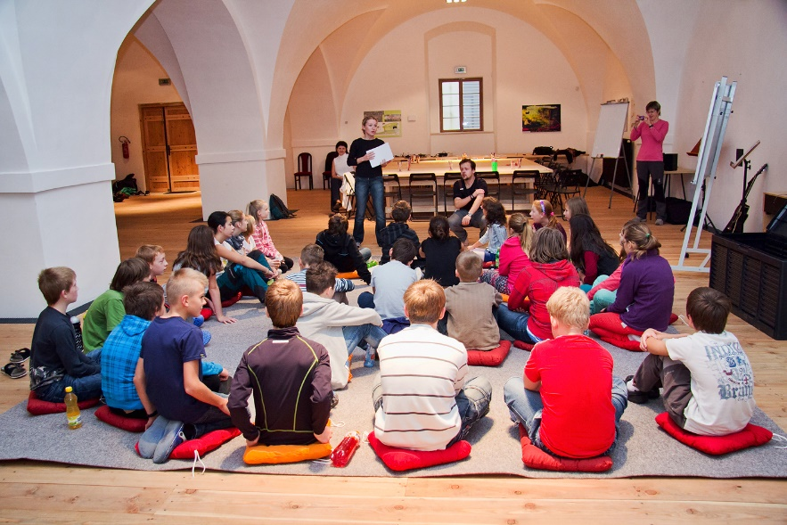
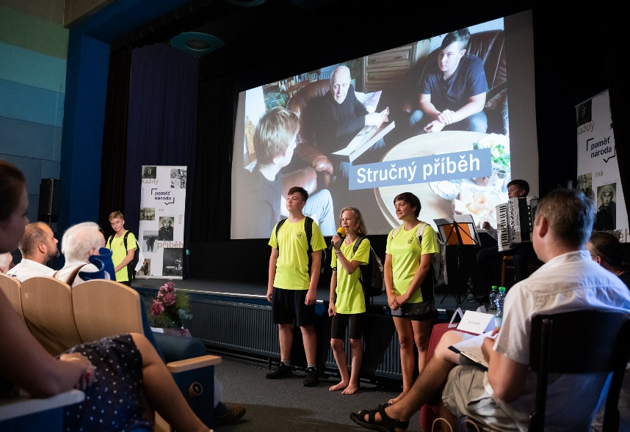
People
Ideal size: 10,000 inhabitants
A growing community
Strong civic engagement
Local pride and patriotism
Active citizens
Cooperation and responsibility

Slide 5
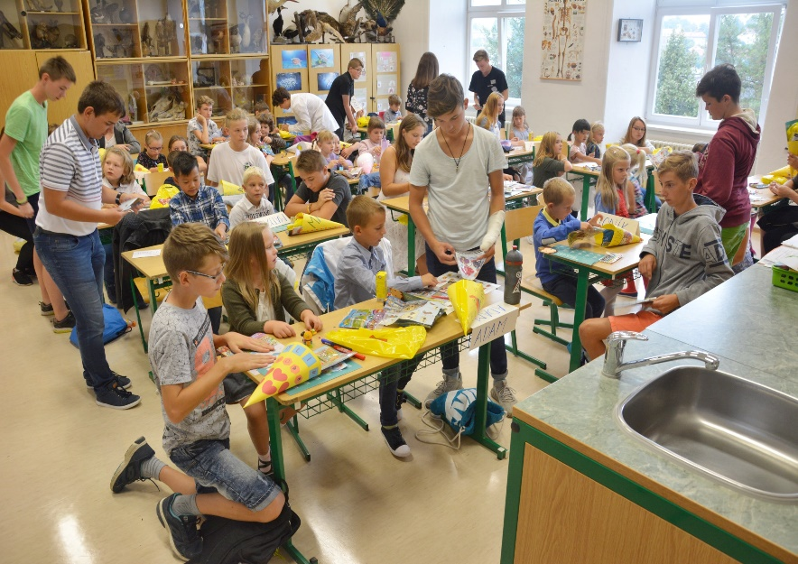
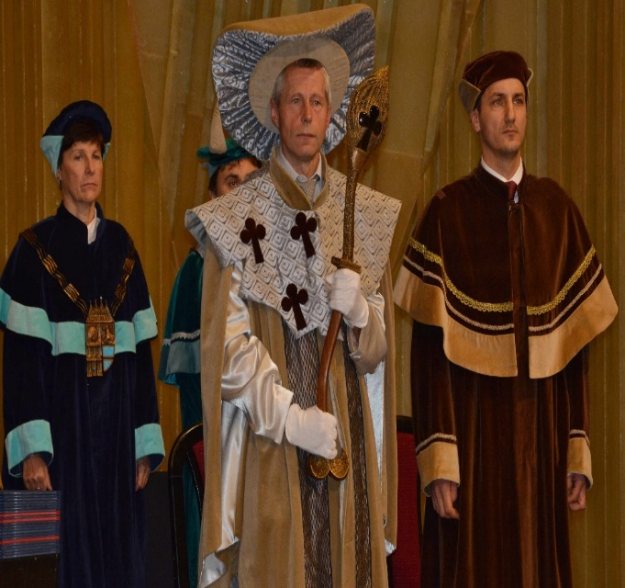
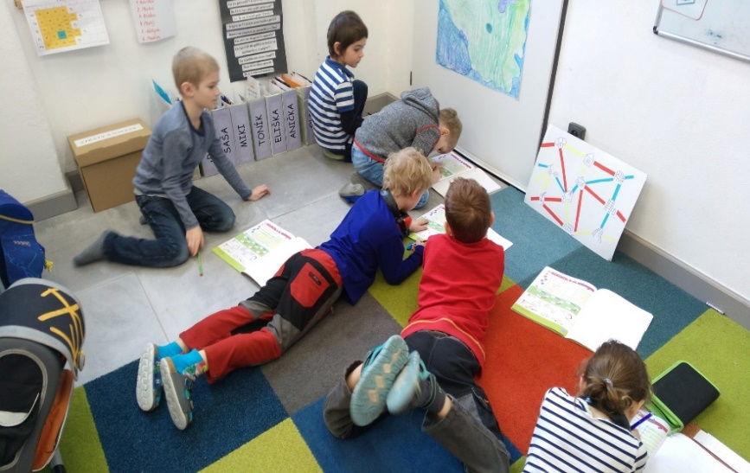
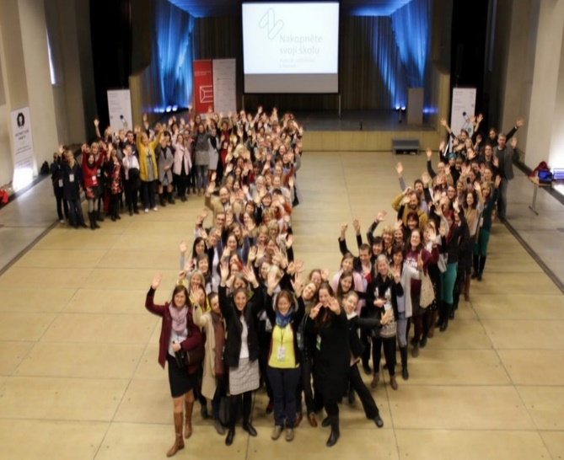
Education
Long-standing tradition
All levels of schools
Both public and private kindergartens and schools
Seminars and conferences
Innovation in business
Openness to newcomers
Student exchanges and inter-school cooperation

Slide 6
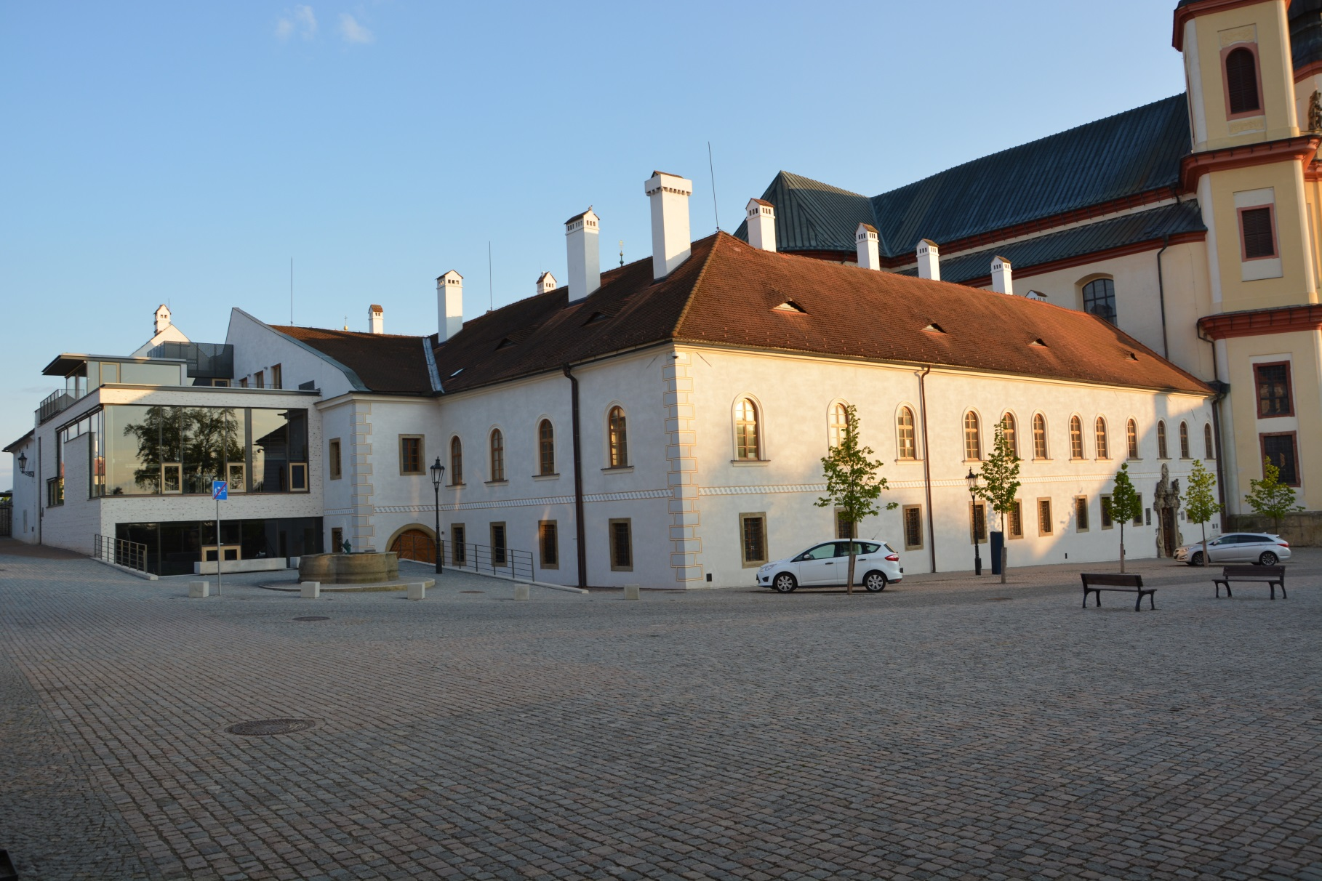
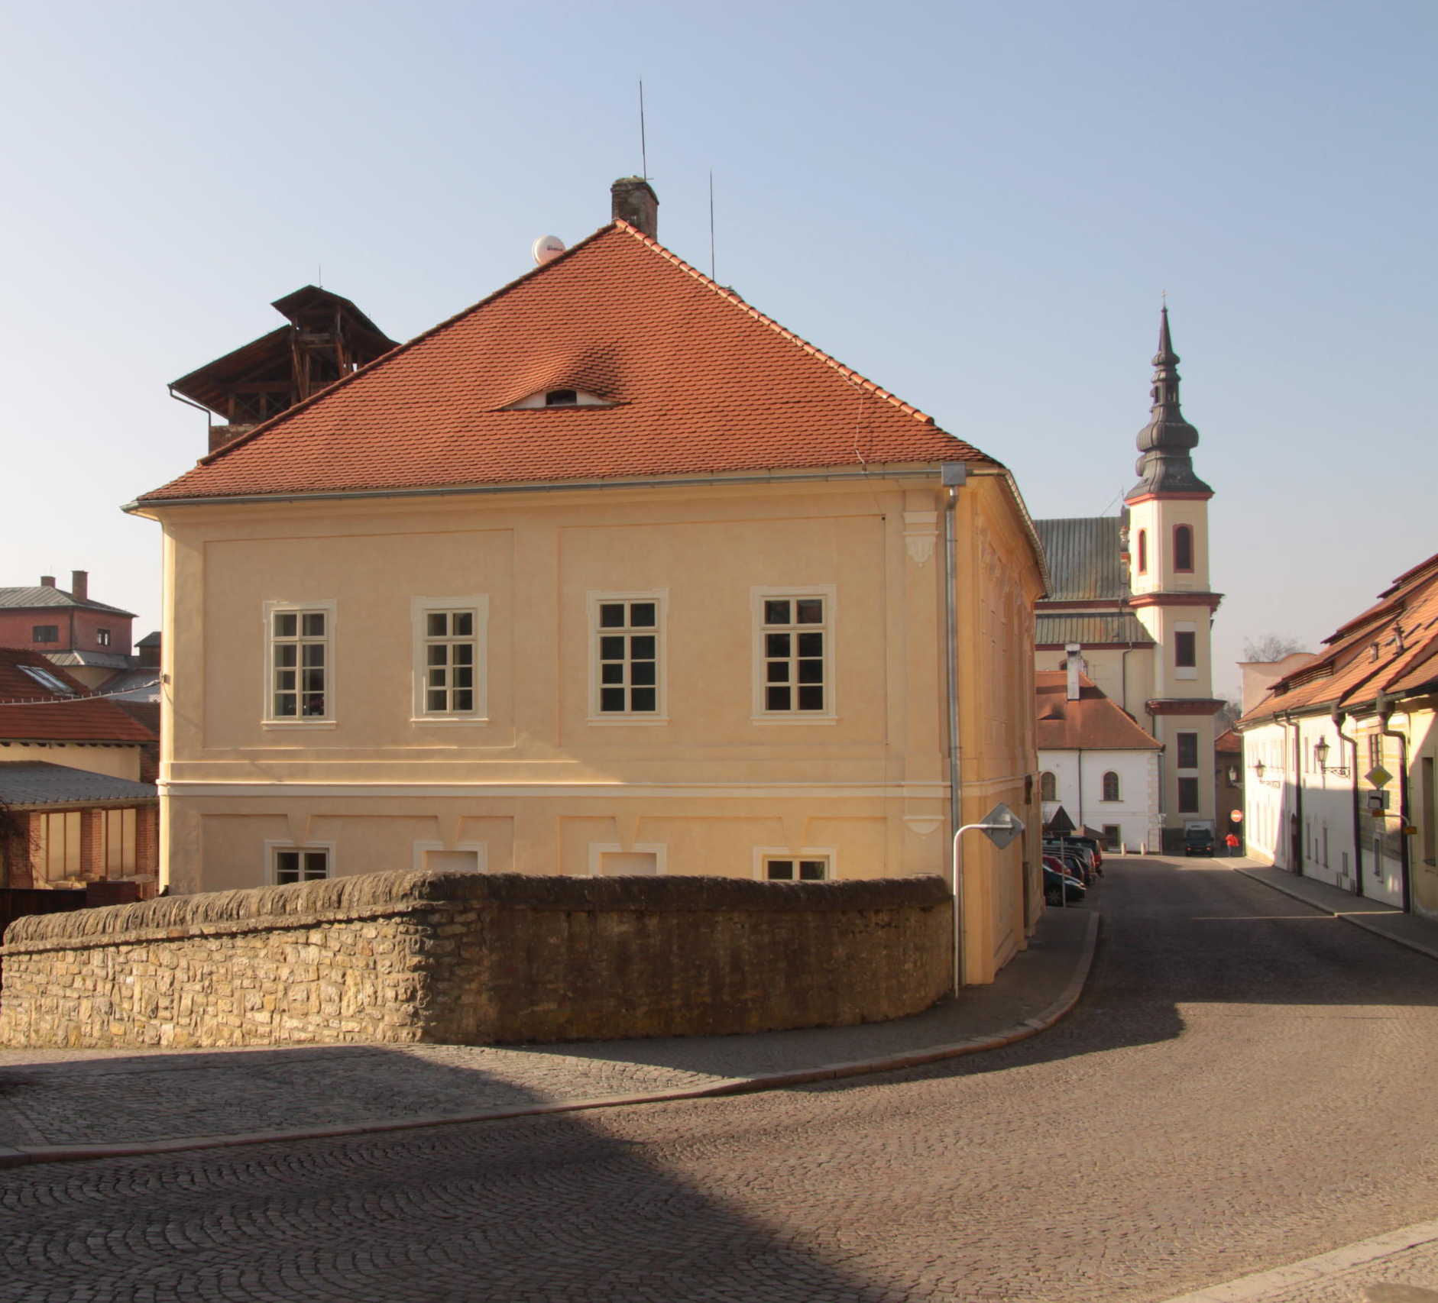
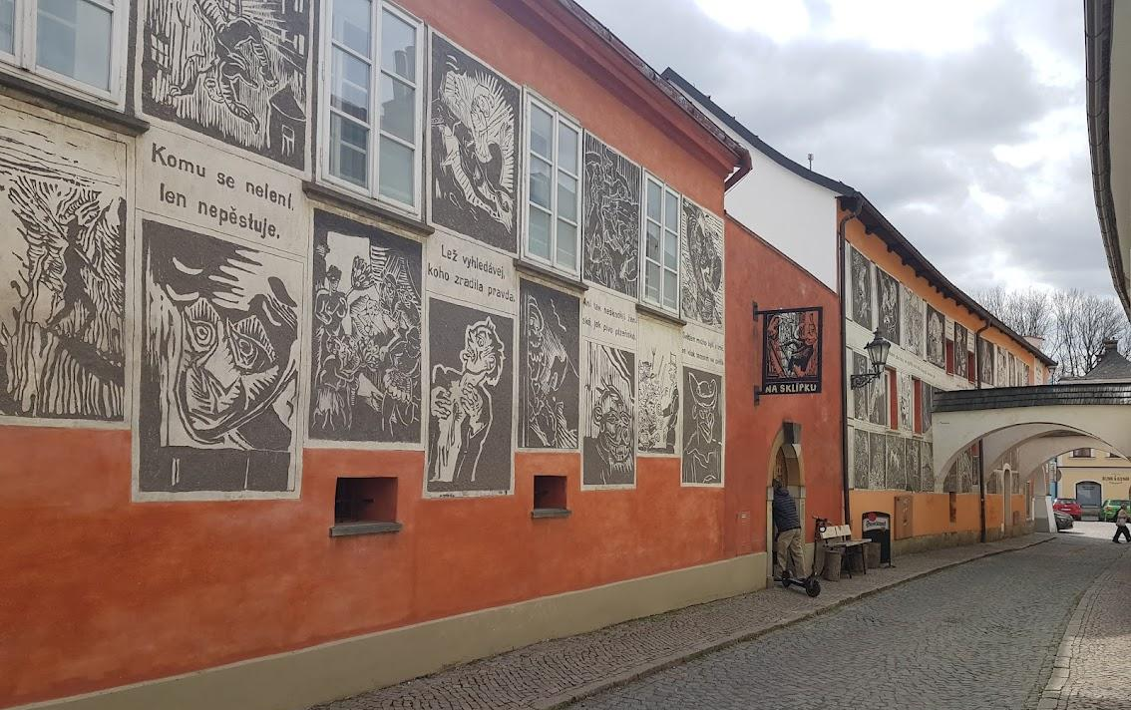
Cooperation with Faculty of Restoration
Helping from the very beginning (1st house from the city to the privat School of Restoration)
Large EU donation project (new library, former monastery)
Vachalova street
Sgrafitto x grafitti

Slide 7
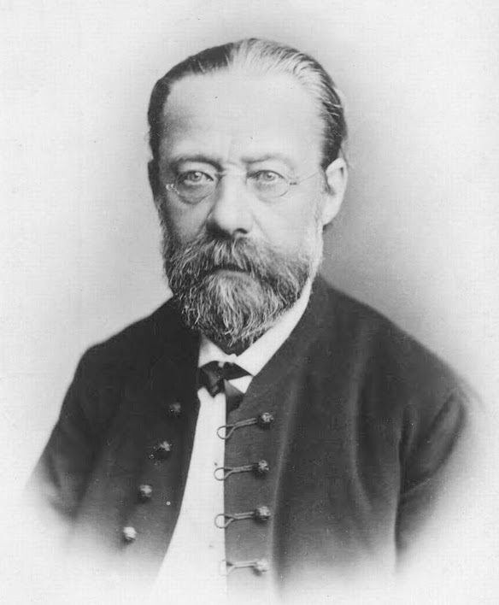
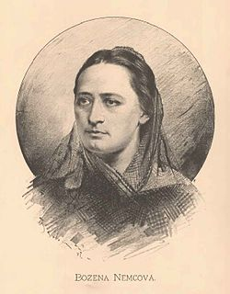
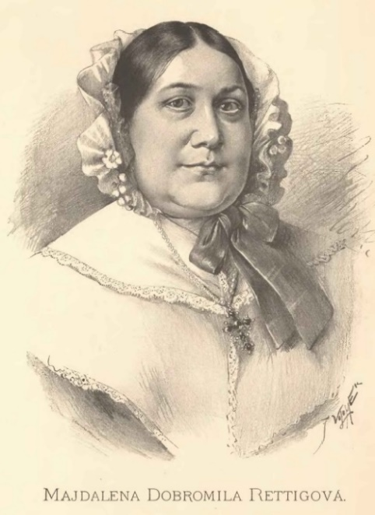
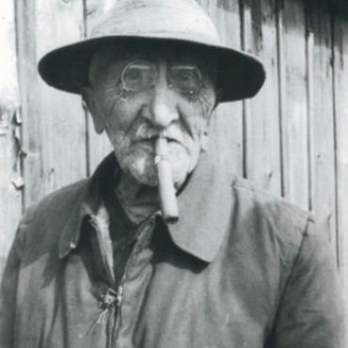
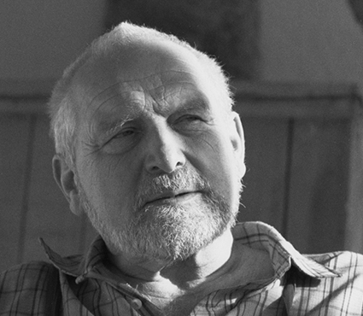
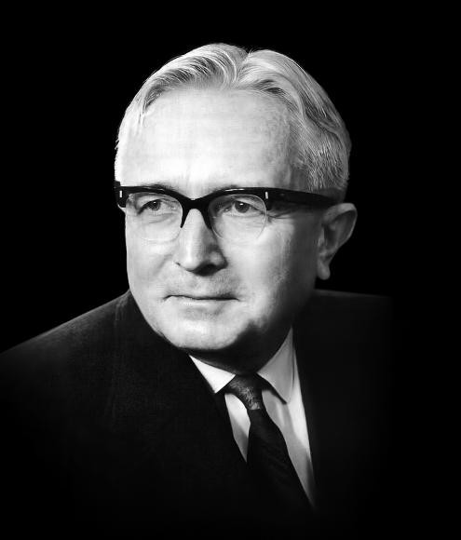
Personalities
Healthy patriotism, pride in our town
Bedřich Smetana
B. Němcová
M. D. Rettigová
Alois Jirásek
Josef Váchal
Olbram Zoubek
Zdeněk Kopal

Slide 8
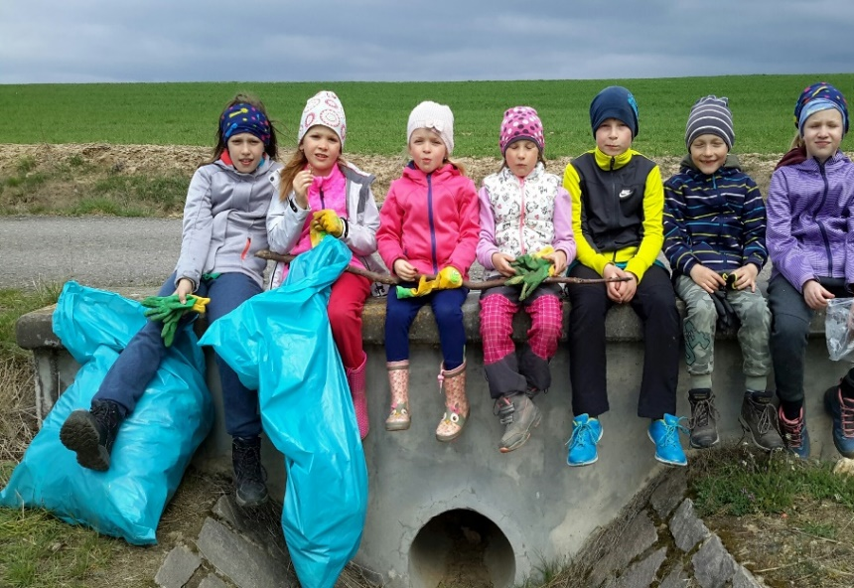
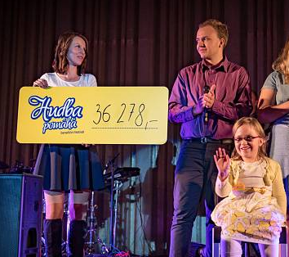
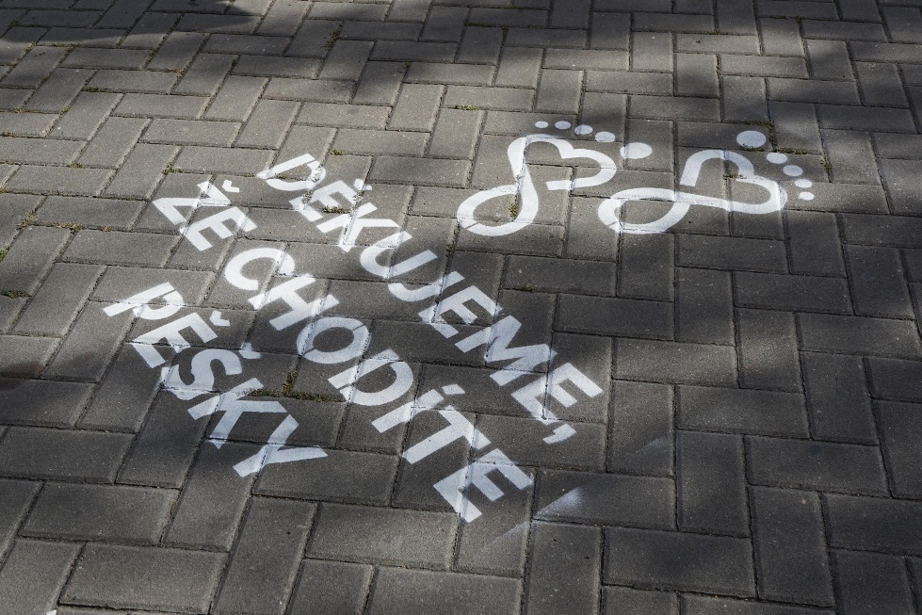
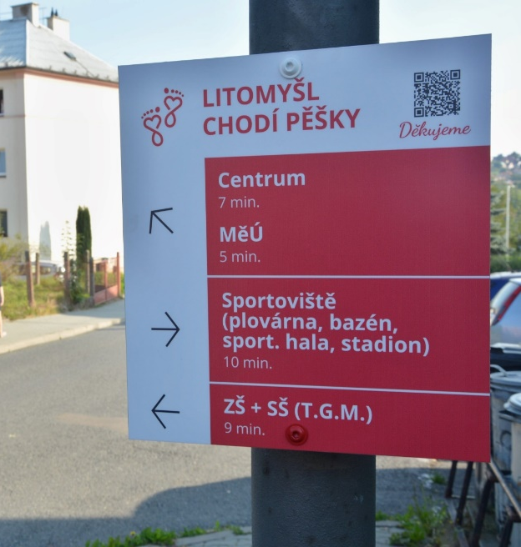
Community & Engagement
Strong civil society
Associations, choirs, community gatherings
Sense of responsibility (waste sorting, cleaning, helping Ukraine)
University of the Third Age
Gambling ban“
Litomyšl Walks on Foot” – pedestrian culture

Slide 9
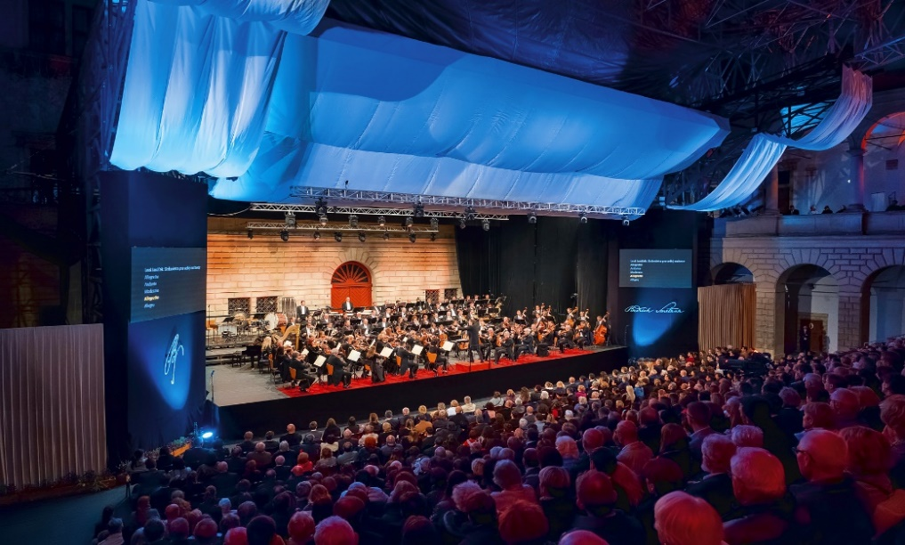
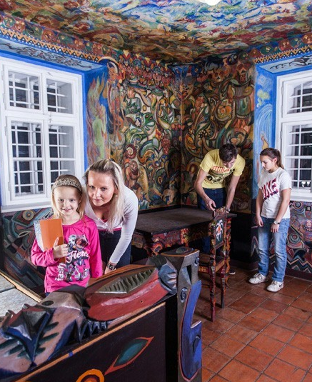
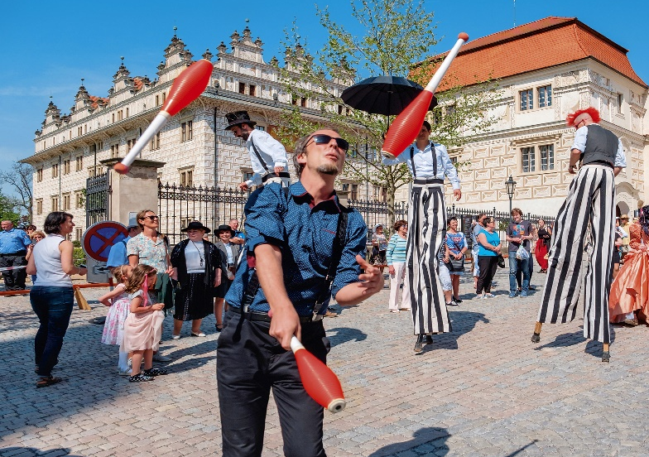
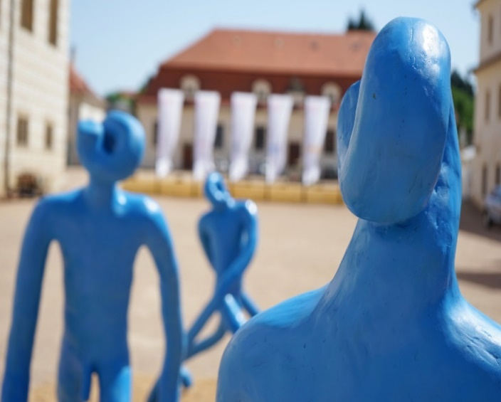
Culture
A vibrant town – cooperation between institutions and citizens
Smetana’s Litomyšl Festival
Smetana’s Visual Litomyšl
“Spa of the Spirit” festival
Student events
Numerous galleries, including private ones
Art in public spaces

Slide 10
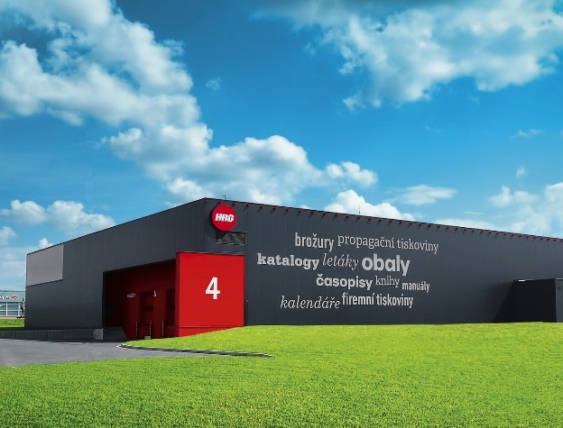
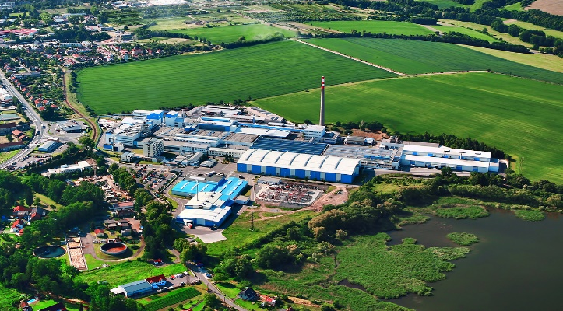
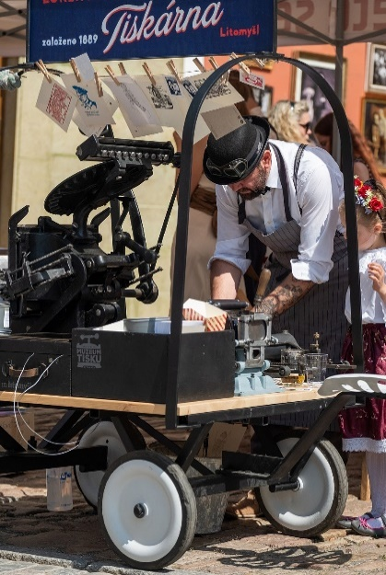
Business
Successful local companies
“Shopping center” on Smetana Square
Branches of foreign firms (France, Denmark, Austria)
Social responsibility – sponsorship and community support
“Made in Litomyšl” association

Slide 11
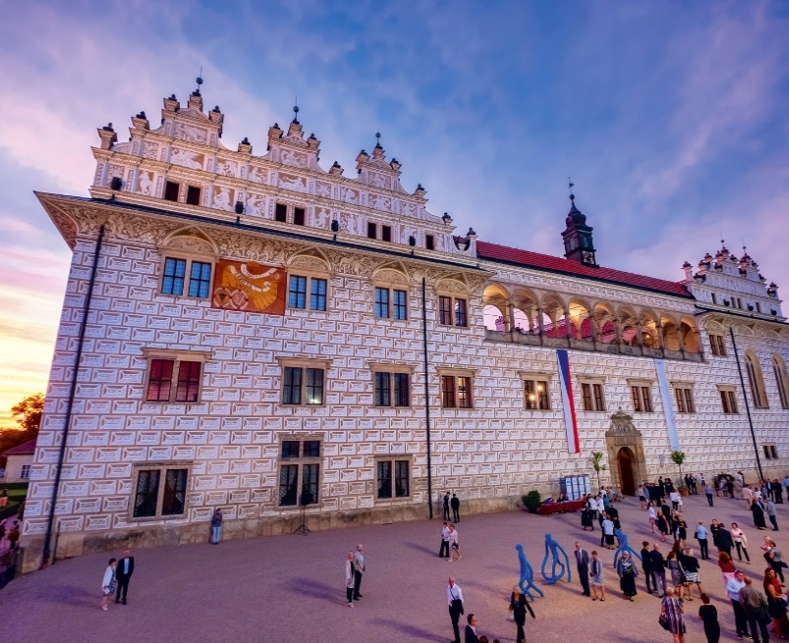
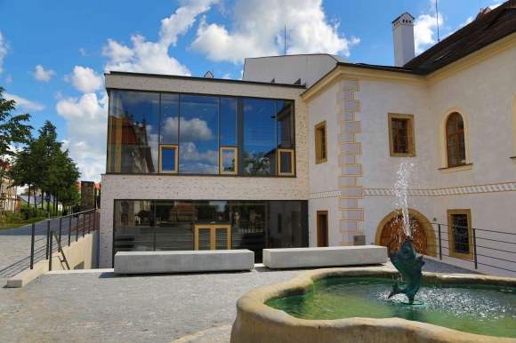
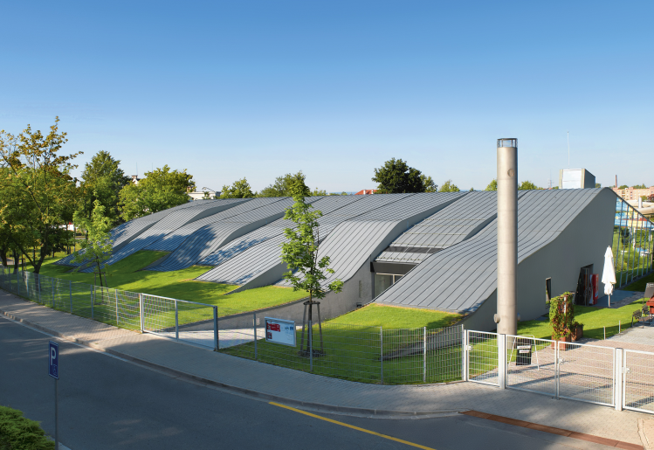
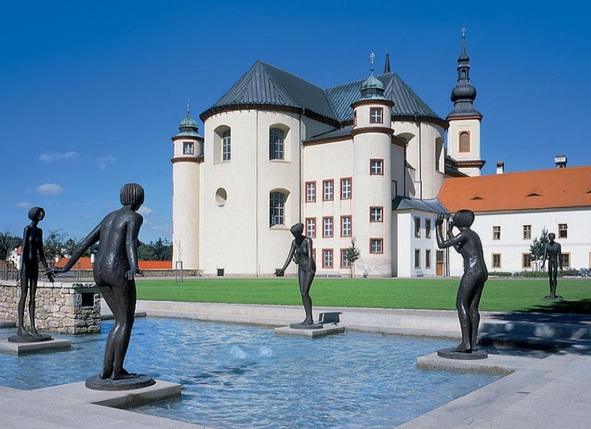
Architecture
Historic and modern
High-quality public space
Inspiration for others / inspired abroad
Public and increasingly private investment
“The Capital of Contemporary Czech Architecture”
www.lam.litomysl.cz

Slide 12
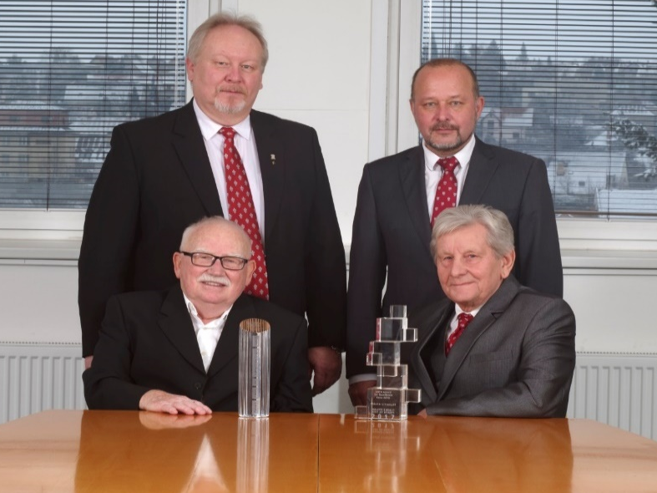
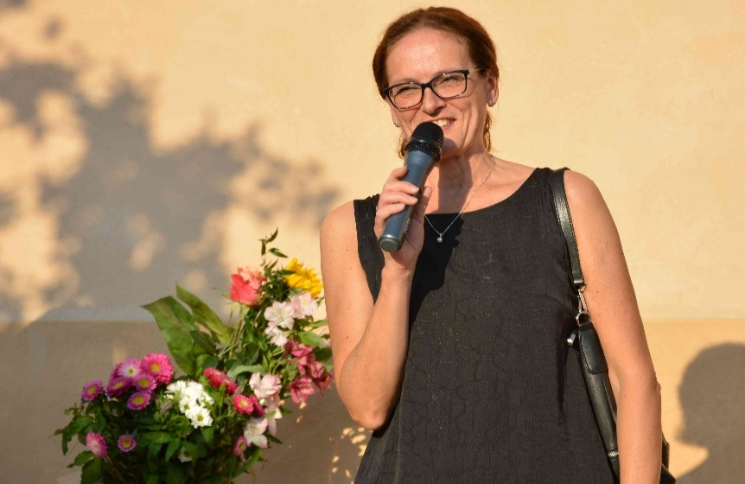
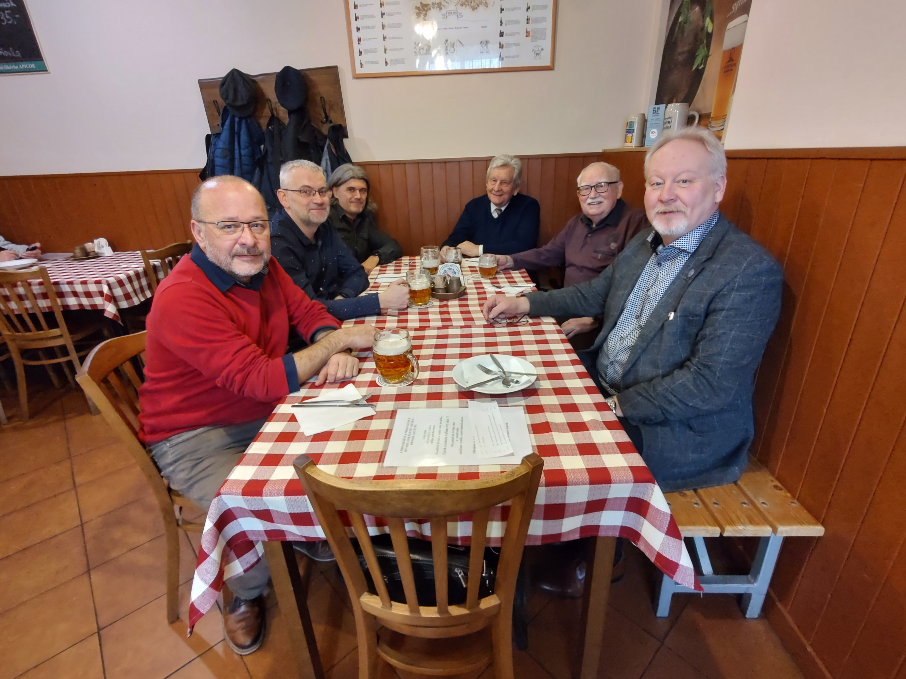
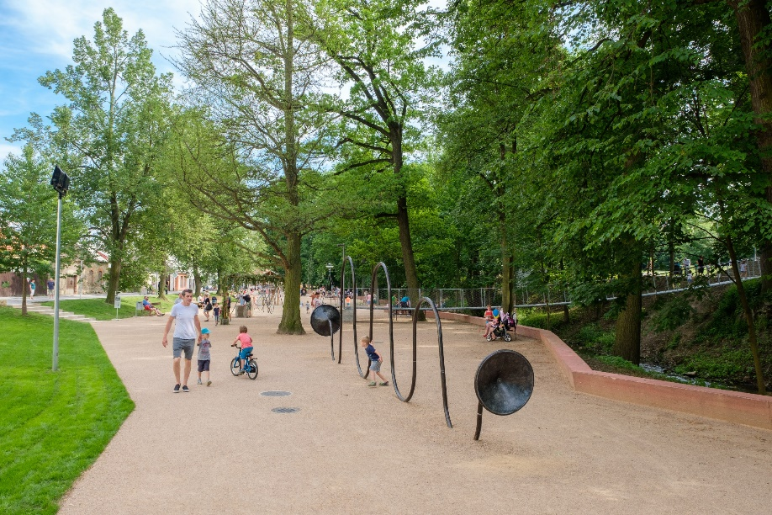
Continuity & Cooperation
Regular meetings of current and all former mayors
All council members meet “over a beer”
City architect since 1991 (the first in CZ)
Political culture and broad coalitions
City staff remain after elections
“In Litomyšl we sometimes change Mayors, but never our Direction.”

Slide 13
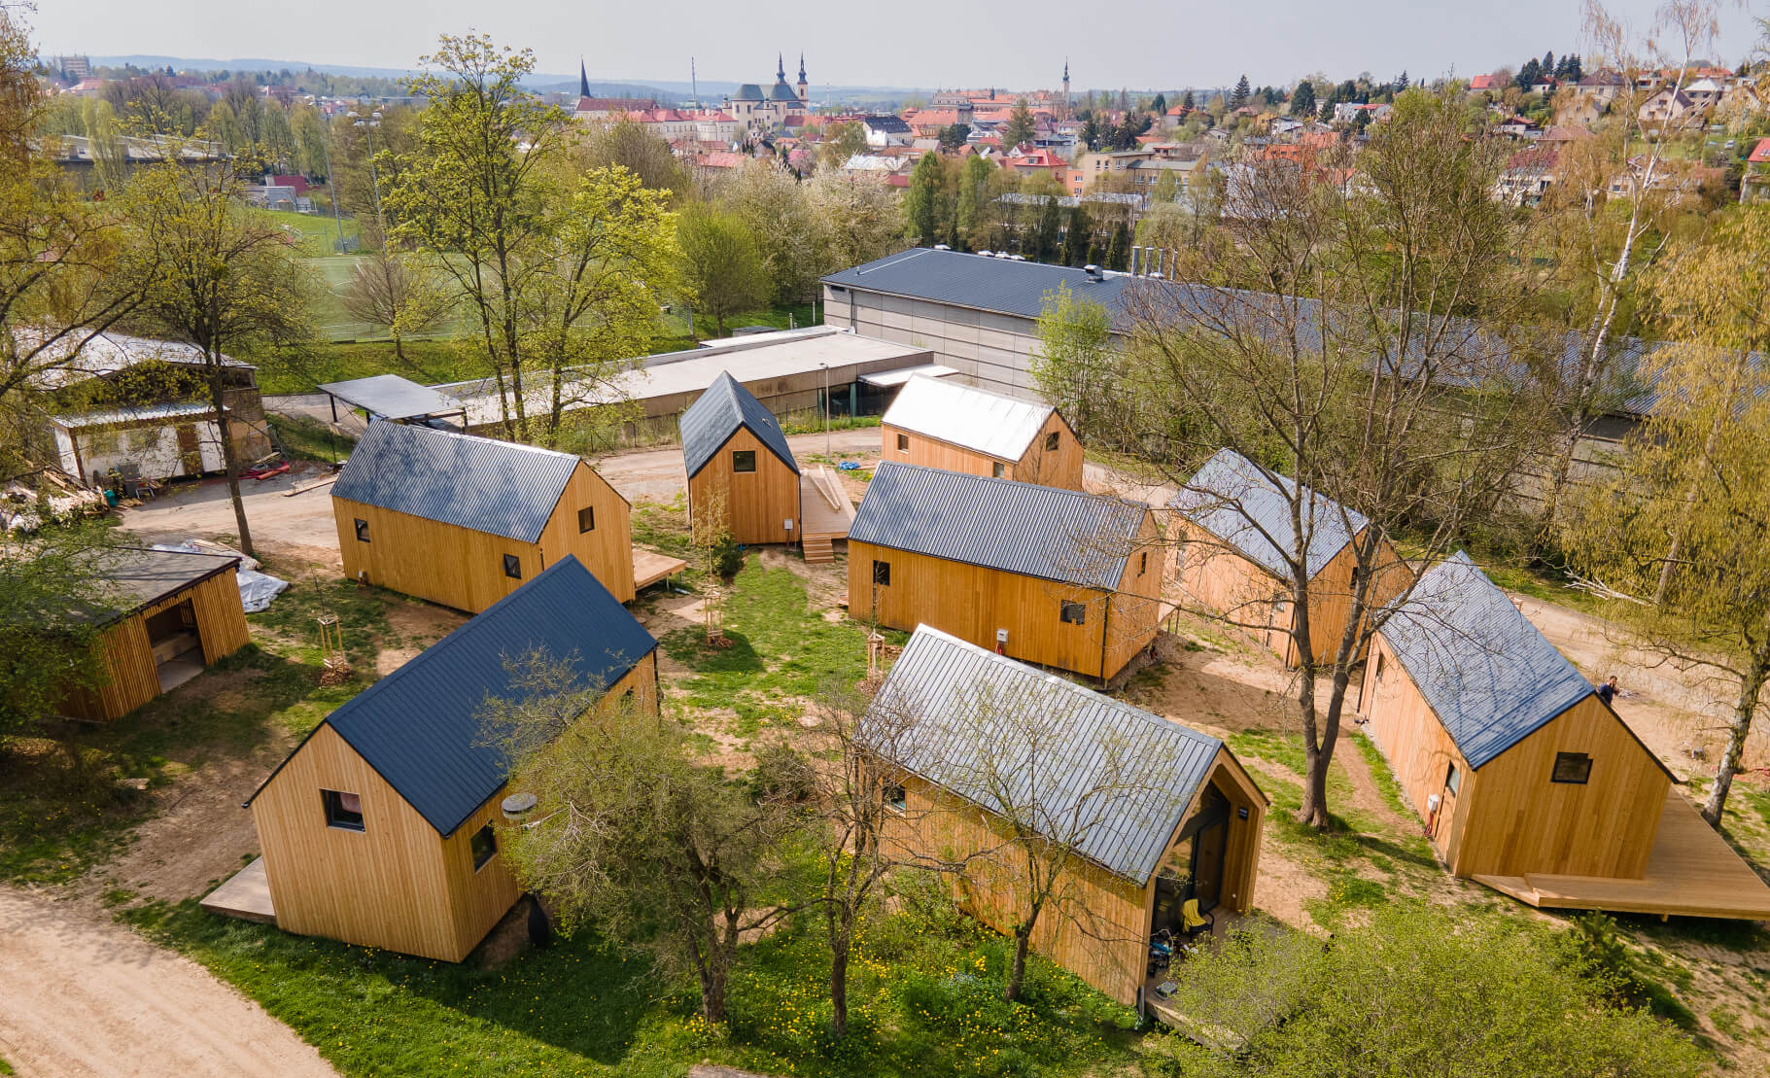
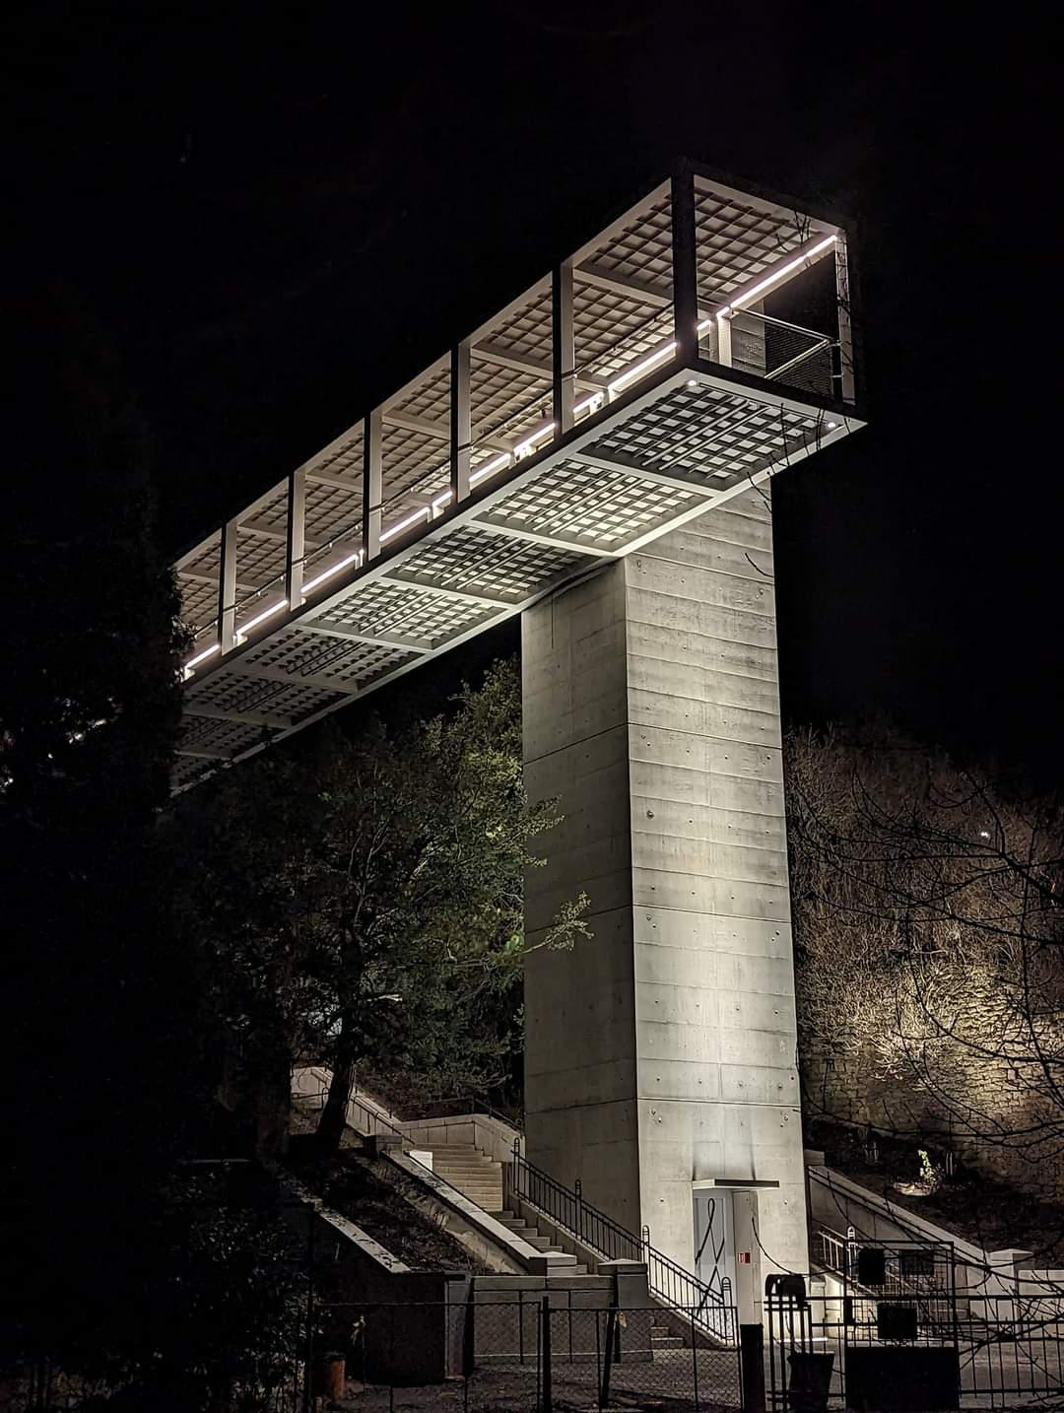
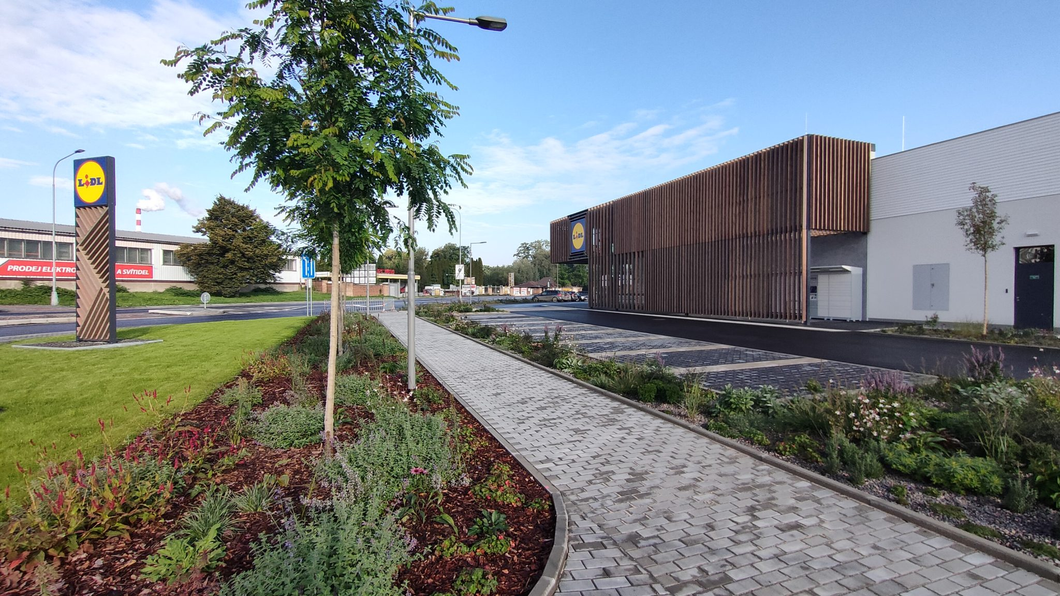
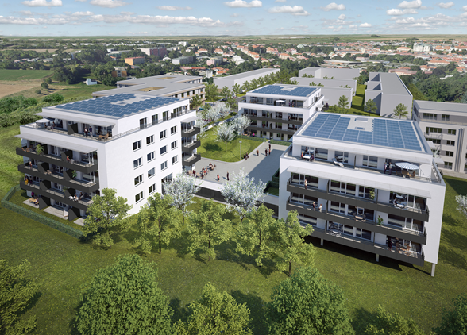
Recent Architectural Achievements
Barrier-free pedestrian overpass
New eco-friendly Lidl supermarket
New campground
Apartment buildings…and many smaller projects
We aim to continue:
Seeking inspiration in both public and private sectors, at home and abroad
Preparing “drawer-ready” projects
Maximizing transparency and communication
https://www.litomysl.cz/pripravovane_projekty

Slide 14
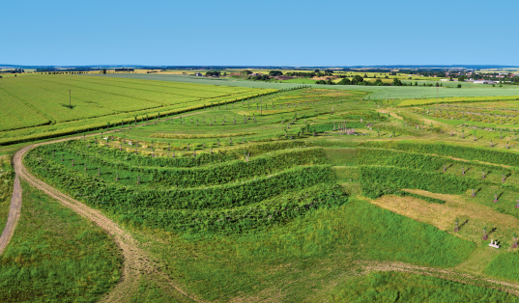



Public Space – Examples from Litomyšl
… see more on https://www.litomysl.cz/turista#pamatky-architektura )

Slide 15




What’s Next?
New senior home being built
Less cars on the main square
“Smart” solutions? Common sense will do
Investment in maintenance and repairs
Sustainable mobility, preferably walking
Quality of life on the town’s outskirts
Refining and regulating the historic center (positively!)
Greater citizen participation in decision-making

Slide 16

Thank You for Your Attention
Daniel Brýdl
Mayor of the Historic Town of Litomyšl

