Slide 1








WIDE AcrossEU
Litomyšl, 16.04.2026
Funded by the European Union. Views and opinions expressed are however those of the author (s) only and do not necessarily reflect those of the European Union or European Research Executive Agency. Neither the European Union nor the granting authority can be held responsible for them.

Slide 2
WIDE AcrossEU
Basic Information
Name: WIDEn performance in research and Innovation capacity and
competence AcrossEU (WIDE AcrossEU)
Consortium: 5 partners (UPCE, UKIM, ZPSU, ULAPLAND, UMU)
Provider: European Commission
Call: Pathway to synergies (HORIZON-WIDERA-2023-ACCESS-04)
Pathway a) Upsteam synergy mode (focusing on human resource development and internationalisation)
Time period: 1. 5. 2024 – 31. 8. 2027 (40 months)
Budget: 1 200 000 EUR

Slide 3
KEY OBJECTIVE
To move participants from Widening countries (CZ, MK and UA) to higher level and prepare for wider and more successful participation in direct EU funding programmes.
The focus is on Horizon Europe, Life, Digital Europe and Interreg calls.
The aim is to increase the number of submitted of HE proposals, also as main applicant (coordinator).
This will be achieved by strengthening the competitiveness by means of a targeted training, work shadowing, mobility, benchmarking best practices and customised group of capacity and competence building activities.

Slide 4
SPECIFIC OBJECTIVES I
To map the needs and requirements of target groups in Widening partners
At least 350 people will answer the questionnaires
To strengthen competitiveness of target groups in Widening countries by acquiring new transferable skills for R&I staff
1 training programme with 10-15 thematic and targeted events and courses with minimum 350 peple trained
  30 cooperating industries (cooperation)
  15 networking events (networking)
  Involvement in 5 experienced R&I networks (networking)
  50 short term stays/secondments/work shadowing
To create strategic priorities for international R&I and Human Resources
  Joint priorities for the joint international R&I strategy
  Joint priorities for HR development strategy
  Preparation for HRS4R award application (UKIM, ZPSU)

Slide 5
SPECIFIC OBJECTIVES II
Access to networks and partnerships to secure more successful proposals and create a base for lead partner rules for Widening partners
  60 in person or online meetings (consultations, advice, methodological support)
  31 project proposals will be written and submitted (6 as coordinator, 25 as partner)
To better use R&I infrastructure funded under ERDF or similar investments
  Online platform of R&I infrastructure
To improve access to excellent European R&I networks and communities
  Involvement in 5 experienced R&I networks
  30 cooperating industries/collaboration partners

Slide 6
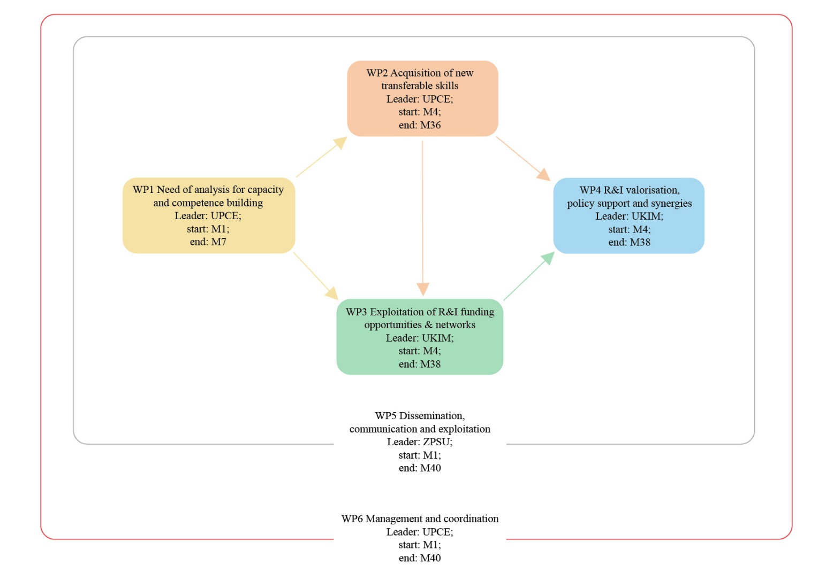

Slide 7
WP1 NEED OF ANALYSIS FOR CAPACITY AND COMPETENCE BUILDING (UPCE, M1–M7)
T1.1 Planning the surveyes (UKIM, M1–M3)
Leadership and management (Directors, support, HR, finance, …)
Academics (Early-stage researchers to Professors)
T1.2 Targeting the survey and participation optimisation (ZPSU, M3–M4)
Pre-announced and published surveys (for each target group)
All partners websites and media channels (source: UPCE)
Questionnaires available in M4
T1.3 Survey (UPCE, M4–M5)
Minimum 50 people respond questionnaire 1
Minimum 300 people respond questionnare 2
T1.4 Analysis of R&I infrastructures (UMU, M3–M6)
Analysis of available R&I infrastructures, research areas and Teams
All partners
T1.5 Survey analysis and inputs to WP2 (UPCE, M5–M7)

Slide 8
WP2 ACQUISITION OF NEW TRANSFERABLE SKILLS (UPCE, M4–M36)
T2.1 Preparation of the training, capacity and competence programme (ULAPLAND, M4–M12)
Creation of training courses/seminars (10–15)
Pre-award (calls, Cordis, F&T Portal, project proposal, eligibility, IPR)
Post-award services (agreements, management, reporting)
T2.2 Training courses and interactive workshops (UPCE, M6–M24)
Implementation
Each course/workshop ½ - 2 days long (online, in person, hybrid)
T2.3 Short-term stays, secondments and work-shadowing (UMU,
M8–M36)
50 stays/secondments/work-shadowing (7–14 days)
75% from Widening to non-Widening (UMU, ULAPLAND, AcrossEU partners, other institutions from non-Widening countries)

Slide 9
WP3 Exploitation of R&I funding opportunities & networks (UKIM, M4–M38)
T3.1 Provide better access to EU R&I funding opportunities (ULAPLAND, M4–M38)
Info about EU, international, national and regional R&I grant schemes
T3.2 Increase access and presence to EU R&I communities, platforms and networks (UMU, M6–M30)
Identify and facilitate the access to networks/platforms/communities
Involvement in 5 networks
T3.3 Development of new systematic aproach to NCP and cross-border cooperation (UKIM, M4–M30)
Exchange of information, experiences and results with NCP networks
Using of Cohesion funds, smart specialisation planning
T3.4 Field test services to potential applicants (UPCE, M10–M38)
Horizon Europe and interregional project proposal preparation
31 project proposals (6 as a coordinator, 25 as a partner)

Slide 10
WP4 R&I valorisation, policy support and synergies (UKIM, M4–M38)
T4.1 Engancing joint actions through international R&I strategic choices – towards updated institutional R&I priorities (UPCE, M4–M12)
Each partner will revise/update institutional R&I and education policy
Joint list of international R&I policy priorities
Joint online sessions, institutional workshops, event in WP6 (UPCE)
T4.2 Joint priorities for more harmonised institutional HR strategy (UKIM, M6–M12)
Agreement on joint priorities in HR management
T4.3 R&I integration through smart specialisation (ULAPLAND, M6–M36)
Joint practicies for Widening partners (good examples)
Dialogue with relevant authorities
Drive for more multibeneficiary cohesion projects

Slide 11
WP4 R&I valorisation, policy support and synergies (UKIM, M4–M38)
T4.4 Embedding of WIDE AcrossEU R&I infrastructure to local, regional and EU collaboration (UMU, M12–M32)
To integrate Widening partners to their local ecosystems
Cooperation with EU networks and platforms
R&I infrastructure platform – combination of TRL values
T4.5 Capacity and competence consolidation and use – leveraging the potential for collaboration (UPCE, M14–M38)
Communicate and convey institutional R&I strategies of Widening partners to national ministries and bodies defining national R&I policy priorities and funding
Influence regional and national R&I policies and strategic priorities of HE and FP10 (together with NCP networks)

Slide 12
WP5 Dissemination, communication and exploitation (ZPSU, M1–M40)
T5.1 Roadmap for communication, dissemination and exploitation (UPCE, M1–M6)
Agreement on common communication channels and communication indicators (factsheets, presentations, social media, press releases, radio-bridges, video materials, leaflet, roll-ups)
Visual identity and branding guidelines
T5.2 Project identity, web and social media (ZPSU, M1–M40)
Setting up and maintaining website and social media accounts
Producing of R&I infrastructure platform
T5.3 Publication and conferences (UPCE, M7–M36)
3 WoS papers and presented at conferences (ICERY, IATED etc.)
Promotion at EARMA conferences and European Week of Regions and Cities

Slide 13
WP5 Dissemination, communication and exploitation (ZPSU, M1–M40)
T5.4 Organisation of communication specific workshops and events (ZPSU, M2–M38)
Kick-off meeting (M2)
Local project events (between M18 and M36) targeting local communities
Final konference (M38/M40) at UPCE (wider dissemination of project results and outcomes)

Slide 14
WP6 Management and coordination (UPCE, M1–M40)
T6.1 Coordination of the project (UPCE, M1–M40)
Progress monitoring (objectives, deliverables, time schedule, finance, risk etc.)
T6.2 Administrative and financial management (UPCE, M1–M40)
Reports to EC and relevant stakeholders
T6.3 Risk management, data management (UPCE, M1–M40)
Evaluate and prevent potential risks
Data management plan (M6)
T6.4 Advisory Board and stakeholder management (UKIM, M6–M36)
Setting up an Advisory Board
T6.5 Impact pathway management (UPCE, M3–M40)
Evidencebased decission-making process
Overall effectiveness of the project

Slide 15
DELIVERABLES
D1.1 Analysis of the needs, requirements and expectations of target group
(WP1, UPCE, M7)
D2.1 Report on training and short-term stays (WP2, UPCE, M34)
D3.1 Report on project proposals initiated and submitted
(WP3, UKIM, M36)
D4.1 Joint R&I international strategic priorities and joint HR strategic priorities (WP4, UKIM, M12)
D4.2 R&I infrastructure online platform (WP4, UKIM, M12)
D5.1 Plan for dissemination and exploitation including communication activities (WP5, ZPSU, M6)
D5.2 Project web page (WP5, ZPSU, M12)
D6.1 Data management plan (WP6, UPCE, M6)
D6.2 Final conference (WP6, UPCE, M40)

Slide 16
MILESTONES
M01 Pre-analysis of the needs, requirements and expectations of target group
(M14, D1.1)
M02 First certificates from training
(M24, first target groups will be awarded WIDE AcrossEU certificates)
M03 Joint priorities and infrastructure platform
(M28, D4.1 + D4.2)
M04 Demonstrated exploitation
(M36, funding proposals submitted)
M05 Successful final conference – end of the project
(M40, number of participants + D6.2)

Slide 17
OUTPUTS
Training programme (1)
People trained (350)
Networking events (15)
Project proposals submitted (3+2+1=6 as coordinator, 10+10+5=25 as partner)
Increasing of the success rate in terms of project proposal acceptance (EU level reached)
R&I funding programmes used (5 – HE, COST, ERDF, IPA, Interreg and others)
Cooperating industries (30)
Joint HR strategy – priciples and priorities including HRS4R – Euraxes (1)
Report on funding opportunities (1)
WIDE AcrossEU joint international R&I priorities (1)
Project consortiums created (6)
Established/consolidated knowledge transfer offices (3)
Created infrastructure online platform (1)
Meetings with ministries, local authorities and industry (60)

Slide 18
PROJECT TEAM
UKIM (NMK)
Ms Beti Kostadinovska Dimitrovska (beti.kostadinovska@ukim.edu.mk)
ZPSU (UA)
Ms Yuliya Bogoyavlenska (bjv@ztu.edu.ua)
ULAPLAND + UAS (FI)
Ms Marlene Kohllechner-Autto (marlene.kohllechner-autto@ulapland.fi)
UMU (S)
Ms Agneta Hånell Plamboeck (agneta.plamboeck@umu.se)
UPCE (CZ)
Ms Diana Kalášková (diana.kalaskova@upce.cz)
Ms Michaela Koudelová (michaela.koudelova@upce.cz)
Ms Monika Vejchodová (monika.vejchodova@upce.cz)

Slide 19
Thank you.
Contact:
Ms Monika Vejchodová
Email: monika.vejchodova@upce.cz
Telefon: +420 466 036 417
+420 602 122 737

