Slide 1
Horizon europe for cities and regions
16 April 2026
Jana Čejková, Naďa Koníčková

Slide 2

horizon europe structure
European missions
European partnerships
PILLAR I
EXCELLENT SCIENCE
PILLAR II
GLOBAL CHALLENGES &
INDUSTRIAL COMPETITIVENESS
PILLAR III
INNOVATIVE EUROPE
European Research Council
Clusters
Health
Culture, Creativity & Inclusive Society
Civil Security for Society
Digital, Industry & Space
Climate, Energy & Mobility
Food, Bioeconomy, Natural Resources, Agriculture & Environment
European Innovation Council
Marie Sklodowska‑Curie
European Innovation Ecosystems
European Institute of Innovation & Technology
Research Infrastructures
Joint Research Centre
WIDENING PARTICIPATION AND STRENGTHENING THE EUROPEAN RESEARCH AREA
Widening participation & spreading excellence| Reforming & Enhancing the European R&I system

Slide 3

Basic rules of HE pillar ii
    minimum consortium composition: 3 different partners from 3 EU countries or Horizon Europe associated countries (in practice, there are usually more)
    eligible participant: any legal entity (universities, research institutes, large companies, SMEs, public authorities, NGOs, hospitals, museums, etc.)
    published calls with specific topics that proposals must “fit into”
    types of instruments:
      Research and Innovation Actions (RIA) = research + limited demonstration
      Innovation Actions (IA) = demonstration + limited research
      Coordination and Support Actions (CSA) = networking, exchange of best practices
    evaluation: 3–5 independent experts based on predefined criteria (scientific excellence, project impact, and quality of implementation)

Slide 4

funding
    RIA, CSA for all types of participants: 100 % of total eligible costs
    IA for profit organisations: 70 % , for non-profit also 100 %
    Overheads = 25 % of direct costs
    Eligible costs
      personnel costs
      subcontracting
      purchase costs
        travel
        equipment
        consumables
      other

Slide 5

Work programmes for 2026-2027
    The most important document
    Specific for each cluster of Pillar II
    Common to all missions
    Summarises topic descriptions, budgets and deadlines
    Can be found here

Slide 6
Opportunities in European missions

Slide 7
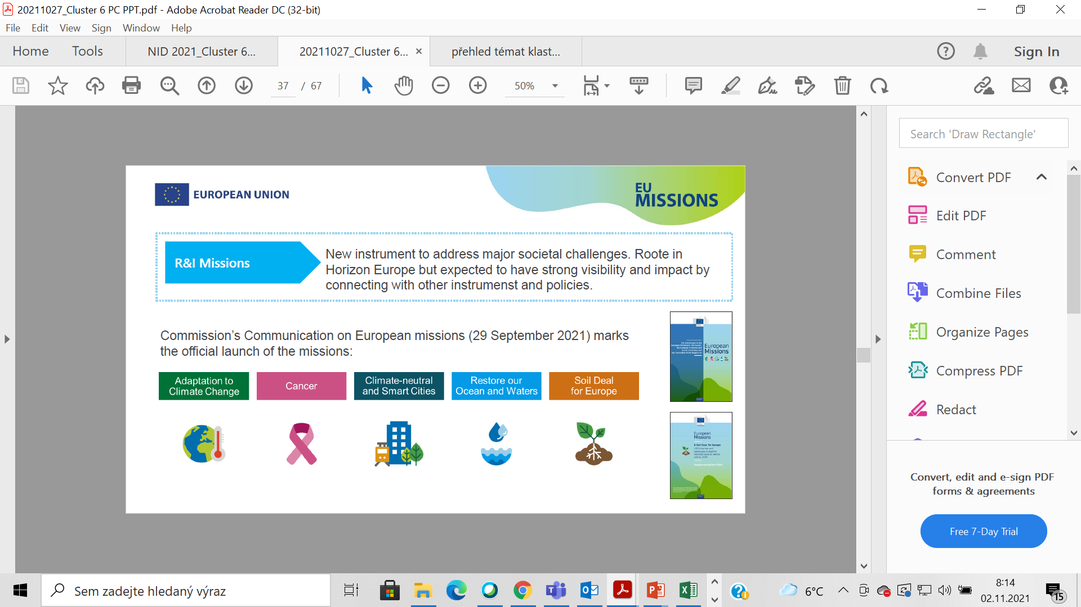
Missions in Horizon Europe
= portfolio of activities with a significant impact across disciplines and sectors with the aim:
to achieve a measurable objective within a specified timeframe that could not be achieved by individual actions
to influence society and policy-making through science and technology
to solve problems of relevance to a wide range of European citizens
specific calls to implement the missions; in the first 3 years a maximum of 10% of the annual budget of Pillar II

Slide 8
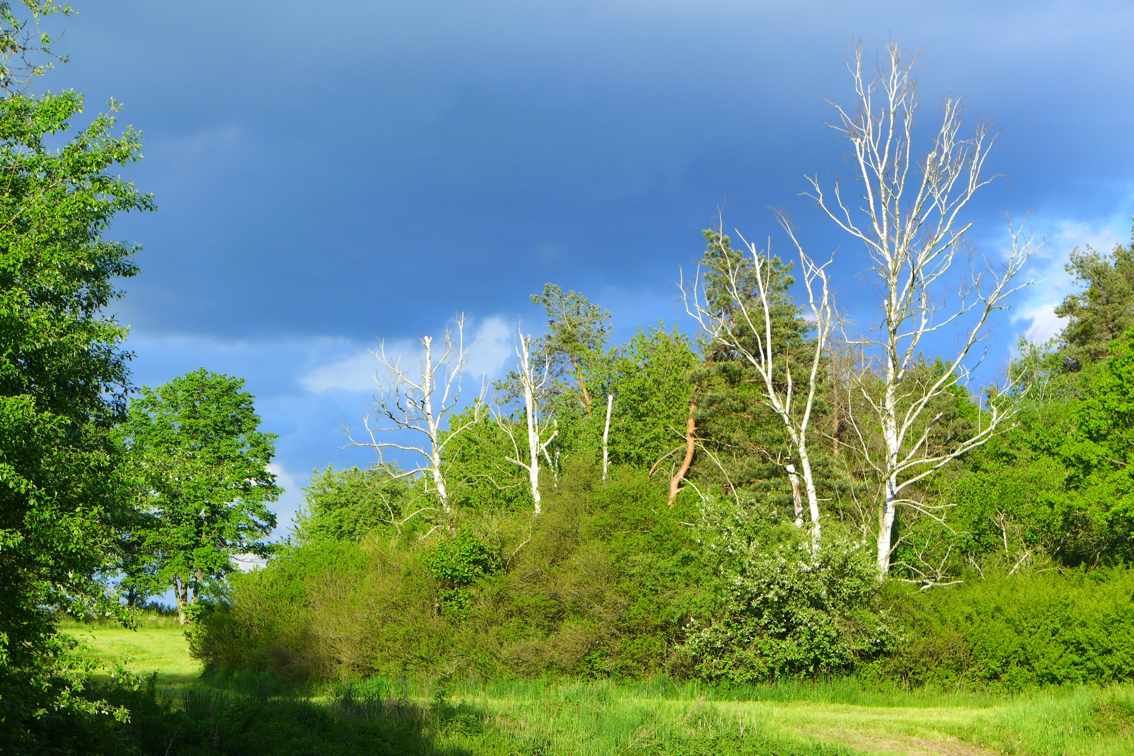
Examples of topics

Slide 9
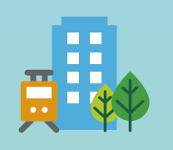
Climate-Neutral and Smart Cities Mission
Energy efficient urban and sub-urban public transport, complemented by shared mobility
  min. 3 „lead“ cities and 3 „follower“ cities
  improving energy efficiency in urban and sub-urban public transport systems, complemented by urban mobility service car fleets
  inventory and assessment of existing instruments and measures to foster electrification and attractiveness of urban and sub-urban public transport systems
  recommendations and guidance for local authorities and public transport operators
  deadline: 8 October 2026
Deploying innovative wastewater management, treatment and valorisation solutions in European cities and regions in the context of climate change
  min. 4 cities
  innovative practices for urban wastewater management, adapted to climate change, taking into account: energy efficiency, secondary raw material recovery and water reuse
  deadline: 22 September 2027
Notes:
Nízkoteplotní – do 70 stupňů Celsia

Slide 10
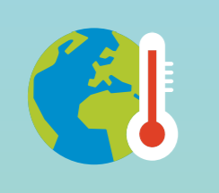
Adaptation to Climate Change
Facilitating implementation of actionable solutions for climate adaptation of regions and local authorities
  detailed inventory of adaptation solutions, proactively promoted with the regions and local authorities
  regional and local authorities = target group of the proposed activities (not expected to participate in the consortium, but they should benefit from project funded by this action)
  deadline: 23 September 2026
Demonstrating solutions to protect and preserve cultural heritage from the impacts of climate change
  identify, test and demonstrate innovative solutions to protect and preserve cultural heritage from the impacts of climate change
  tangible (movable and immovable) heritage, and natural heritage with cultural significance
  in the territory of min. 3 different regional or local authorities that host cultural heritage + 3 replicating authorities
  deadline: 23 September 2026
Demonstrating transformative solutions to increase cross-border climate resilience
  at least one relevant cross-border climate risk (e.g. water scarcity, flooding, storms, wildfires)
  regional / local authorities from each side of country borders better prepared to withstand jointly the impacts of climate change
  at least 2 cross-border demonstration sites + min. 1 replicating site
  deadline: 21 September 2027

Slide 11
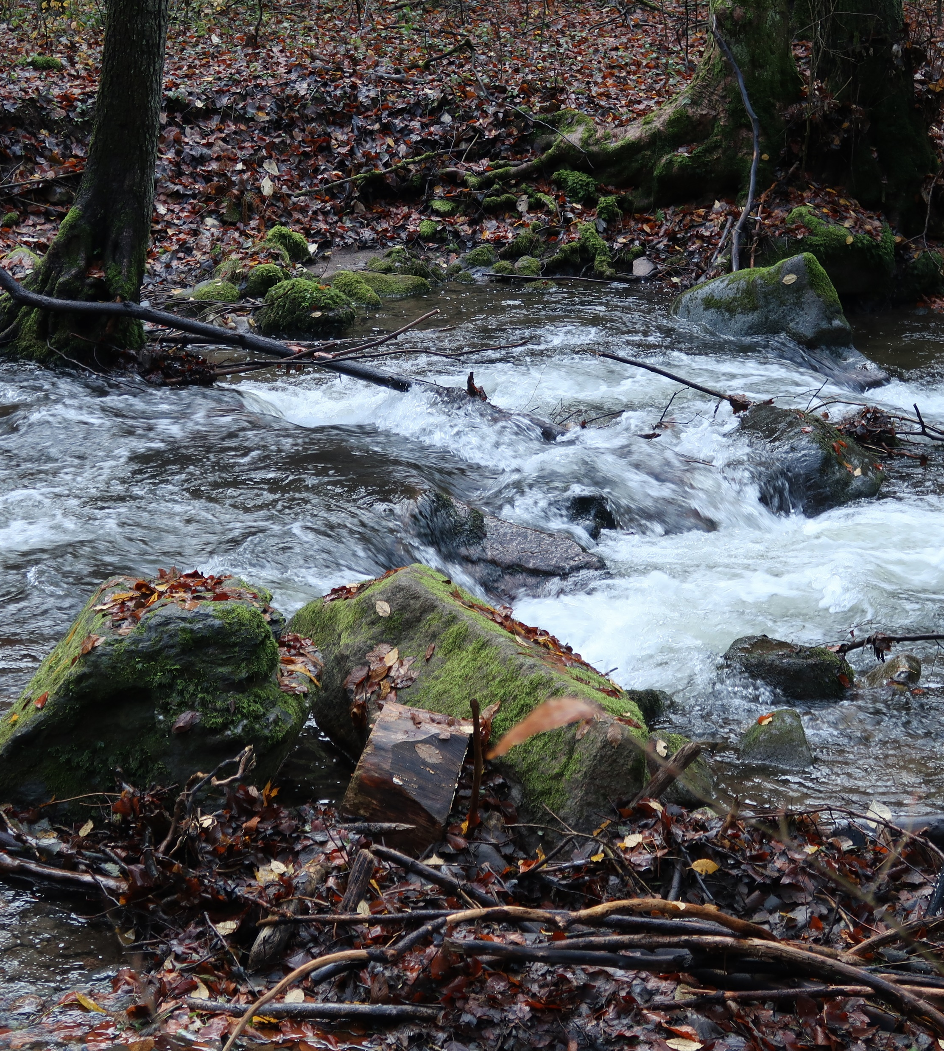
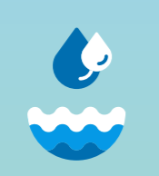
Restore our Ocean and Waters by 2030
Addressing aquatic pollution and biodiversity loss through nature positive solutions from source to sea
  solutions to remediate and reduce pollution from nutrients, chemicals, plastics and microplastics from source to sea, while protecting and restoring the capacity of ecosystems
  financial support to third parties → in following years check the calls for „associated regions“
  deadline: 23. 9. 2026

Slide 12

Soil Deal for Europe
Leveraging long-term field experiments and other datasets to develop AI-ready decision support systems for sustainable soil management
  develop open-access interoperable systems to improve data sharing and allowing researchers, advisors, land managers access and utilize comprehensive soil health information
  financial support to third parties
Monitoring soil health in practice: equipping stakeholders to sample, analyse, and interpret soil health indicators
  to equip land managers, laboratory personnel and advisors with practical tools and skills to improve soil data quality and soil data interpretation
deadline: 23. 9. 2026

Slide 13
opportunities in clusters

Slide 14
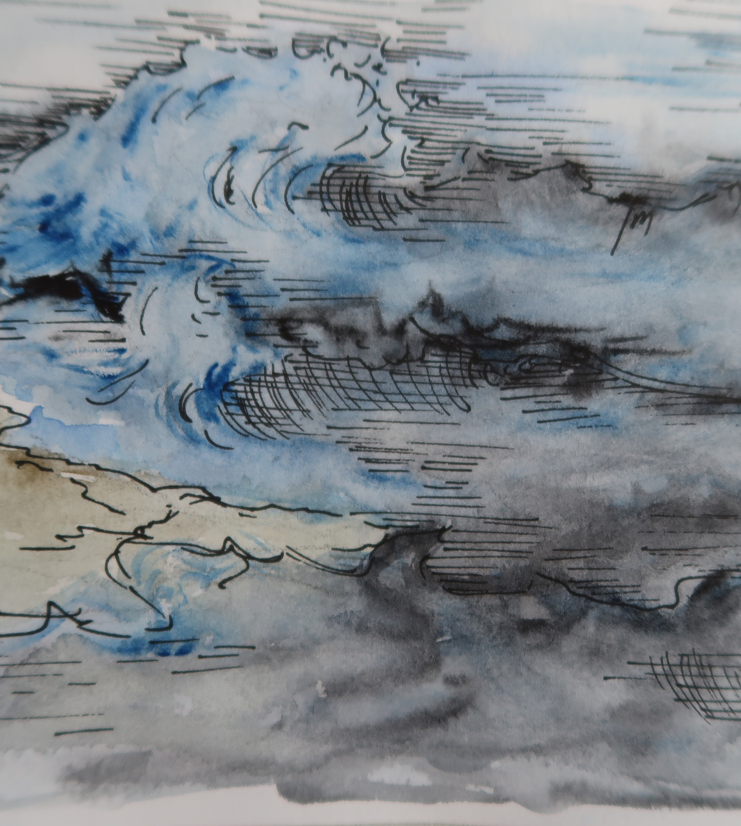
CLUSTER 2 – Culture, Creativity and Inclusive Society
Strengthened implementation of the EU Pact on Migration and Asylum and a focus on inclusion, integration, and health,
  efficient migration governance
  mapping of the existing landscape of health data integration for migrants
  best practices at EU, national, local levels and particularly the role of small and medium-sized towns
  deadline: 23 September 2026
Impact of access to nature-positive environments in promoting social cohesion and reducing inequalities in urban and peri-urban settings
  benefits of nature at societal level
  role of community-based projects; planning and design of green spaces; barriers to access nature
  deadline: 23 September 2027
Notes:
Geo hrozby – např. záplavy, sesuvy, požáry, zemětřesení.
CBRN-E hrozby – záměrně (terorismus) nebo nehodou – např. hrozby chemické (C), biologické (B), radioaktivní/radiologické (R), nukleární/jaderné (N) a výbušniny (E).

Slide 15

cluster 3 – civil security for society
Crime prevention approaches, online and off-line, tackling the nexus between addictions and crime
addictions (gambling, drug or alcohol use) often connected with crime
effective solutions to prevent addictions and related crimes, with a special attention to young people at risk
Enhancing the security of citizens against terrorism and lone-actor violence in confined spaces such as schools
solutions for ensuring civil security (of pupils, school staff, administrative workers) via exploring various societal and technological means of preventing such threats
Multi-hazard approach and cumulative / cascading impacts
integrated forecasting models, that enhance the prediction and management of multi-hazard scenarios (heatwave, floods, droughts, landslides, heavy rain)
interoperability of regional and national hazard warning systems
In some topics compulsory as beneficiaries: Police authorities and Civil Society Organisations
deadline:
5 November 2026
Notes:
Geo hrozby – např. záplavy, sesuvy, požáry, zemětřesení.
CBRN-E hrozby – záměrně (terorismus) nebo nehodou – např. hrozby chemické (C), biologické (B), radioaktivní/radiologické (R), nukleární/jaderné (N) a výbušniny (E).

Slide 16

cluster 5 – climate, energy and mobility
Flagship-pilot: large-scale demonstrations of CCAM (CCAM Partnership)
  large-scale demonstrations of inclusive, user-oriented, and well-integrated CCAM systems and services for people and goods
  enhance safety, reduce congestion, lower harmful emissions, contribute to decarbonization
  identification and selection of viable business models aiming for continued operation
Supporting sustainable and smart urban mobility in Europe (CIVITAS)
  dissemination of innovative solutions for sustainable urban mobility, from EU and national projects
  support to national CIVITAS networks, capacity building, twinning, experience exchange, cooperation with the industry,…
Deadline:
8 October 2026

Slide 17
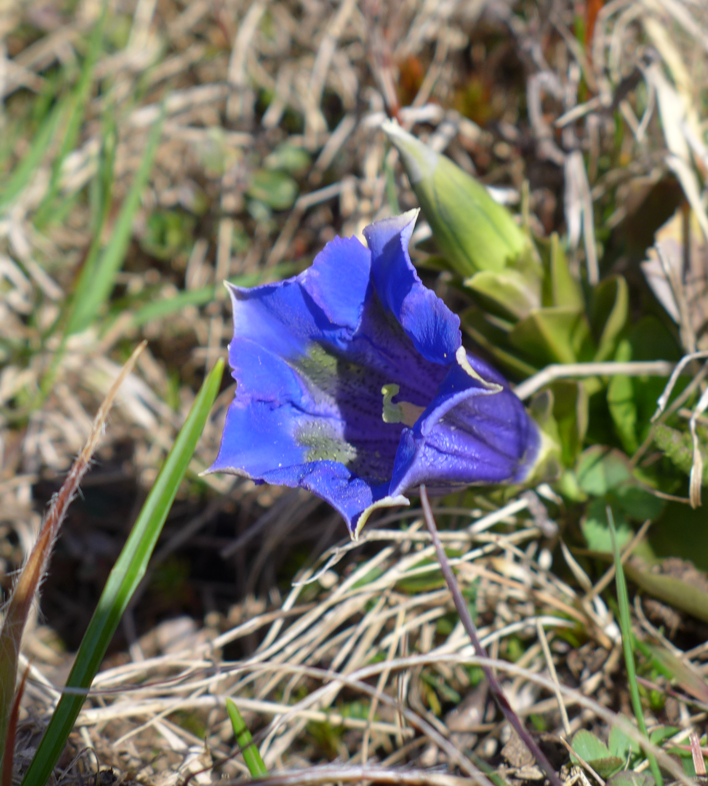
cluster 6 - Food, Bioeconomy, Natural Resources, Agriculture and Environment
Demonstrating and deploying innovative collection, sorting-for-reuse and repair systems for textiles at city/region level (Circular Cities and Regions Initiative topic)
  min. 9 distinct regional or local authorities must be part of the consortium as beneficiaries (from min. 3 different demonstration cities/regions + min. 6 replication cities/regions)
  deadline: 17 September 2026
Deploying circular systemic solutions through living labs in cities and regions (Circular Cities and Regions Initiative topic)
  min. 5 living labs incl. cities/regions (min. 2 demonstration + min. 3 replication, 1 of them from Widening country, e.g. CR)
  participation of all stakeholder in targeted cities and regions (citizens, policymakers, researchers, industries, SMEs, social economy entities and financial intermediaries)
  solutions that are practical, relevant, and readily applicable
  deadline: 8 April 2027

Slide 18
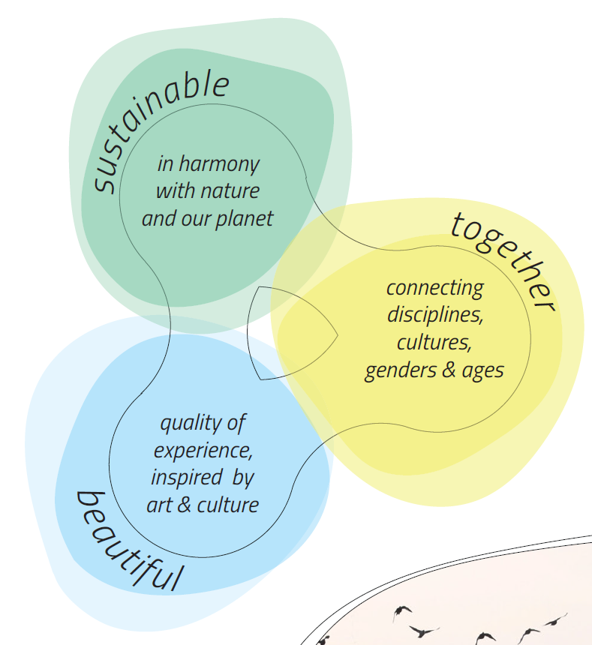

innovative solutions for the transformation of neighbourhoods to become not only sustainable, but also inclusive and beautiful
Examples of topics:
  Advancing sustainable maintenance and repair measures for existing buildings
  Understanding inhabitant’s experiences of neighbourhoods to support their health and well-being
  Approaches to reuse vacant, obsolete or underutilised spaces
  deadline: 1 December 2026

Slide 19

INFORMATION SOURCES
Cluster 2
  Information day TC Prague
  Information days EC
Cluster 3
  Information day TC Prague
  Information day EC
Cluster 5
  Information day TC Prague
  Information day EC
Cluster 6
  Information day Prague
  Information day EC
Missions
  Information day EC
NEB
  Information day EC

Slide 20
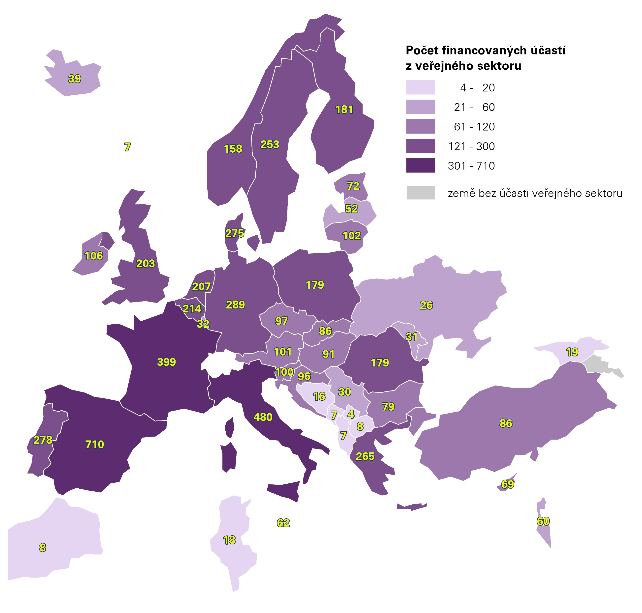
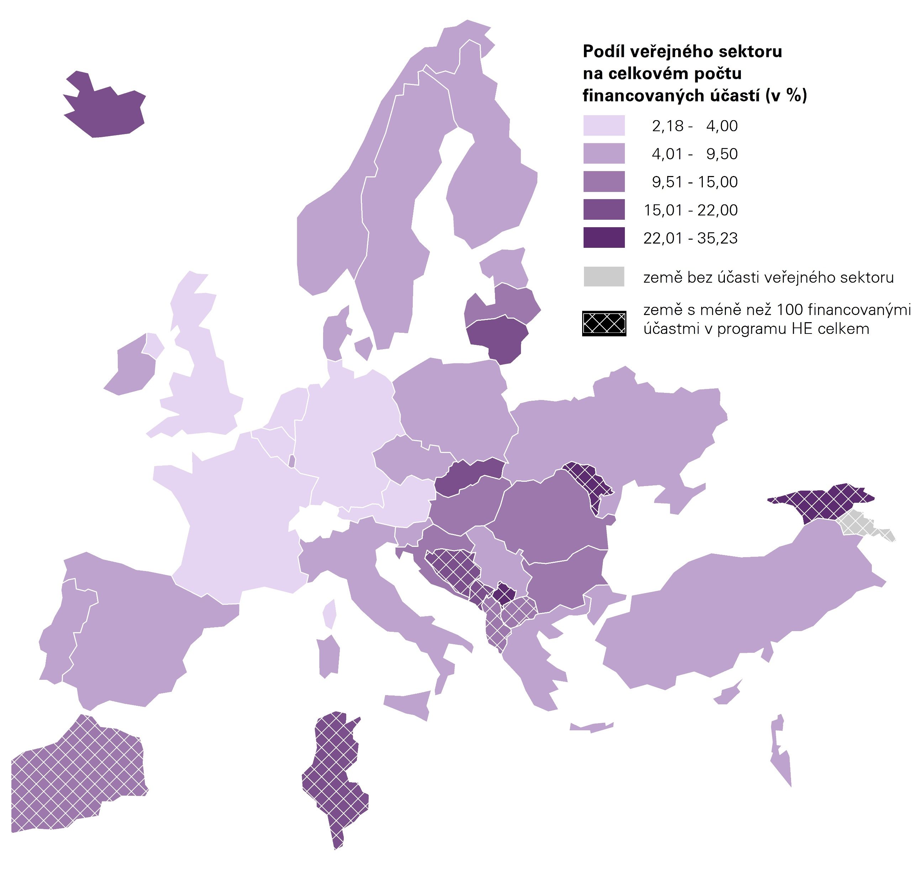
How does public administration participate in HE?

Slide 21
How does our public administration participate?
Organisation | Number of particip. | Net EU contribution in EUR
SPRAVA INFORMACNICH TECHNOLOGII MESTA PLZNE, PRISPEVKOVA ORGANIZACE | 3 | 649 563
SPRAVA NARODNIHO PARKU CESKE SVYCARSKO | 1 | 545 225
MESTO PISEK | 1 | 446 625
MESTO KRASNA LIPA | 1 | 427 550
STATUTARNI MESTO KLADNO | 1 | 413 000
Krajska nemocnice Liberec as | 1 | 345 175
STATUTARNI MESTO LIBEREC | 3 | 290 000
HLAVNI MESTO PRAHA | 1 | 201 418
Utvar koordinace evropskych projektu mesta Plzne, prispevkova organizace | 1 | 198 750
MESTSKA CAST PRAHA 6 / District Prague 6 | 3 | 130 318
PRAZSKA DEVELOPERSKA SPOLECNOST PRISPEVKOVA ORGANIZACE | 1 | 100 125
INSTITUT PLANOVANI A ROZVOJE HLAVNIHO MESTA PRAHY | 1 | 88 482
SPRAVA NARODNIHO PARKU SUMAVA | 1 | 77 750
Masarykovo muzeum v Hodonine, prispevková organizace | 1 | 0
TECHNICKA SPRAVA KOMUNIKACI HL. M. PRAHY, A.S. | 1 | 0
Total | 21 | 3 913 979
Funded participation of Czech municipalities and regions, and organisations established by them, in HE as of 21.10.2025

Slide 22
How can we help you = services of NICER

Slide 23
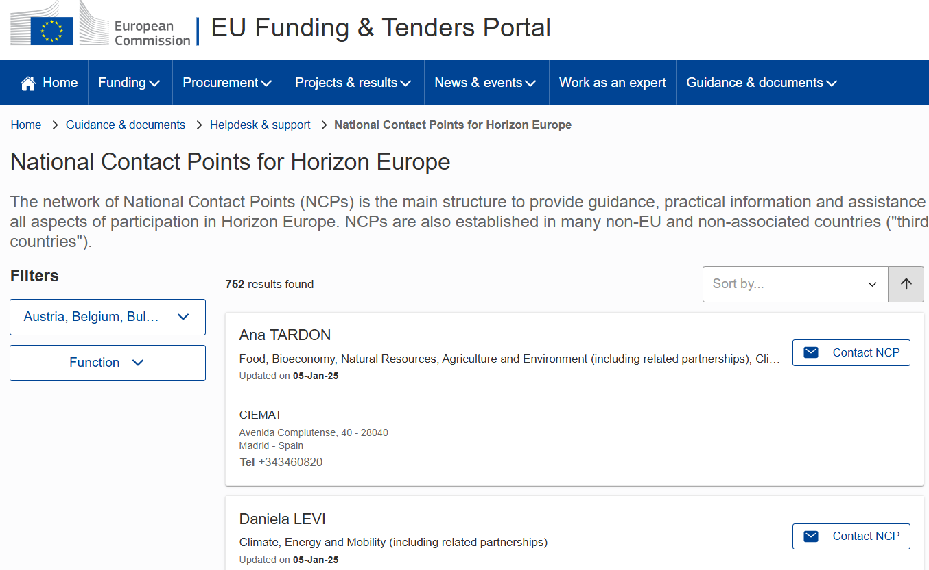
National contact points of HE (NCP)
= national structures established and financed by governments of EU MS and AC (states associated to HE)
give personalised support on the spot and in applicants' own languages
Where to find them

Slide 24
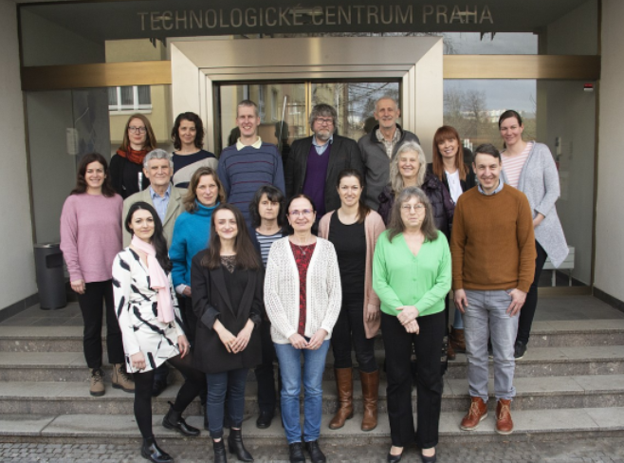
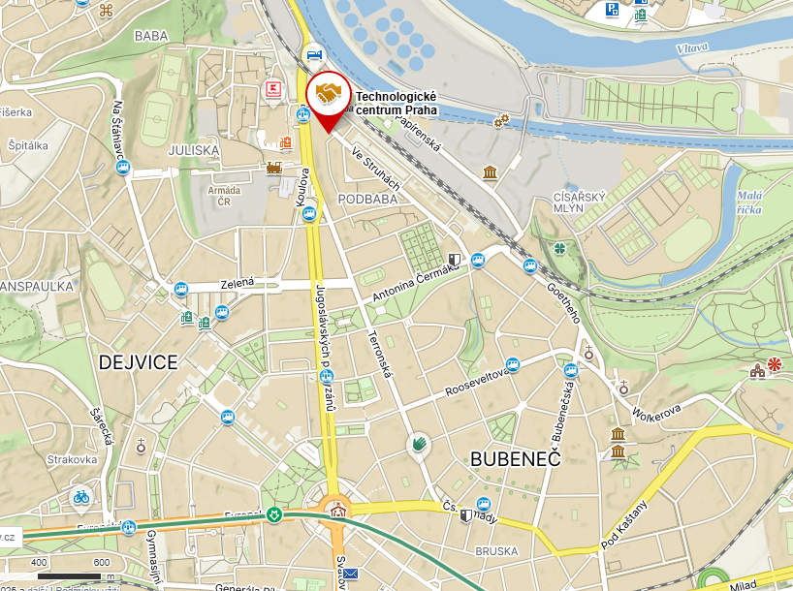
Nicer = national information centre for European research
provides a complete portfolio of services necessary for participation in international cooperation in research, development and innovation
team of NCPs officially appointed by the Ministry of Education, Youth and Sports in all priorities and horizontal activities of HE
our mission = to help increase the participation of national teams in HE and thereby contribute to improving the quality of Czech research
Where to find us

Slide 25
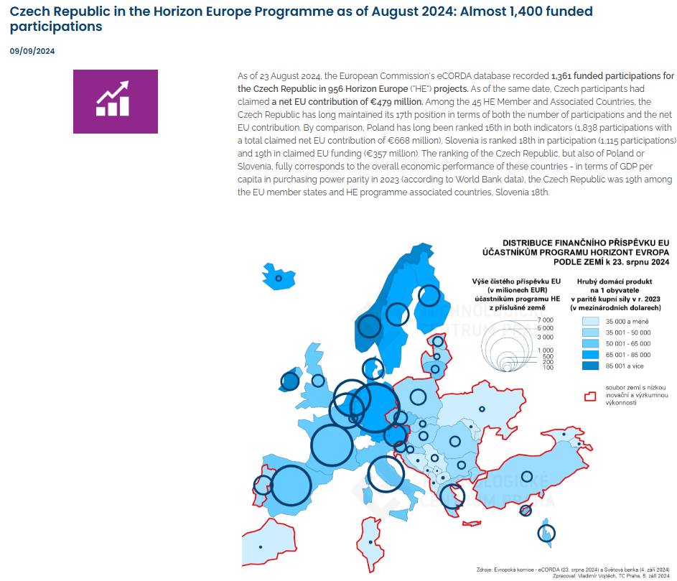
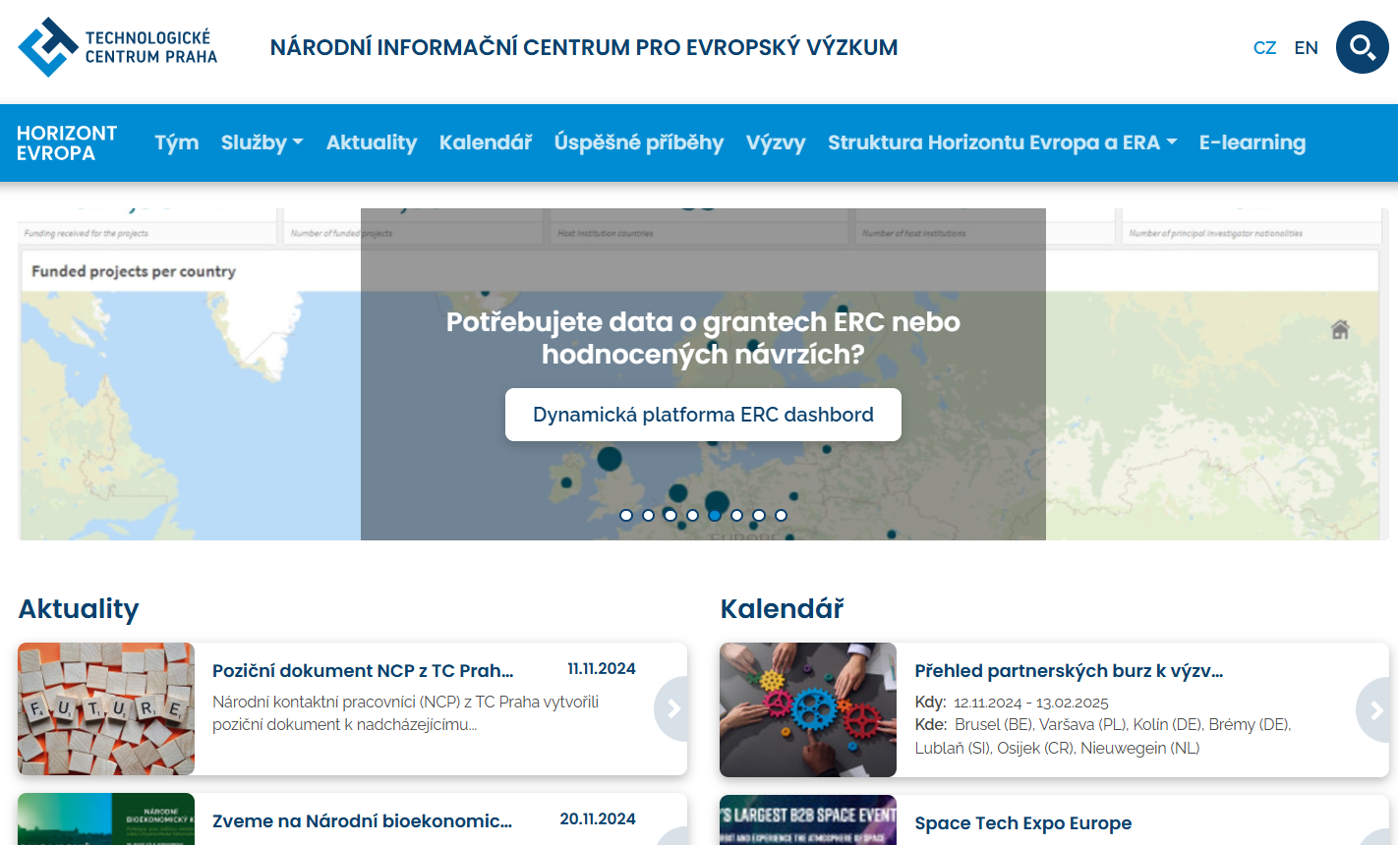
What are we doing?
Trainings and information events
Analysis of the FP participation
5
1
Support to public administration
Consultations
NICER
4
www.horizontevropa.cz
2
3
Publication activities

Slide 26
Funded Project example

Slide 27
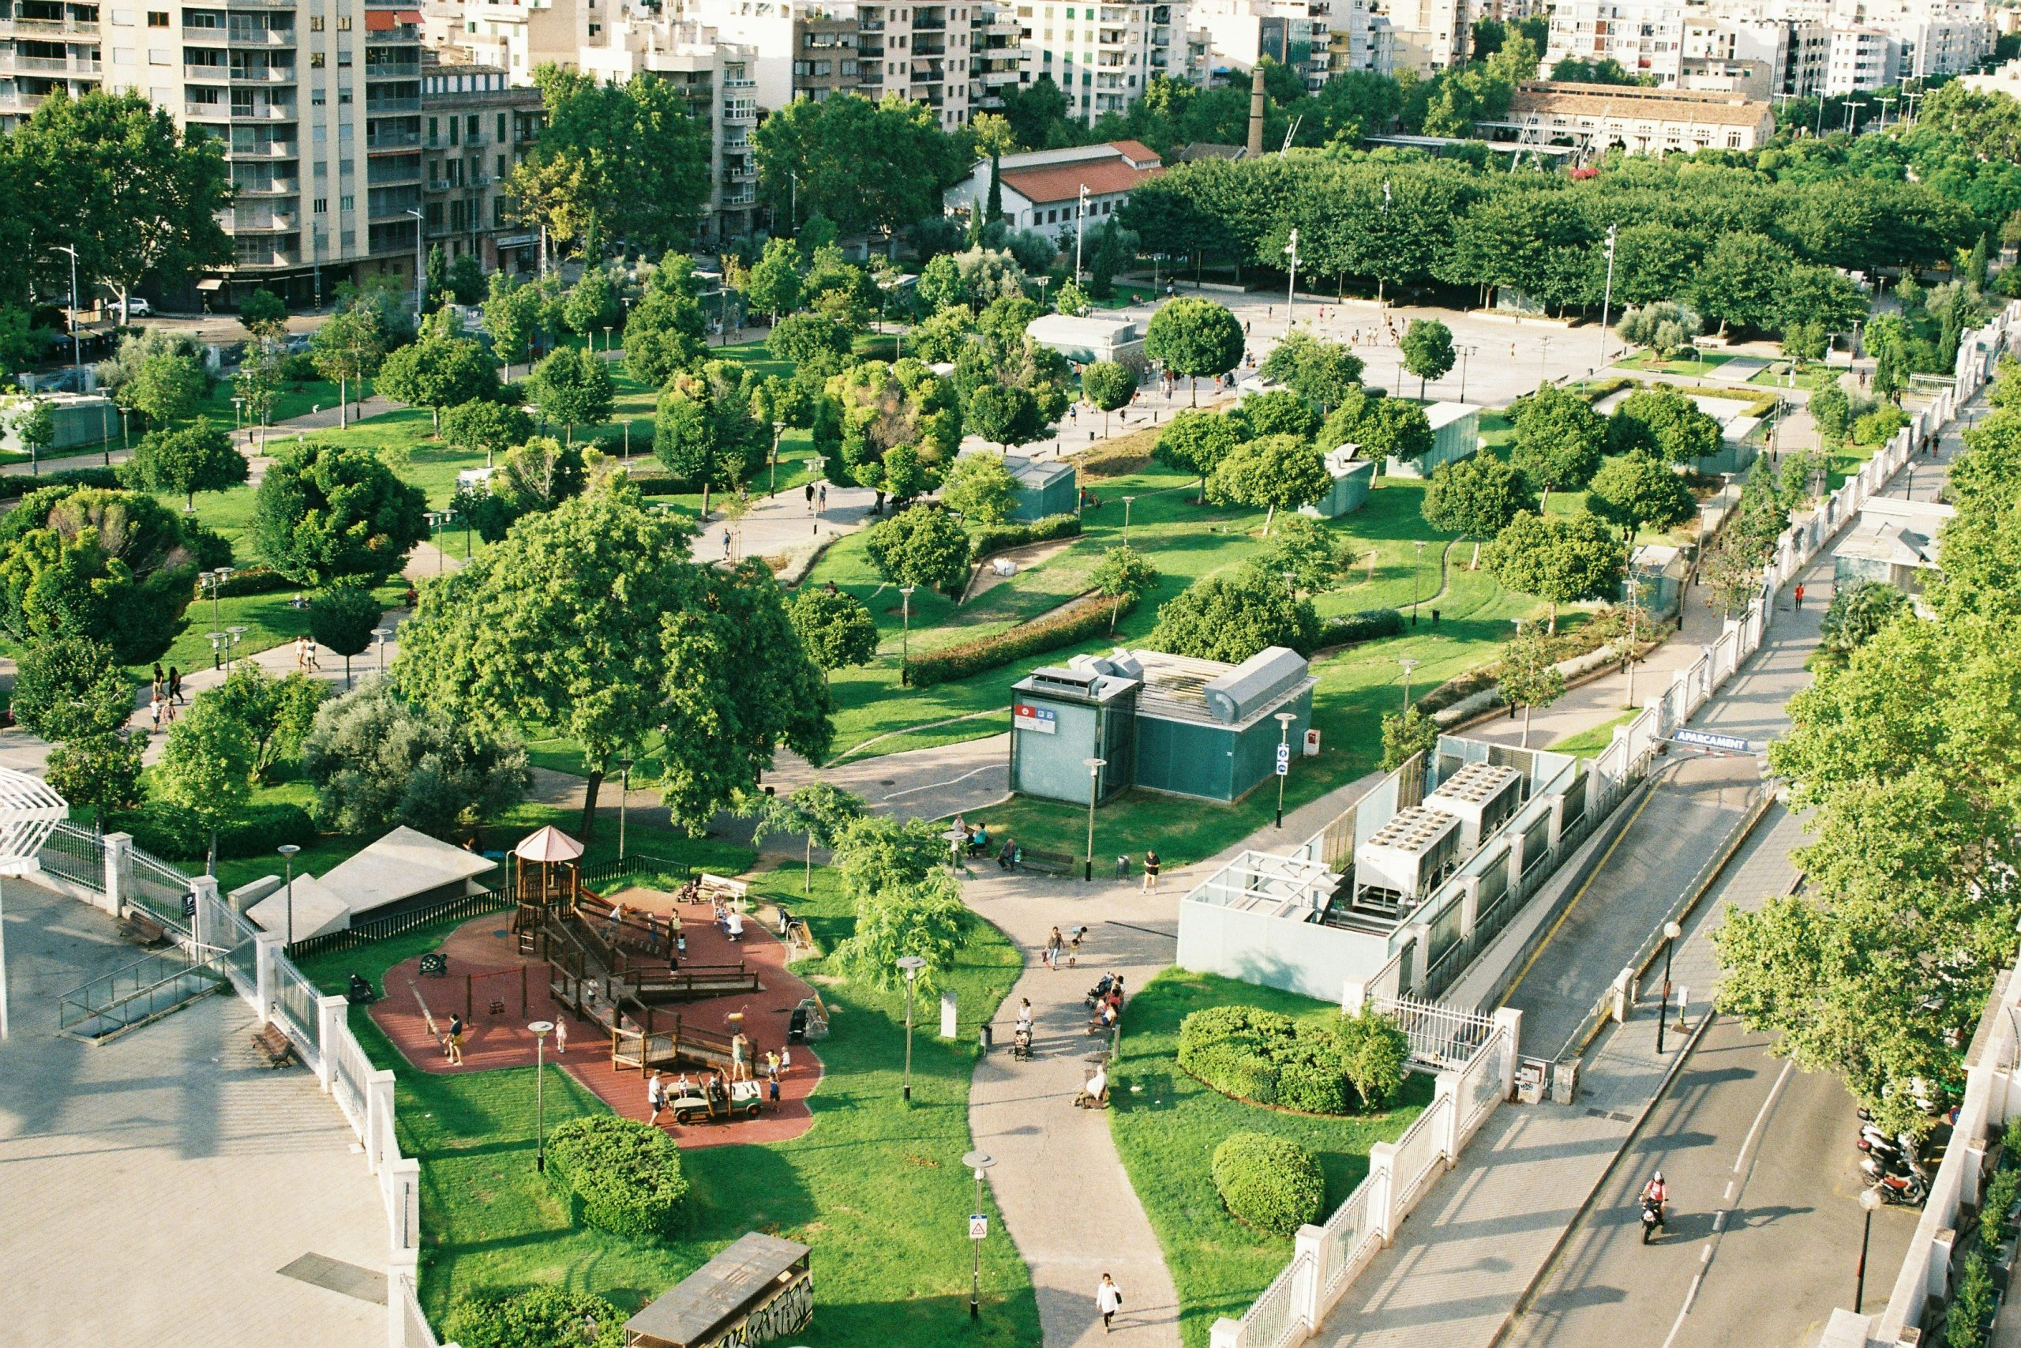
ProjeCt Regreeneration
The next generation of green, resilient and socially inclusive smart cities
2024-2027, 10,8 mil. eur
26 participants, including 9 cities collaborating to find solutions for the regeneration of urban districts to enhance resilience to climate change; transfer of good practices
experts from architecture, urbanism, spatial planning and landscape design, sociology, and economics…
the aim is to improve quality of life, achieve better water management and use, preserve biodiversity in cities; the project also includes educational activities
https://regreeneration.eu/

Slide 28

Questions?
Jana Čejková, Naďa Koníčková
cejkova@tc.cz, konickova@tc.cz
www.tc.cz

