Slide 1
Horizon Europe EU Framework Programme for Research and Innovation
Michal Vávra
Litomyšl, 16 April 2026
Datum

Slide 2
Aim of the presentation
To provide a basic overview about Horizon Europe Framework Programme, its structure and main instruments
To trigger you to think about potential areas and opportunities for cooperation and involvement

Slide 3
Horizon Europe Framework Programme
9th EU Framework Programme for Research and Innovation
Implemented in 2021 – 2027
Budget 93,5 bil. EUR
To support EU‘s scientific and technological excellence
To address policy priorities and grand societal challenges, thus contributing to the competitiveness of the EU
To boost uptake of innovations in Europe
To strengthen the European Research Area and support widening participation
Complementary programme – Euratom for Research and Training Programme

Slide 4
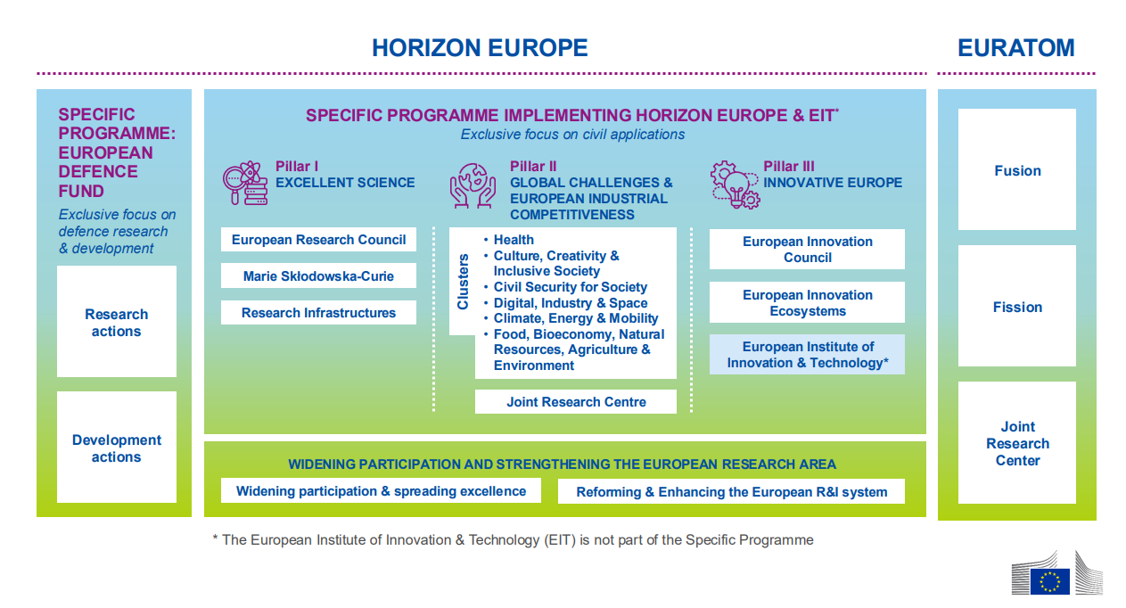
Horizon Europe Structure
Nadpis 1
Odrážka
Odrážka
Nadpis 2
Odrážka
Odrážka
Nadpis 3
Odrážka
Odrážka

Slide 5
Pillar I – Excellent Science
Excellence-driven bottom-up research
European Research Council (ERC)
Frontier research aiming at breakthrough discoveries
Topics decided by the researchers
Marie Sklodowska-Curie Actions (MSCA)
Mobility schemes, incl. Intersectoral mobility
Brain circulation
Research infrastructures
State-of-the-art research facilites

Slide 6
Pillar II – Global challenges and European industrial competitiveness
Top-down research aiming to solve pressing socioeconomic challenges
6 thematic clusters
Health; Culture, Creativity & Inclusive Society; Civil Security for Society; Digital, Industry & Space; Climate, Energy & Mobility; Food, Bioeconomy, Natural Resources, Agriculture & Environment
European partnerships
Around 50 partnerships of 3 types across all thematic priorities
Missions
Adaptation to climate change; Climate; Climate-neutral and smart cities; A Soil Deal for Europe; Restore our Oceans and Waters

Slide 7
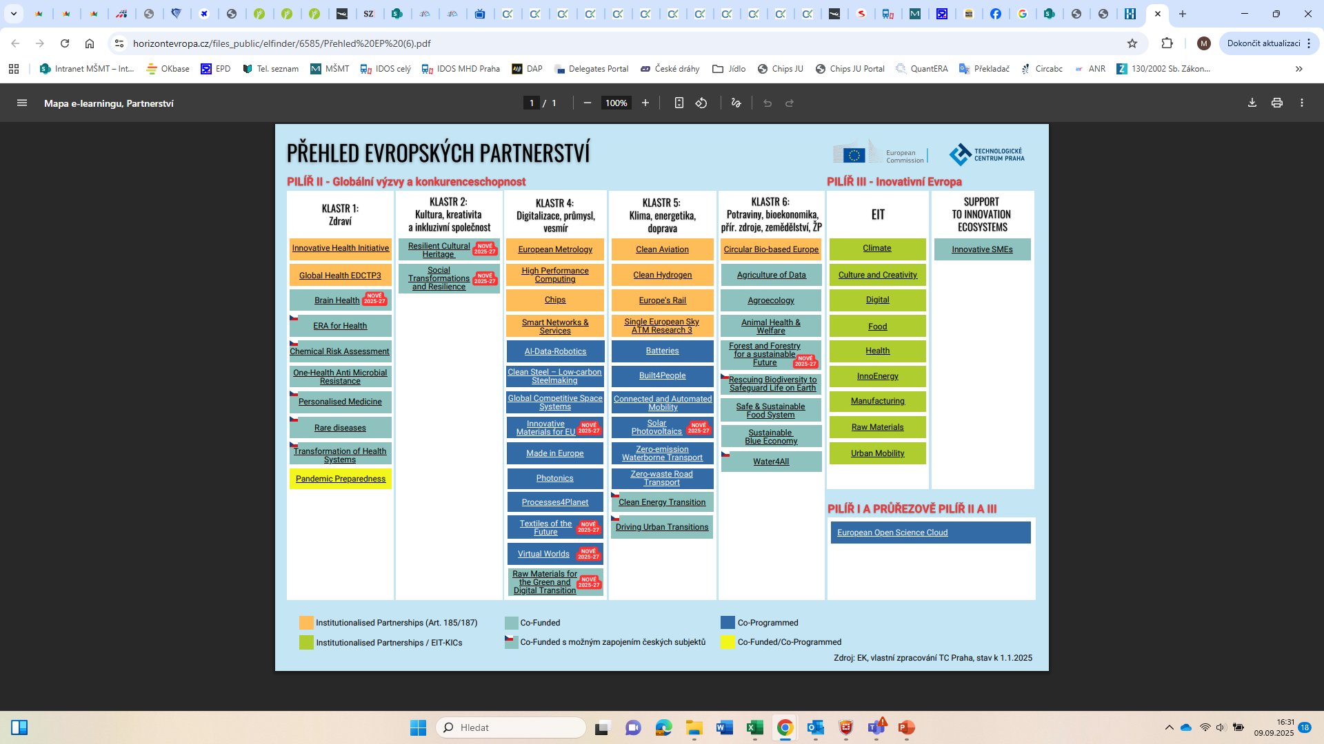
Pillar II – European partnerships

Slide 8
Pillar III – Innovative Europe
Focus on innovations and uptake of innovative solutions at the market
European Innovation Council (EIC)
Support to breakthrough innovations of European companies
Bottom-up approach, project topics defined by the researchers
European Innovation Ecosystems (EIE)
Aimed at connecting regional and national funding providers for innovators
European Institute of Innovation and Technology (EIT)
Activities aiming at supporting the knowledge triangle – education, research, industry
Based on activities of thematically focused Knowledge and Innovation Communities

Slide 9
Widening Participation and Strengthening European Research Area
Cross-cutting priority
„ERA Part“
Activities on implementing the goals of the European Research Area
„Widening Part“
Aiming at reducing disparities among EU Member States‘ performance in research and innovation
Capacity building, cooperation with excellent partners, institutional development, etc.
BG, CY, CZ, EE, EL, LT, LV, MT, PL, PT, RO, SI, SK + some Horizon Europe Associated Countries (e.g. UA, MK and more others)

Slide 10
Euratom for Research and Training
Complementary programme to Horizon Europe
Support of R&D activities in the nuclear field
To foster the development of fusion energy as a future source for electricity production,
To improve nuclear safety, security, safeguards, radiation protection, waste management and decommissioning - for power and non-power applications of nuclear technologies,
To further develop expertise and competence in the nuclear field within the EU,
To support the policy of the EU and its members on continuous improvement of nuclear safety, safeguards and security.
€222 million for indirect actions in fusion research and development
€108 million for indirect actions in nuclear fission, safety and radiation protection

Slide 11
A view forward
FP 10 legislative proposals introduced by the European Commission in July 2025
Currently negotiations underway in both Council and European Parliament
4-pillar structure, evolutionary approach
Legal texts rather short and general in nature
Strong synergies with European competitiveness fund (ECF) foreseen
Start of the programme envisaged in 2028

Slide 12
Thank you for your attention!
Michal Vávra
Michal.Vavra@msmt.gov.cz
Tel. +420 773 793 439

