Slide 1


Faculty of Restoration / University of Pardubice
International and national cooperation

Slide 2
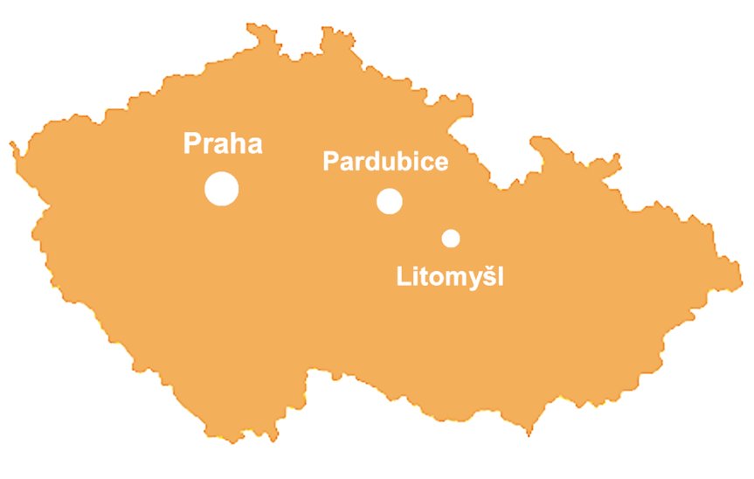

Slide 3
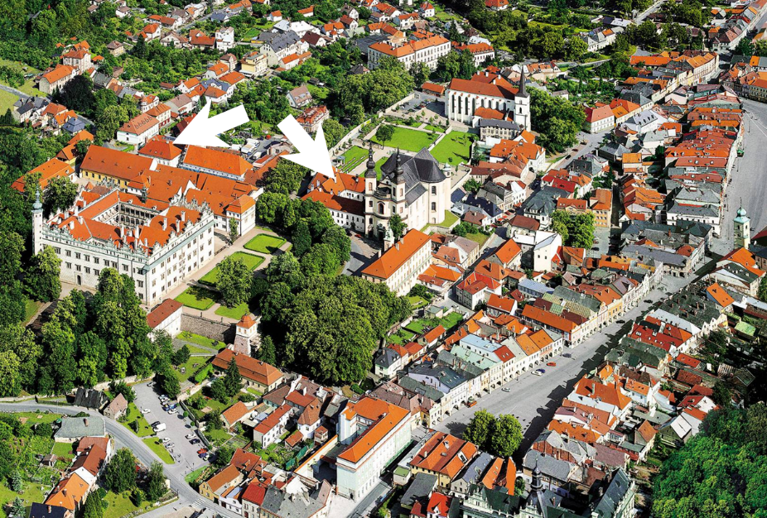

Slide 4
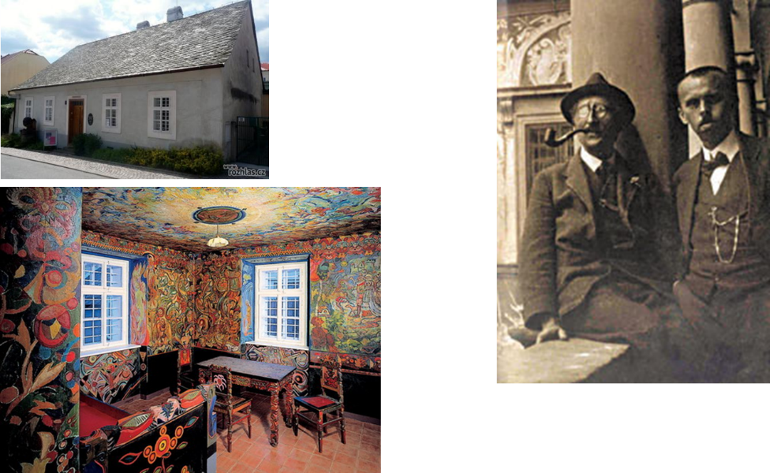
Start - 1993
Portmoneum
Mural paintings: Josef Váchal, 1920-1924

Slide 5
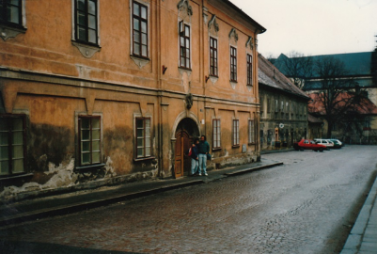
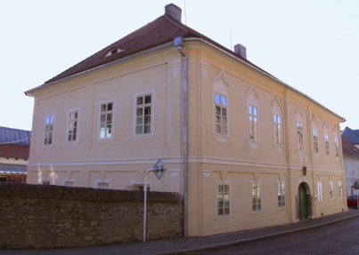
History
1993 – establishment of The School of Restoration (three-year post-secondary study program)
1997 – The Tertiary Professional School of Restoration and Conservation Techniques (tertiary professional school)
2000 – Institute of Restoration and Conservation Techniques (higher education institution of non-university type)
2005 – University od Pardubice

Slide 6
Study programmes
Bachelor level - four study programmes
Duration 4 years (8 semester)
Restoration and Conservation of Stone and Related Materials
Restoration and Conservation of Wall Painting and Sgraffito
Restoration and Conservation of Paper, Bookbinding and Documents
Restoration and Conservation of Artworks on Paper and Related Materials
Consecutive master level - two study programmes
Duration 2 years (4 semester)
Restoration and Conservation of Wall painting, Sculptures and Architectural surfaces
Restoration and Conservation of Works of Art and Art-craft works on Paper, Textile and Related materials
Doctoral programme „Conservation sciences“ prepared for the accreditation in 2021

Slide 7
Structure / Studios and departments
Studio of Restoration and Conservation of Stone and Related Materials
Studio of Restoration and Conservation of Wall Painting and Sgraffito
Studio of Restoration and Conservation of Paper, Bookbinding and Documents
Studio of Restoration and Conservation of Artworks on Paper, Textile and related Material
Department of Chemical Technology
Department of Humanities
Studio of Fine Art Training

Slide 8
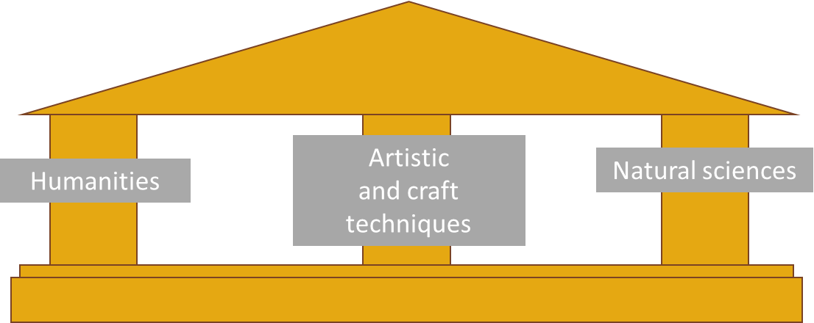
Education and research concept
based on the actual principles of cultural heritage care - interdisciplinary approach
understanding and experience of art techniques, material science and humanities related to cultural heritage care
up-to-date knowledge and methods and specific theoretical knowledge in the field of restoration and conservation

Slide 9
International and National Cooperation
Main Goals
Mobility – academic staff and student mobility; gaining experience at the international level
Research – cooperation in international and national research projects
Invited Lectures – incoming and outgoing lectures; exchange of experience; enhancement of knowledge and quality; continuous updating of expertise
Practice-Oriented Cooperation – collaboration with institutions / subjects within the framework of practical education

Slide 10
International and national cooperation
Main Partners
Universities across Europe
Restoration companies and independent conservators-restorers
National heritage and monument conservation institutions
Archives, museums, and galleries
Private owners

Slide 11
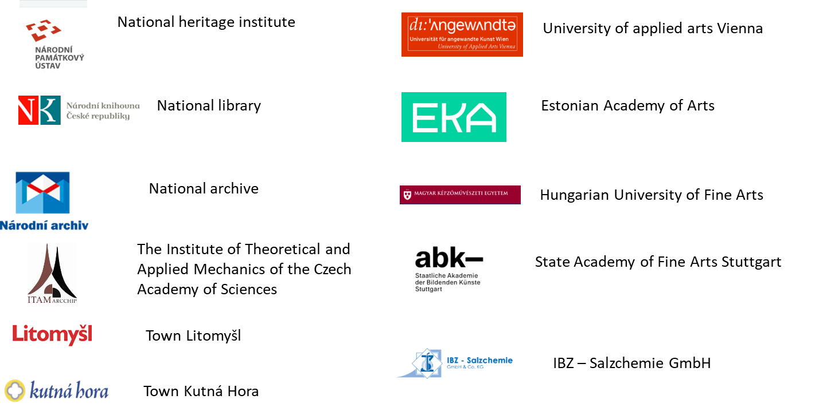

Slide 12
Research, development and innovation
Main defined topics
study of historical artistic techniques and materials e.g. historical mortars and
inorganic binding media, architectural surfaces, mosaics, bookbinding techniques
cooperative development and testing of innovative conservation techniques e.g. nanomaterials for consolidation; specific and safe cleaning methods; new desalination procedures etc.
comprehensive survey and restoration / conservation of specific artworks or
artworks with specific damage

Slide 13
International and national cooperation
Main funding sources / financial support
International
EU – research funding (Horizon, European Territorial Cooperation, FP 7…)
Erasmus / Erasmus plus
DBU (Deutsche Bundesstiftung Umwelt / The German Federal Environmental Foundation)
National
NAKI (Applied research and experimental development program focused on national and cultural identity, Ministry of culture of the Czech republic
TACR (The Technology Agency of the Czech Republic)
GACR (The Czech Science Foundation)

Slide 14
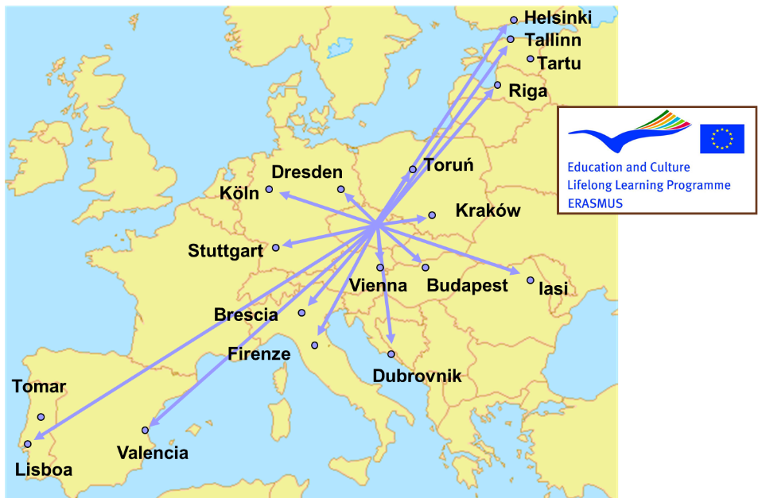

Slide 15

ROCEM – Roman Cement to restore built heritage effectively (2003-2006) (EU project EVK4-CT-2002-00084)
ROCARE – ROman Cements for Architectural REstoration to new high standards (2008-2012) (EU project FP7-ENV-2008-1)
STONECORE – Stone Conservation for Refurbishment of Buildings (2008-2011) (EU project FP7-NMP 2007-SME-1)
NANOFORART – Nano-materials for the conservation and preservation of movable and immovable artworks (2011-2014) (EU project FP7-ENV-NMP-2011)
NANOLITH - Application of nanomaterials for sustainable conservation of historical
works of sculpture and architecture constructed of Leitha limestone; M00264; program: European Territorial Cooperation, Austria – Czech Republic 2007 – 2013)

Slide 16
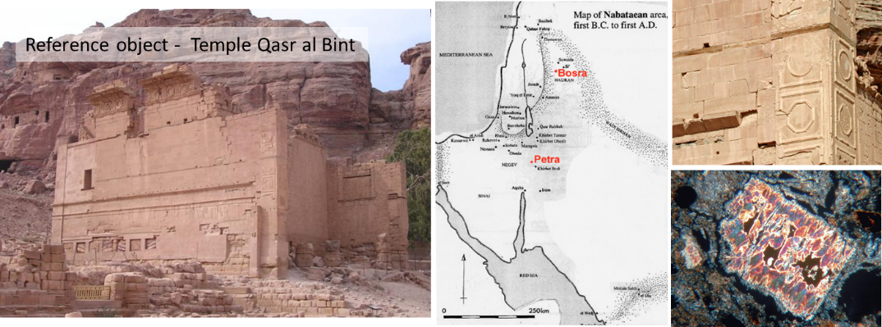
Research projects examples
NAMO „Nabatean Mortars – Technology and Application“ (EU- project ICA3-2002-10038, 2002-2004)
Investigation of mortars and building technologies used in the Nabatean period (Nabatean kingdom) in Jordan and Syria

Slide 17
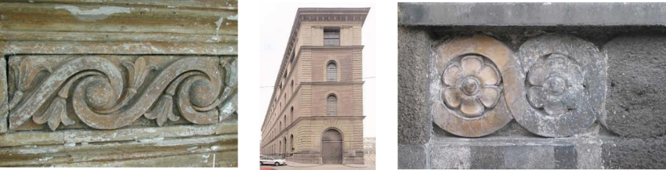
Research projects examples
ROCEM „ROman CEMent to restore built heritage effectively“
(EU project EVK4-2001-00159, 2002-2005)
ROCARE „Roman Cements for Architectural REstoration to new high Standards“
(EU-PROJECT No. 226898; FP7-ENV-2008-1, 2010-2012)
Both projects focused on Roman cement and Roman cement technologies
Roman cements – specific highly hydraulic natural binders - key materials to decorate facades of buildings in the 19th/early 20th centuries in Europe
Roman cement – basic characteristics: calcined at relatively low temperature, short time of setting, little shrinkage on setting, warm yellow-to-brown colour; good durability

Slide 18
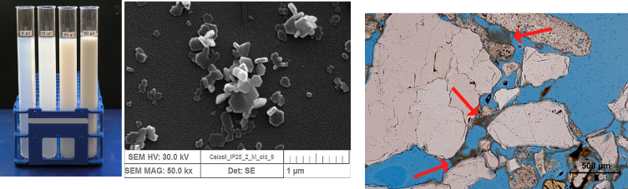
Research projects examples
„STONECORE“, 2008-2011 (Stone conservation for the refurbishment of buildings, project number 213651; FP7-NMP-2007-SME-1)
„NANOFORART"; 2012-2014 (Nano-materials for the conservation and preservation of movable and immovable artworks; 282816; FP7-ENV-NMP-2011)
„NANOLITH“; 2013-2014 (Use of nanomaterials for sustainable conservation of sculptural and architectural works made of Leitha-limestone; M00264; program: European territorial cooperation, Austria – Czech republic 2007 – 2013)
Research focused on development, testing and application optimising of new nanomaterials for conservation

Slide 19
Research projects examples
„Traces of creation, Saving the heritage of great sculptors of the first half of 20th century – Restoration and care for sculptural monuments made of gypsum“; 2016 - 2020
„Conservation of Glass and Stone Mosaics of the Czech Mosaics School"; 2016-2020
„Czech Art of 50th - 80s in the Public Space: Records, Survey and Restoration “; 2016-2020
„A gate to wisdom has been opened. Baroque cultural heritage of monasteries in Broumov and Rajhrad: protection, restoration, presentation“; 2016-2020
„Rennaisance and Mannerist stucco work on Czech and Moravian territory“ 2018-2022
„Blind witnesses: Blind tooling decoration on bookbindings“ 2020-2022

Slide 20
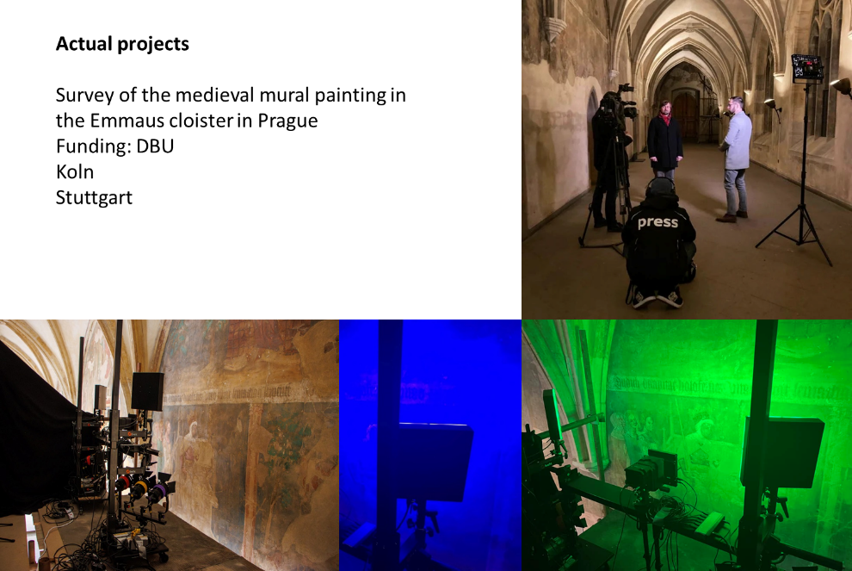
Concept of preventive conservation, securing and preserving the cycle of wall paintings in the Emmaus Monastery in Prague
2 Universities from Germany
1 University from Czech Republic
Deutsche Bundesstiftung Umwelt

Slide 21
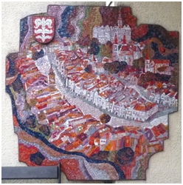
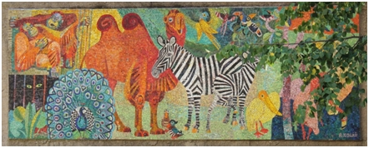
Mosaic Heritage: An AI-Powered Interdisciplinary Database of Czech Mosaic Artworks (MOHER)
EU - ECHOES Cascading Grants Programme
Data to the Cultural Heritage Cloud

Slide 22
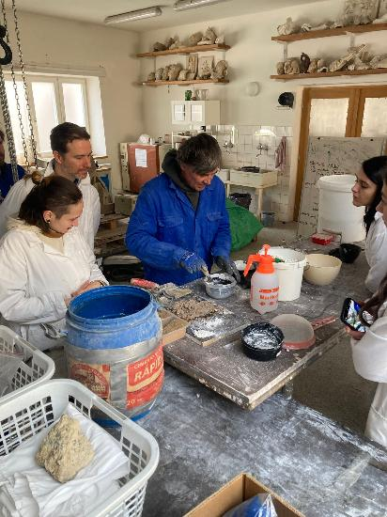
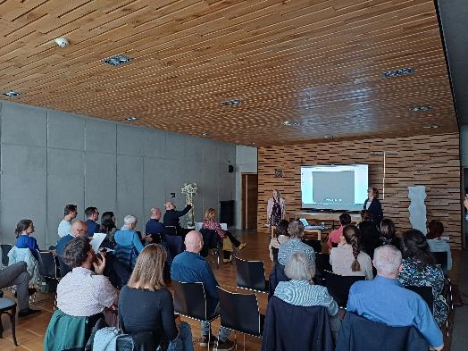
International Cooperation for Professional Training in Heritage Conservation - Heritage Train II
Erasmus plus / Lifelong learning
Slovakia / Austria / Czech Republic

Slide 23
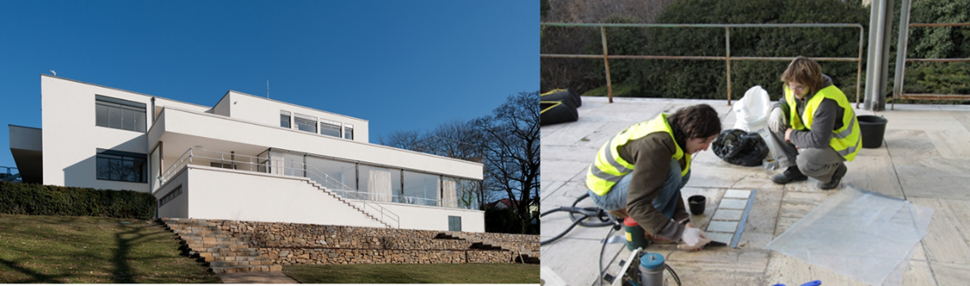
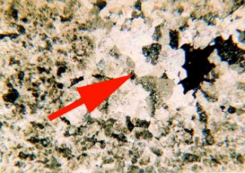
Conservation / restoration projects
Cooperation on comprehensive survey of the Villa Tugendhat in Brno

Slide 24
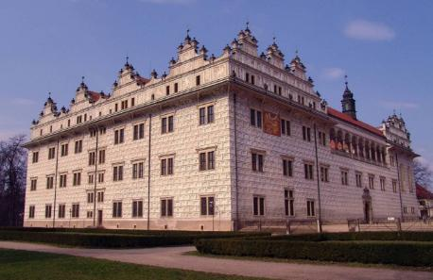
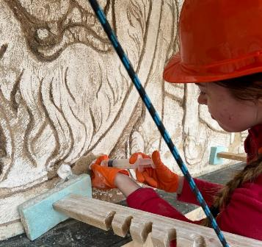
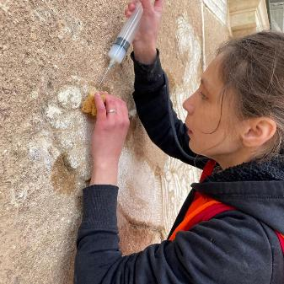
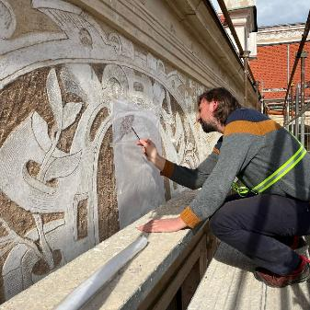
Conservation / restoration projects
Survey and conservation of the sgraffito facade on the Litomysl Chateau

Slide 25
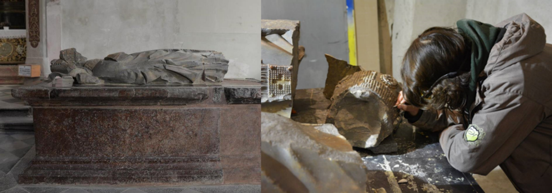
Restoration / Conservation projects
Comprehensive survey and restoration of medieval tombstone of Arnošt of Pardubice in Klodzko in Poland

Slide 26
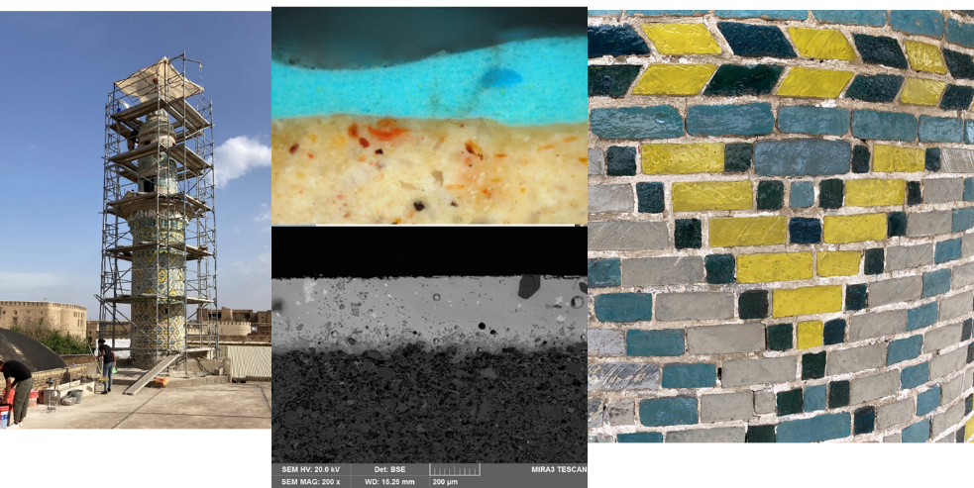
Restoration / Conservation projects
Cooperation on the survey and conservation of the Minaret of the Grand Mosque at Erbil citadel (leadership GEMA ART international)

Slide 27
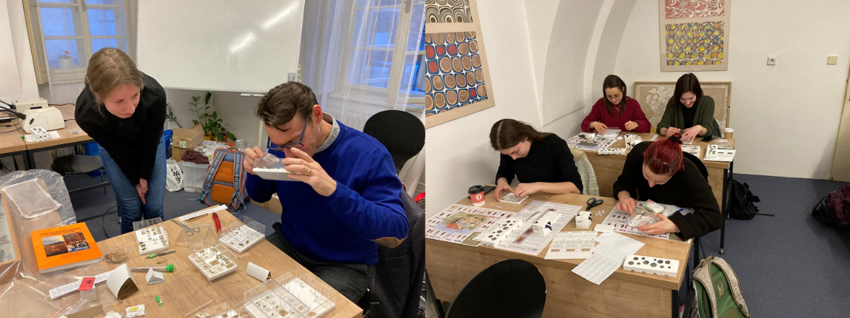
Invited lectures / Courses
IPM workshop (Integrated pest management – Dr. Pascal Querner, University of Natural Resources and Life Sciences Vienna

Slide 28
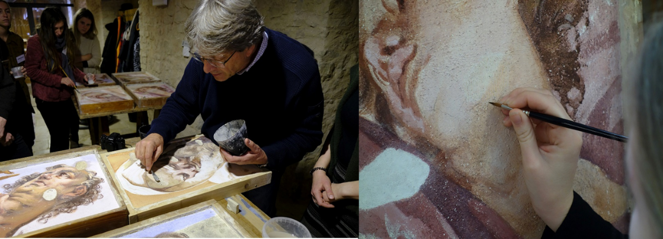
Painting retouching course
Paolo Pastorello / Studio C.R.C di Paolo Pastorello

Slide 29
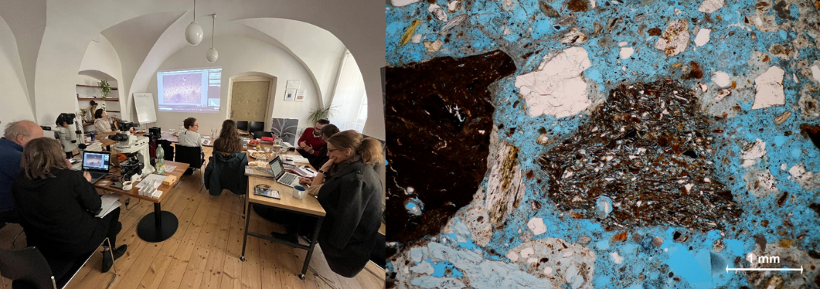
Advanced course on microscopy of mortars in cultural Heritage
Univ.-Prof. Dr. Johannes Weber, University of Applied Arts Vienna

Slide 30
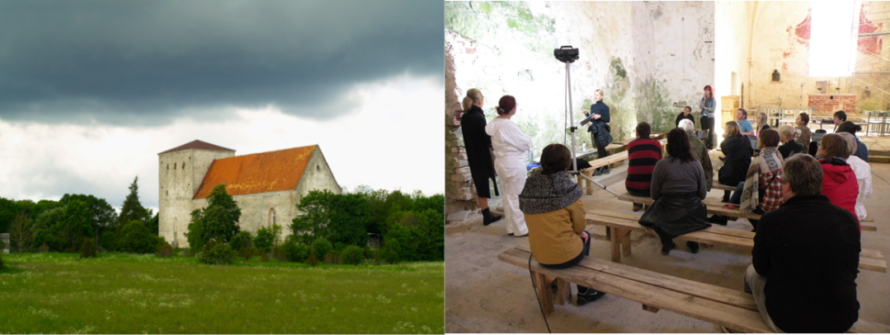
Nano­‐lime for conservation of stone, plasters and architectural surfaces
Estonia, Saaremaa
Jan Vojtěchovský / Karol Bayer, University of Pardubice

Slide 31
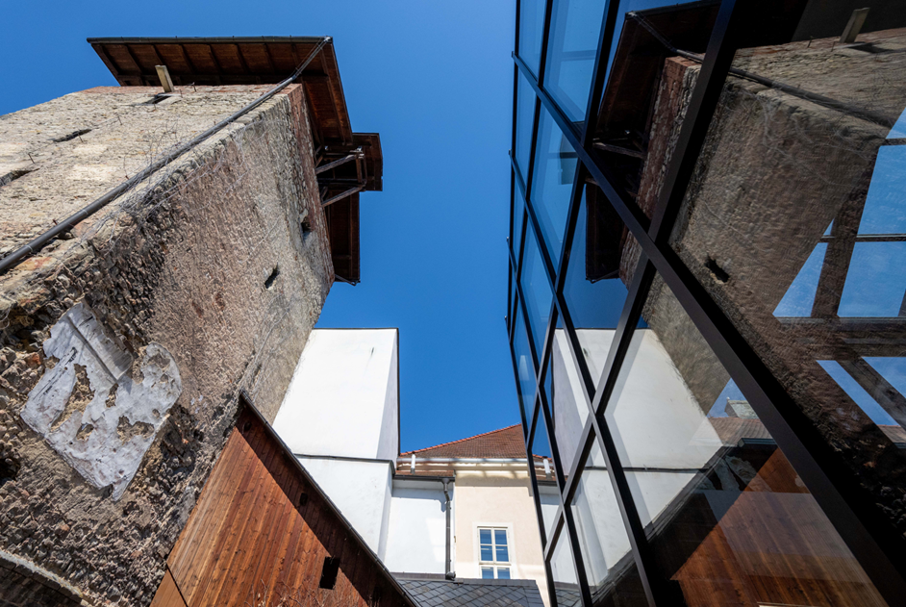
Thank you for your attention

