Slide 1
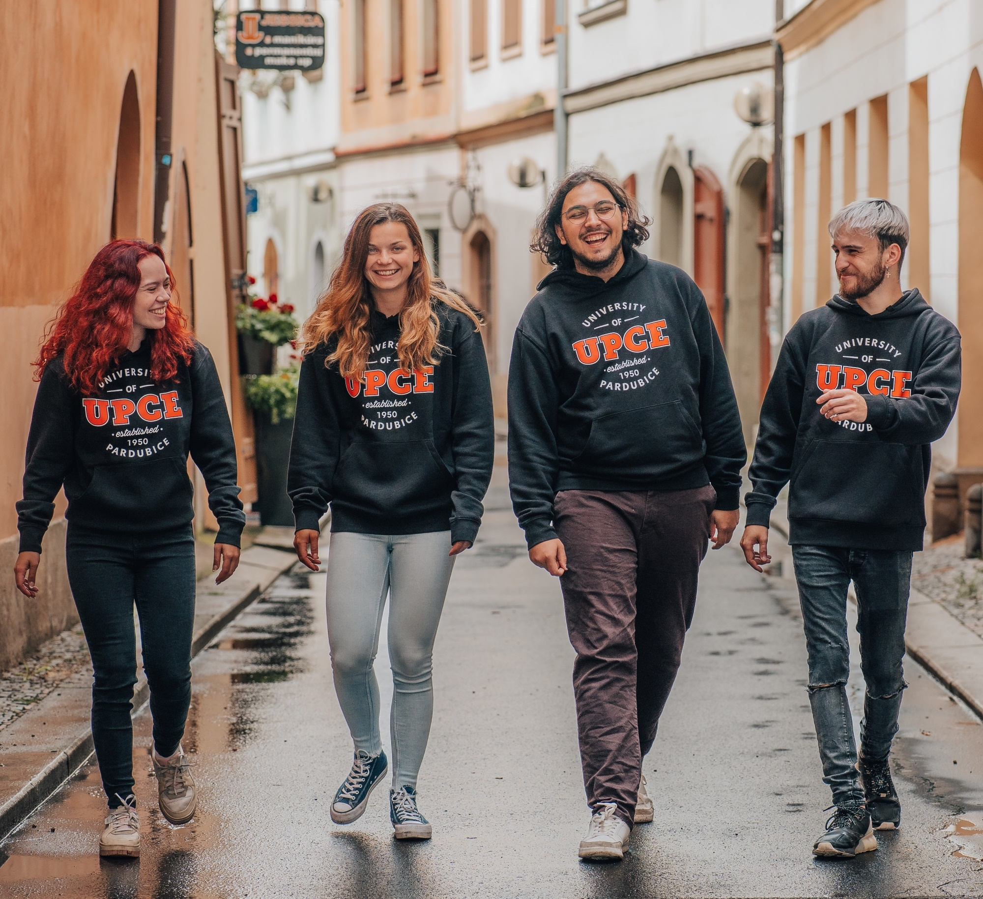


Slide 2
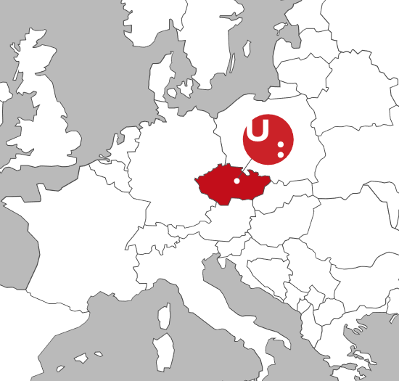
UNIVERSITY OF PARDUBICE
1950 Chemical College in Pardubice
1953 Institute of Chemical Technology
1991 Faculty of Chemical Technology
1991 Faculty of Economics and Administration
1993 Faculty of Transport Engineering
1994 University of Pardubice
2001 Faculty of Arts and Philosophy
2005 Faculty of Restoration
2007 Faculty of Health Studies
2008 Faculty of Electrical Engineering and Informatics
Writing our history since 1950

Slide 3

WE OFFER EDUCATION IN SEVERAL FIELDS
Transport
Economics
Humanities
Chemistry
Electrical Engineering and Informatics
Art Restoration
Health Studies
100
STUDY PROGRAMMES

Slide 4
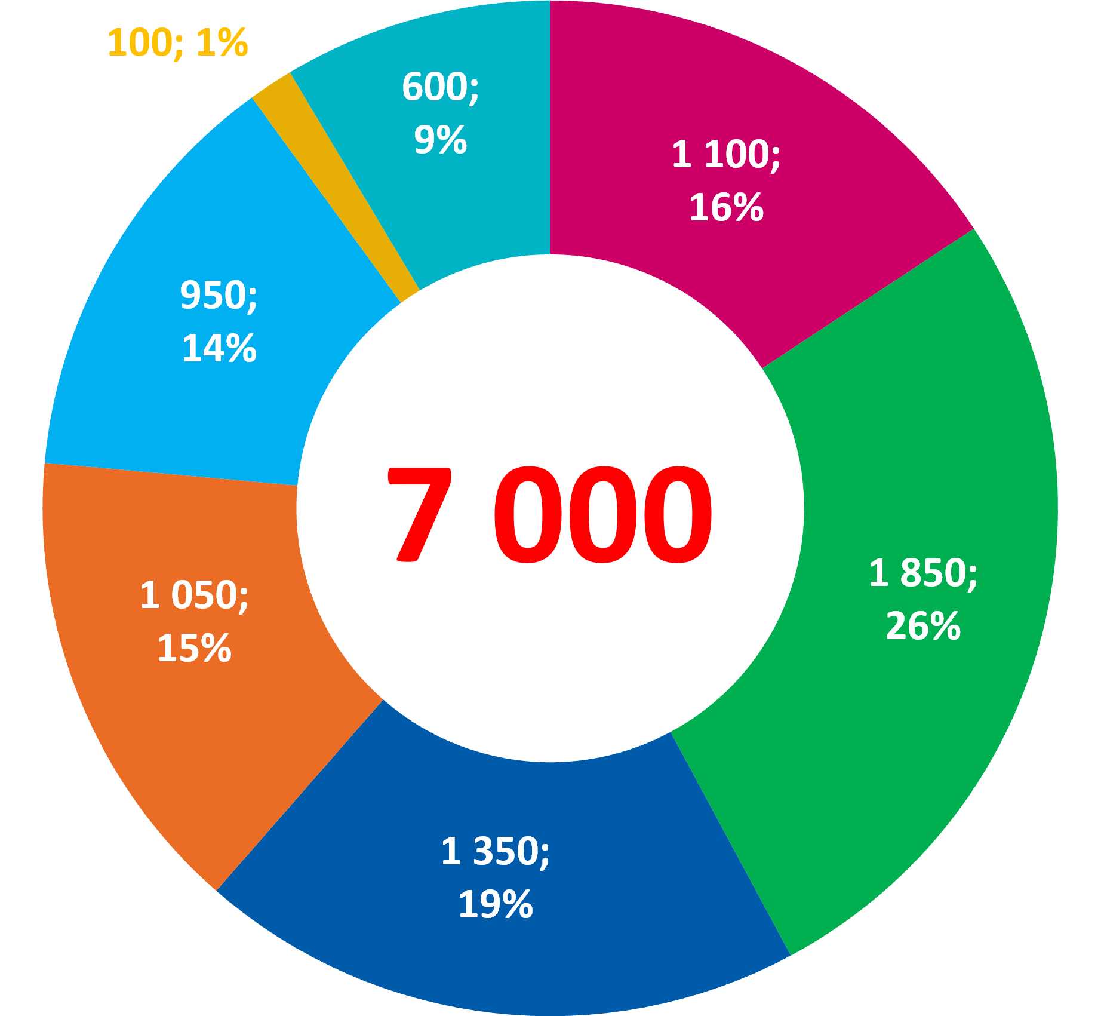
7 000 STUDENTS
Faculty of Health Studies
Faculty of Restoration
Faculty of Electrical Engineering and Informatics
Faculty of Chemical Technology
Faculty of Economics and Administration
Faculty of Transport Engineering
Faculty of Arts and Philosophy
73 %
22 %
5 %
550
100
BACHELOR'S
MASTER'S
DOCTORAL
INTERNATIONAL STUDENTS
ERASMUS
STUDENTS

Slide 5
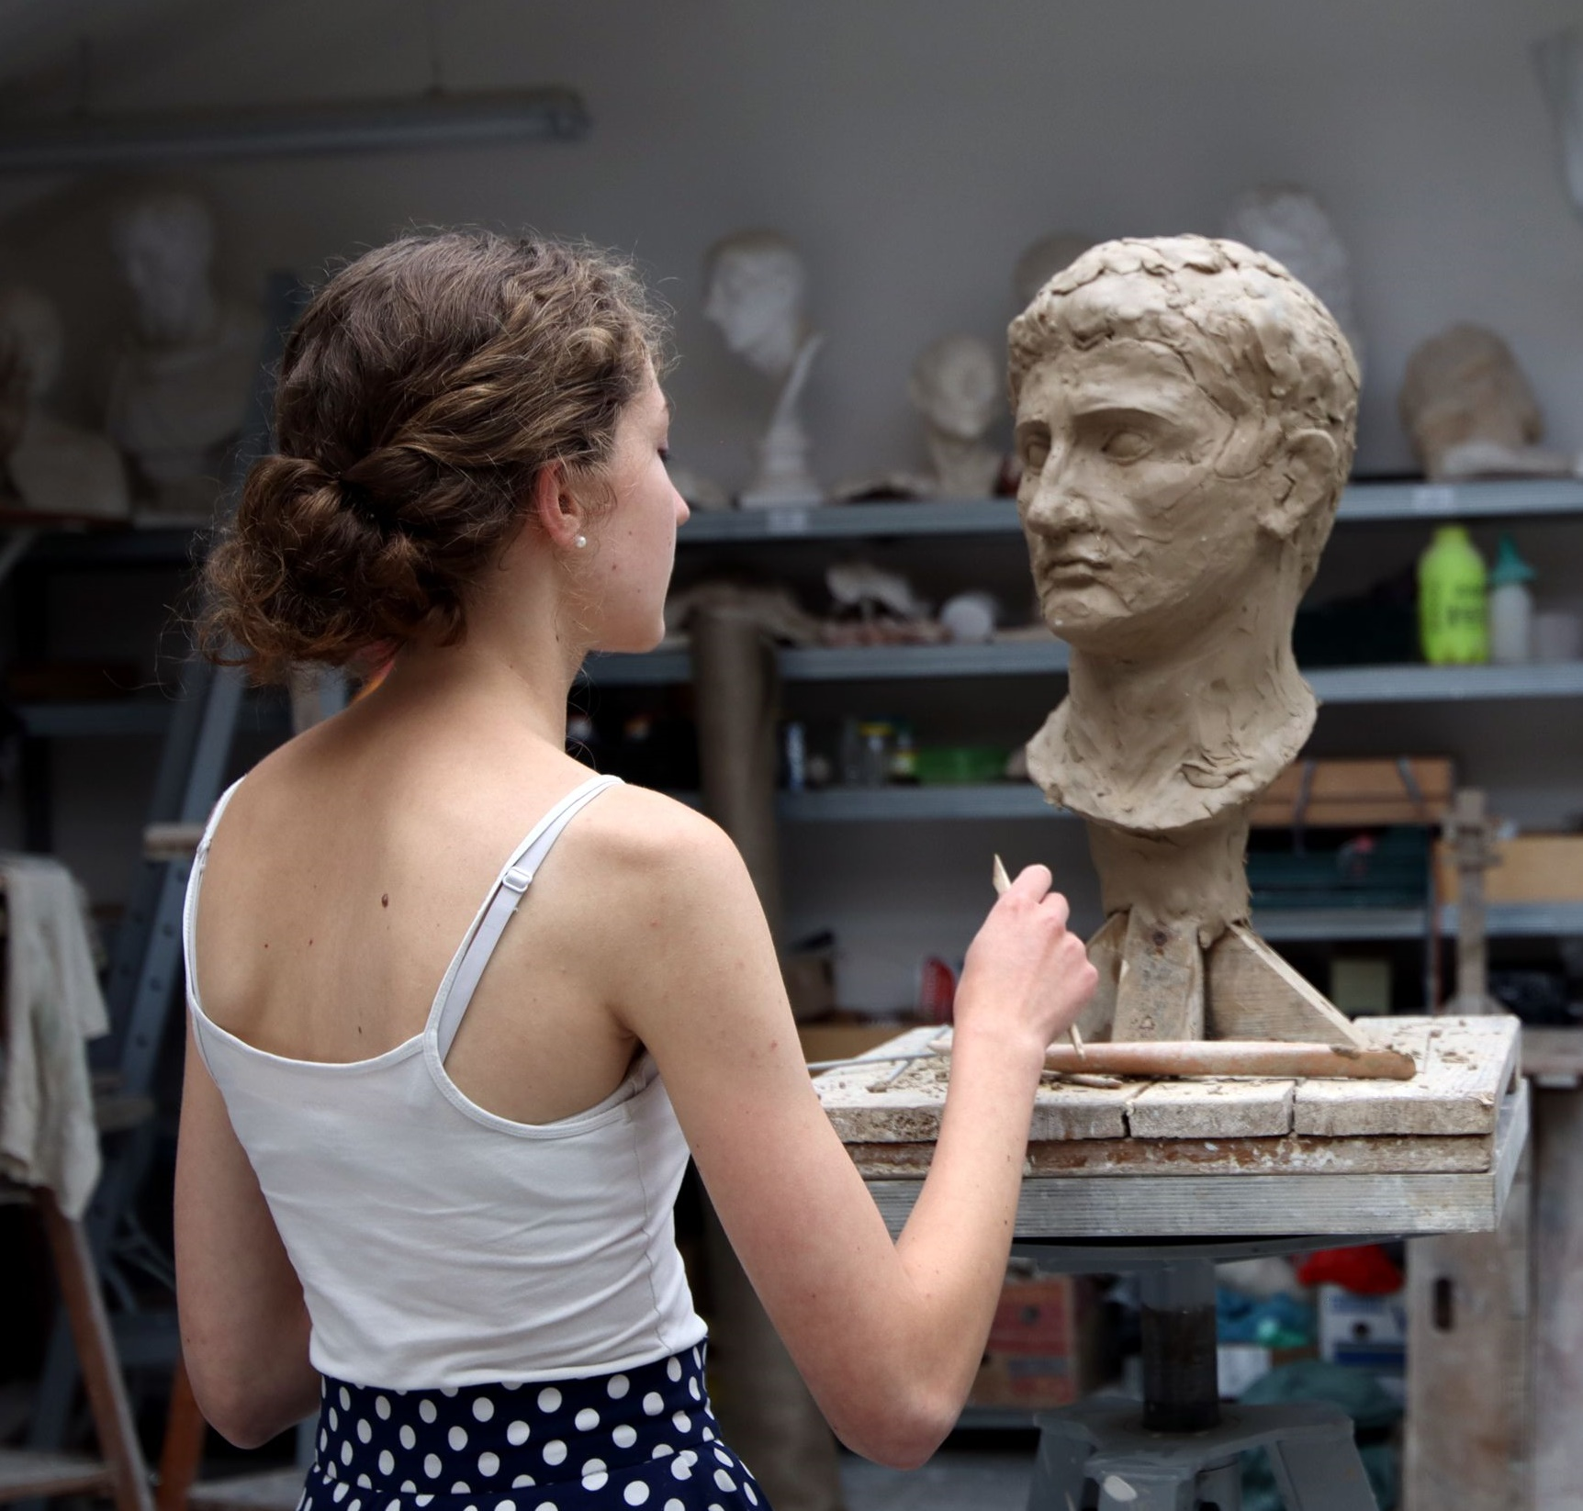
ExcelLENT SCIENTIFIC AND RESEARCH TEAMS
1
NATURAL SCIENCES
Computer Sciences, Information Sciences
Organic Chemistry
Inorganic and Nuclear Chemistry
Physical Chemistry
Analytical Chemistry
ENGINEERING AND TECHNOLOGY
Materials Engineering
Coatings and Films
ARTS AND SOCIAL SCIENCES
History
Philosophy, Ethics
Arts, Art History
2
3

Slide 6
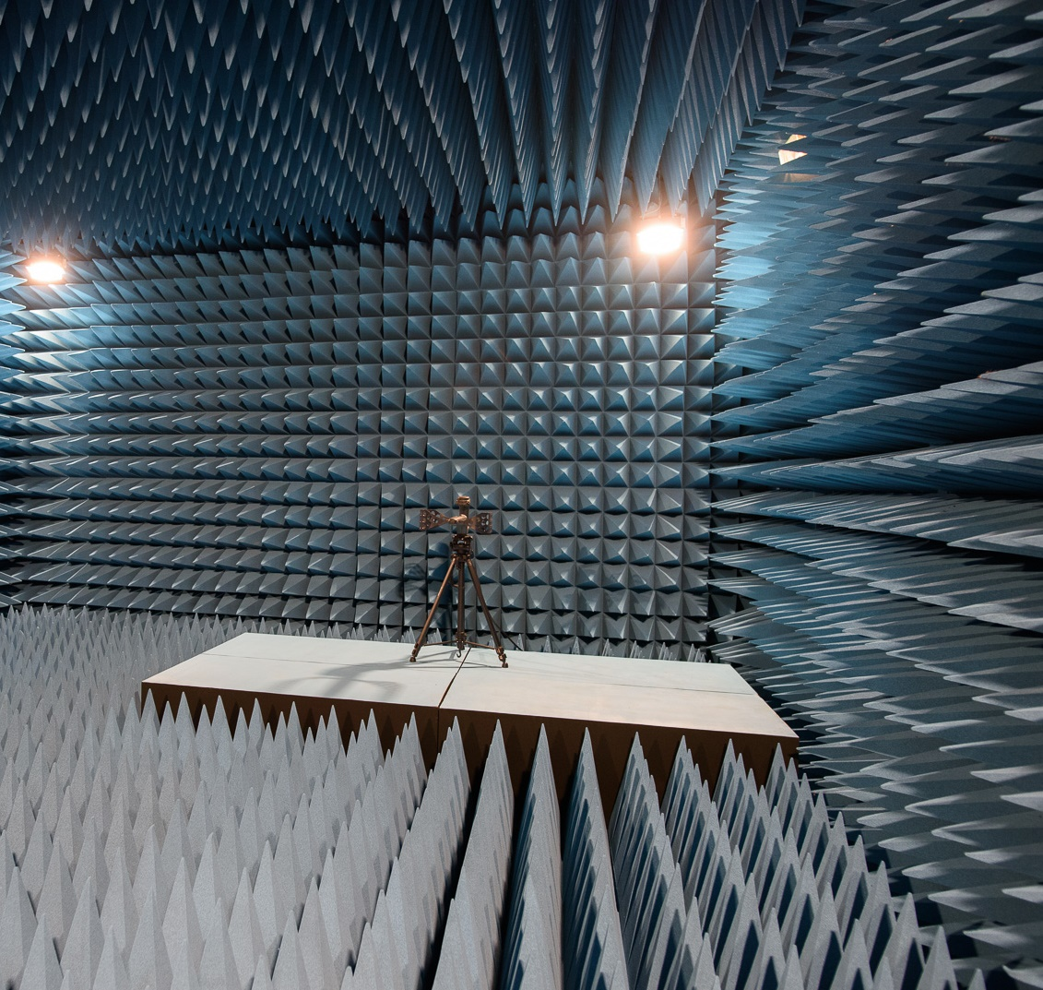
Research centres
RESEARCH AND DEVELOPMENT
Center of Materials and Nanotechnologies (CEMNAT)
Centre for Ethics as Study in Human Value
Educational and Research Centre in Transport
Centre for Technology and Knowledge Transfer
1 200
700
350
200
EMPLOYEES
ACADEMIC STAFF
PUBLICATIONS PER YEAR
R&D PROJECTS CURRENTLY

Slide 7
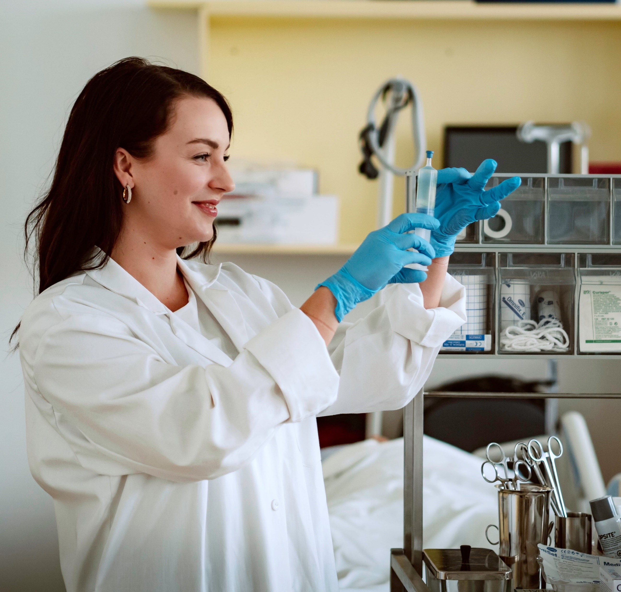
Cooperation Levels
International
Czech Republic
Pardubice Region
City of Pardubice

Slide 8
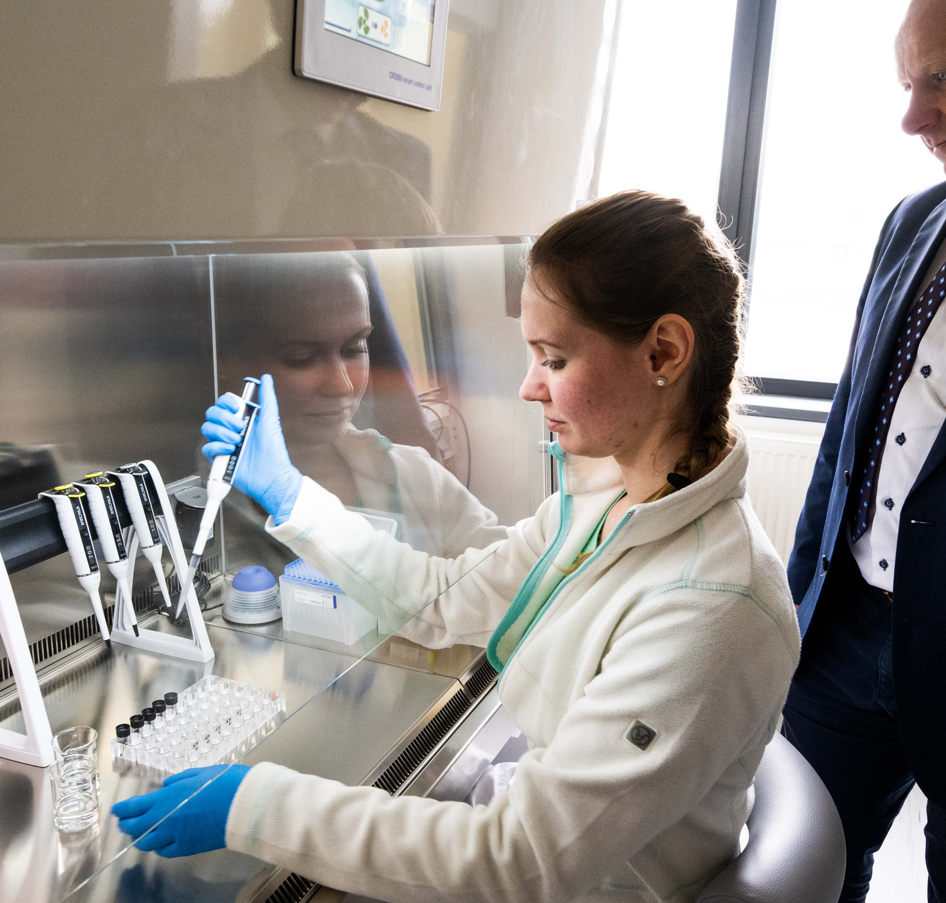
MAJOR INTERNATIONAL RESEARCH PROJECTS
program erc – horizon europe
Oncolipidomics: Why is lipidomic dysregulation pattern in blood similar for various cancers? (ONCOLIPID) – Lipid analysis and its application in cancer diagnostics
program horizon europe
European Bus Rapid Transit of 2030: electrified, automated, connected (EBRT2030) – Optimisation of energy management for the operation of the bus line serving Václav Havel Airport
INnoVation and ENTrepreneurship in HEIs (Deep INVENTHEI) – Creating an international network of regional innovation centres to retain talent in Europe in the field of advanced technologies and to support academic spin-offs and start-ups
Hybrid Virtualized Testing Certification Environment – The adoption of EGNSS for deploying efficient, resilient, and competitive ERTMS systems
Building a Community of Railway Scientific Researchers and Academia for ERJU and Enabling a Network of PHDS (Academia Teaming with Industry) - ACADEMICS4RAIL – Building a scientific community in the field of railway transport
Salamander – Smart sensors and self-healing functionalities for battery longevity with manufacturability and economical recyclability

Slide 9
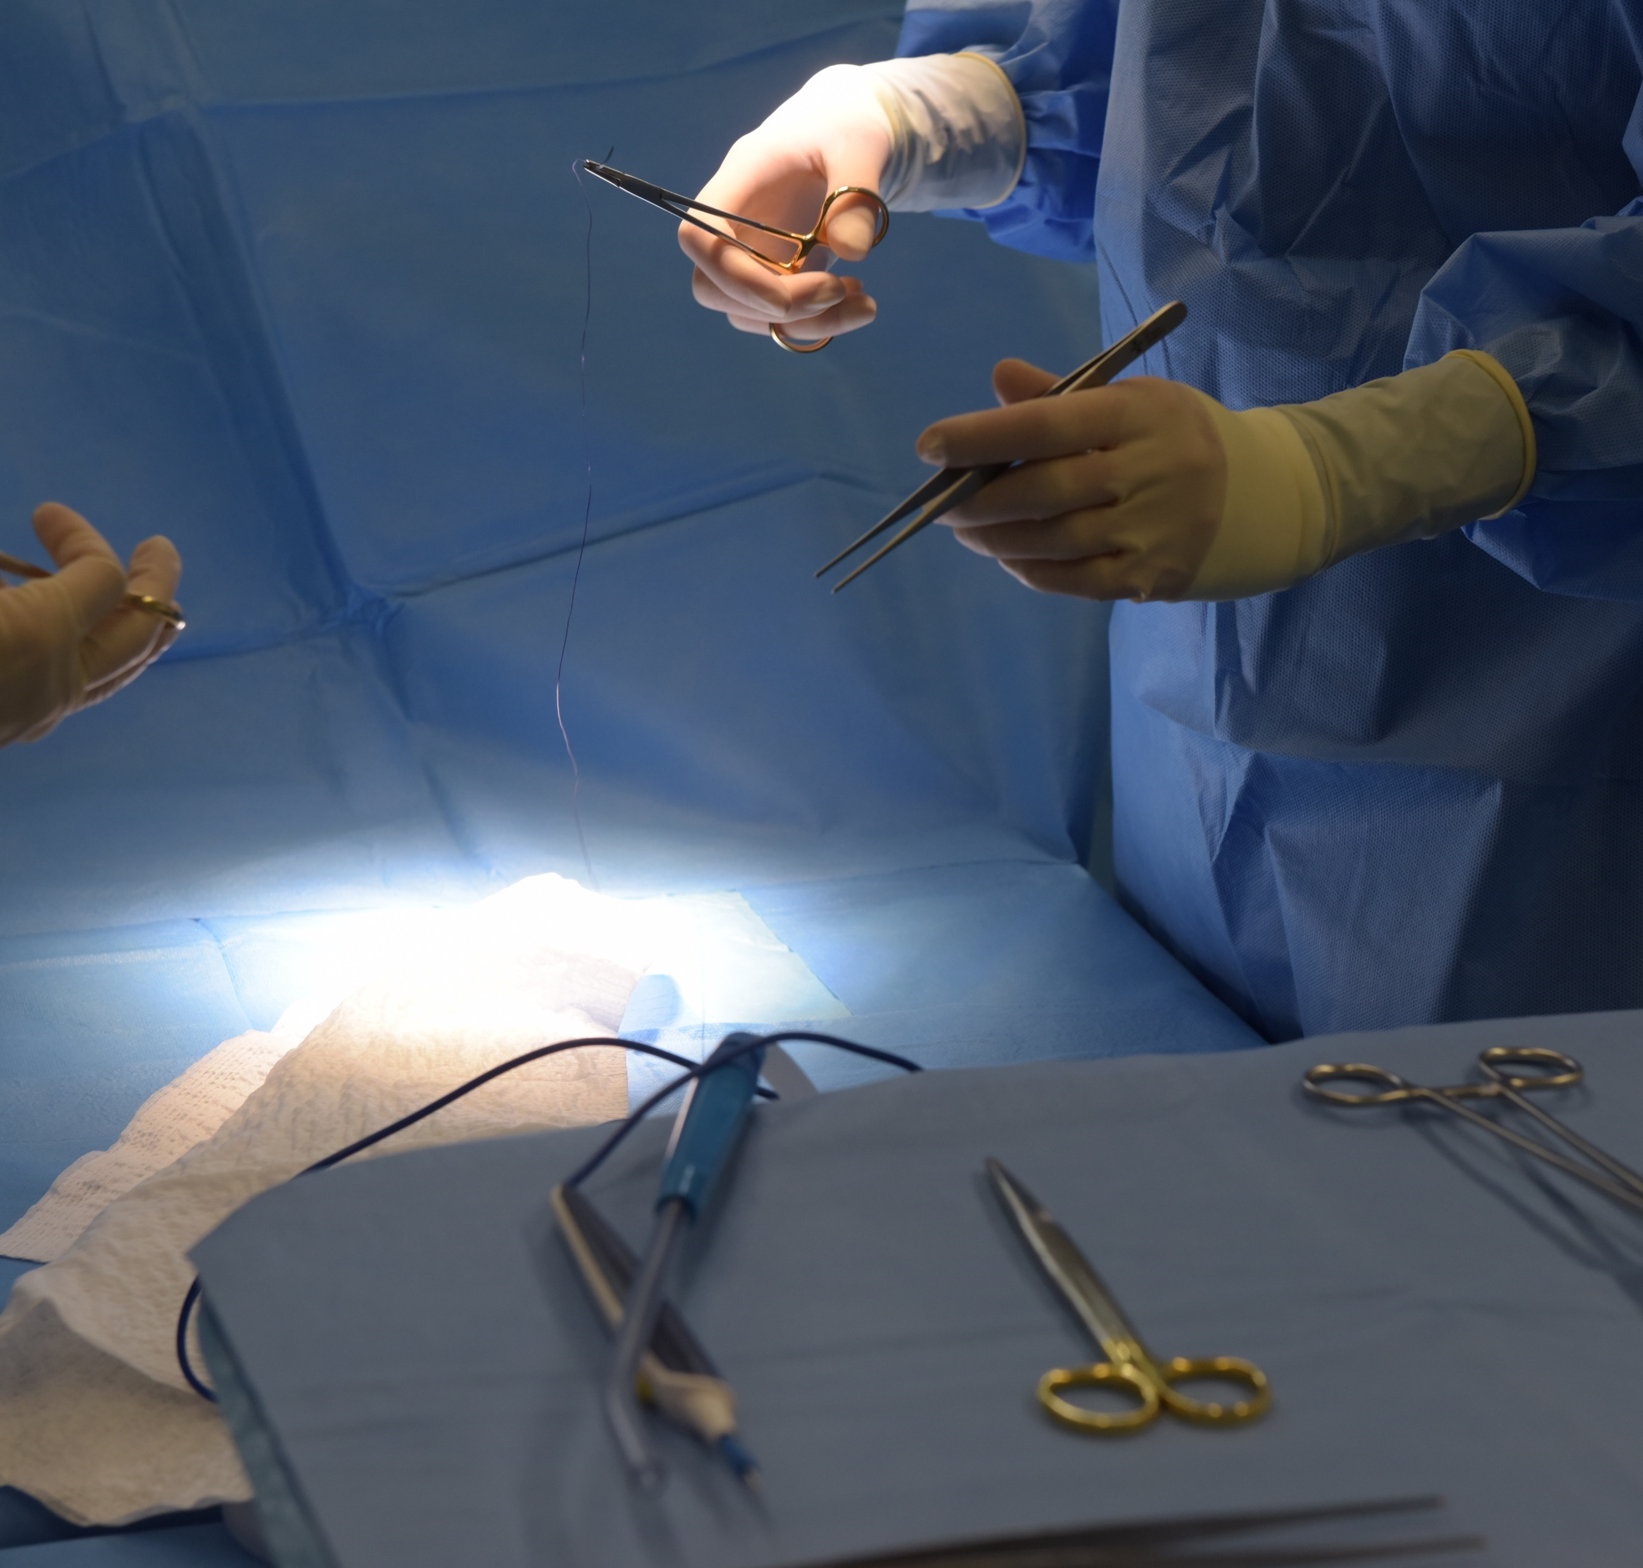













NATIONAL RESEARCH
Fundamental
Research
Applied
Research
Experimental Development &
Contract Research

Slide 10
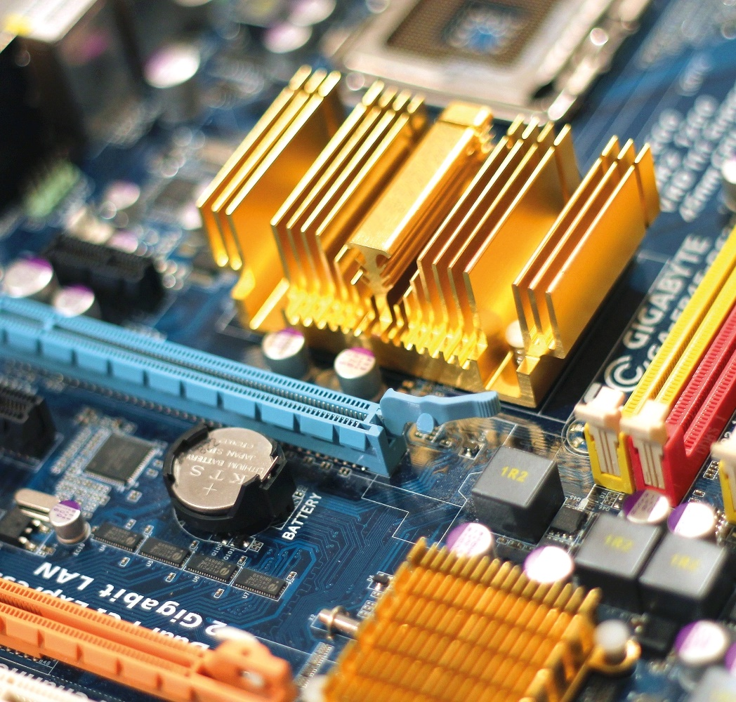
REGIONAL AND CITY GOVERNANCE & INNOVATION ECOSYSTEM
Strategic regional bodies
Regional Standing Conference of the Pardubice Region (RSK)
Regional Innovation Council (KRPI)
Integrated Territorial Investments of the Hradec-Pardubice Agglomeration (ITI)
Innovation ecosystem partners
Innovation Platform of the Pardubice Region (IPPK)
Pardubice Business Incubator (P-PINK)
Regional Development Agency of the Pardubice Region (RRAPK)
Regional Chamber of Commerce
EXAMPLE projects
Innovative materials with high added value suitable for applications – Intersectoral cooperation between UPCE and Synpo, a.s., Paramo, a.s., Austis a.s. and Tomil s.r.o.
Multi-sector and Interdisciplinary Cooperation in Research and Development of Communication, Information and Detection Technologies for Control and Signalling Systems – research in the fields of electronic sensors, radio elements, radar systems and shielding materials for communication, and detection and information technologies
Biomedical Indicators for Personalized Medicine – advanced technologies and procedures in the field of personalized medicine with a focus on the most fragile population

Slide 11
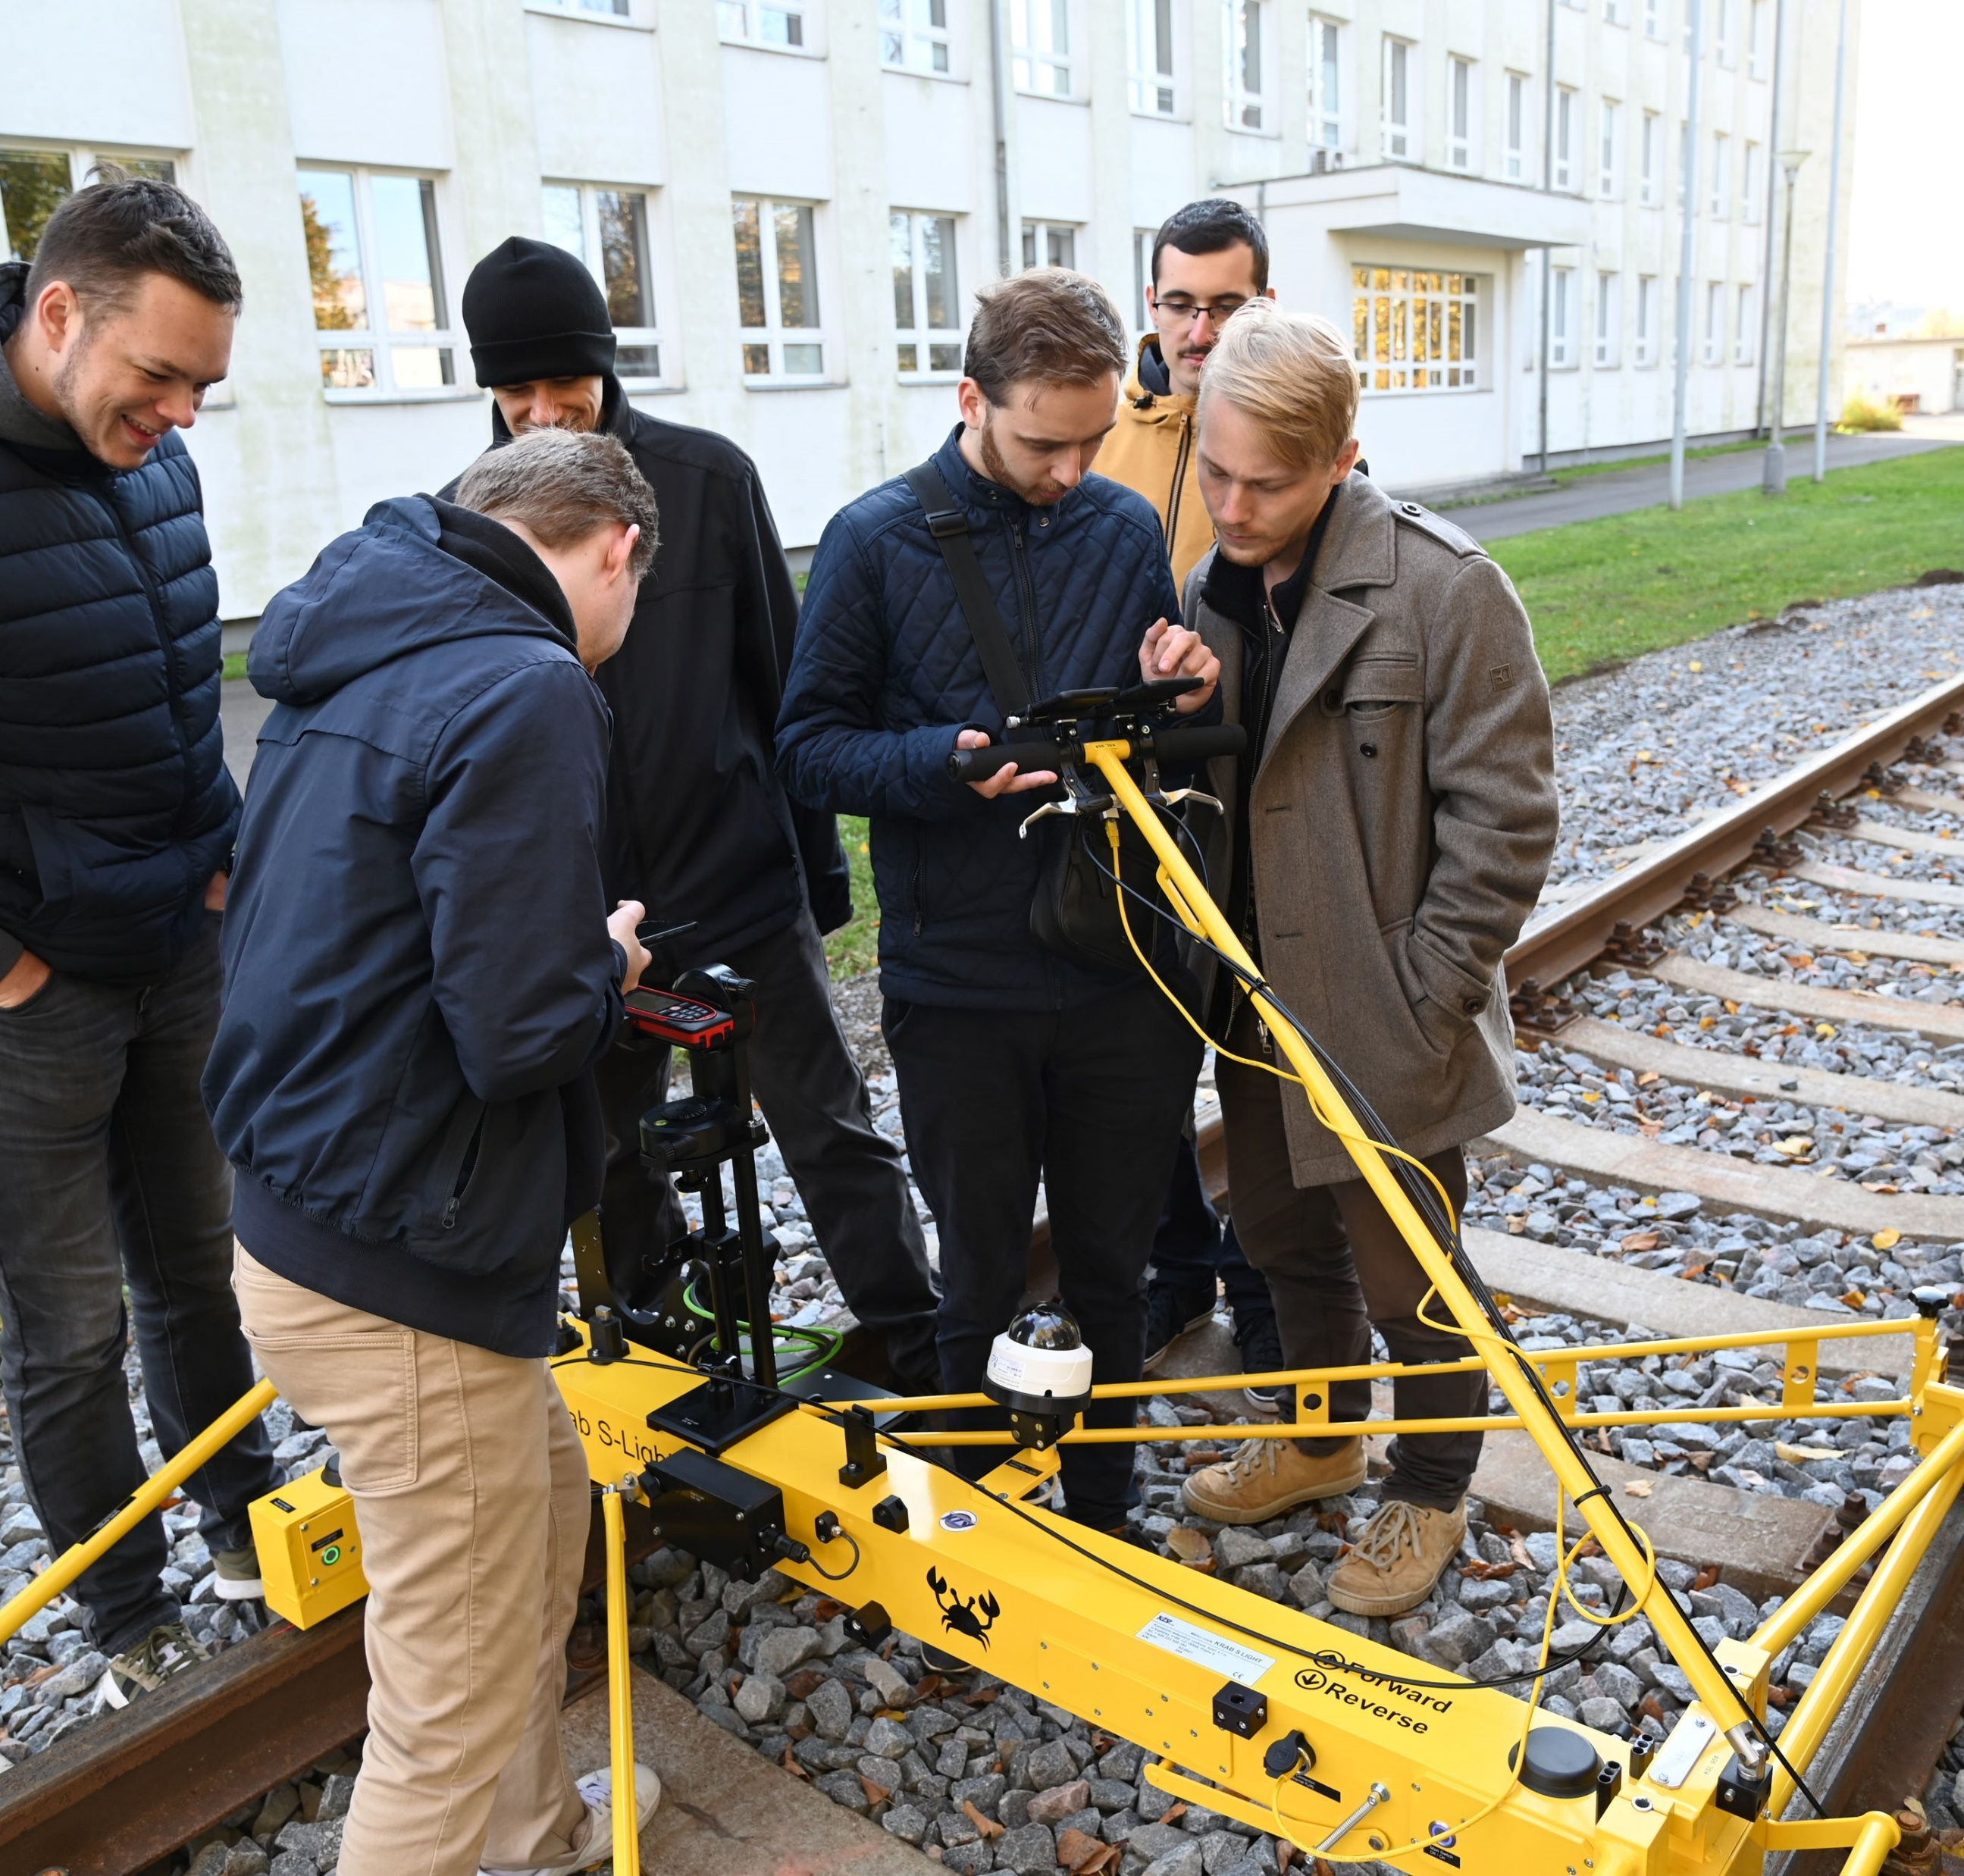







COOPERATION WITH REGIONAL COMPANIES AND PUBLIC SECTOR
RESEARCH & INNOVATION
Joint R&D projects with regional companies
Technology transfer and commercialization
Entrepreneurship support with P-PINK
Talent & employability
Internships, trainee programmes and industry mentoring
Career Centre and labour-market connection
KONTAKT job fair for students and graduates
Solutions for the region
Contract research and expert services
Student theses with companies and public institutions
Cooperation with city and regional departments on practical challenges
UPCE is a knowledge partner for regional industry and a talent pipeline for employers across the Pardubice Region.

Slide 12
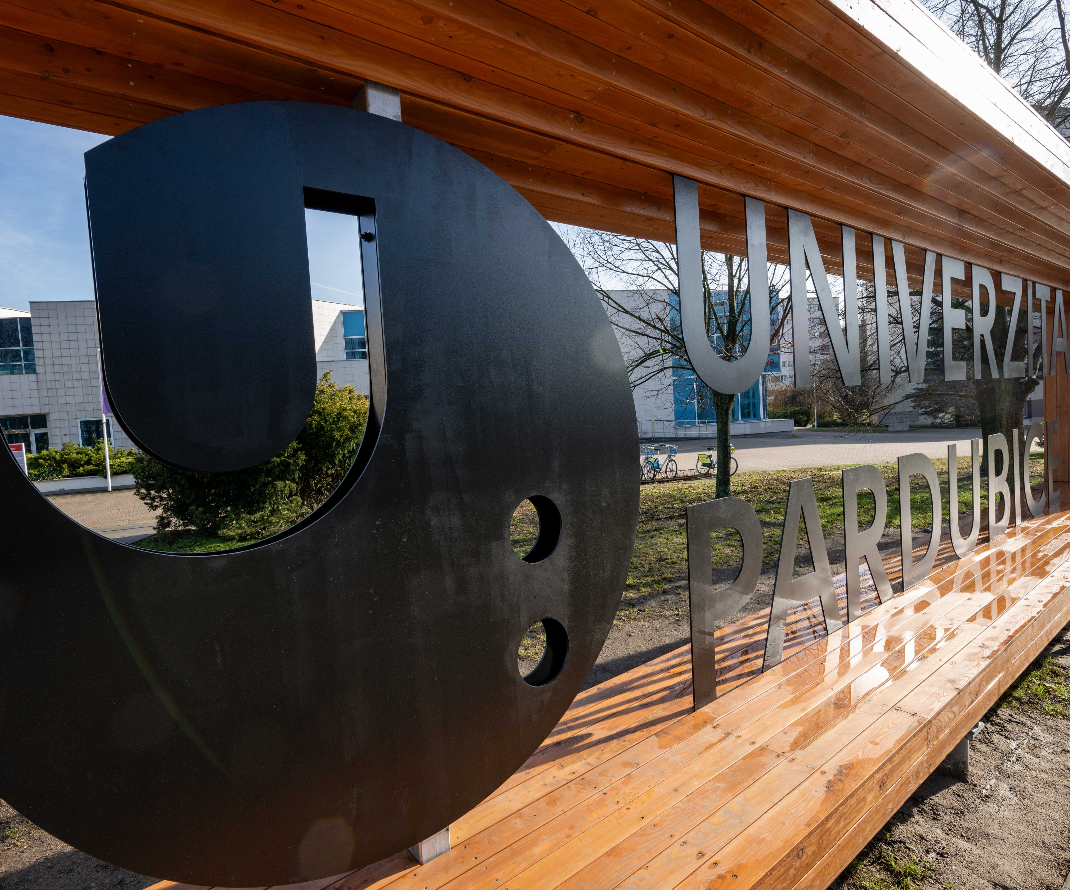
CONTACTS
University of Pardubice Studentská 95 532 10 Pardubice Czech Republic
www.upce.cz/en

