Slide 1
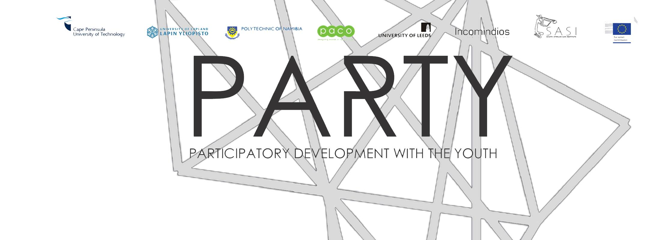
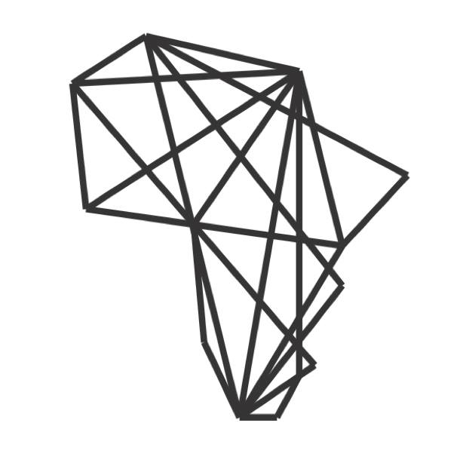
https://cordis.europa.eu/project/id/645743/results

Slide 2
Goals
Challenges faced by the marginalized youth in developing countries, such as unemployment, are not simple or easily solved. This is influenced by a number of factors including levels of education, gender, self-esteem, geographic location, physical ability and transport.
The objective of the project is to contribute to solving the issues related to the youth unemployment in developing countries by creating participatory tools for human development that enable transformational change for the youth.
Based on a service design approach, the project will provide tools for the marginalized youth suitable for daily use, enhancing regional democracy, increasing equal opportunities and contributing to human and service development with a particular target group: the San people in South Africa and Namibia.
The San are faced with various social, cultural and political difficulties, and their communities are among the poorest in their countries, which are among the most unequal societies in the world. The tools aim to support the youth’s motivation and abilities to participate in the development of their own community towards a wider integration into their national socio-economic systems.

Slide 3
Goals
Another objective is to cooperate with NGOs and other service providers in order to produce agile and human-centred processes and methods for developing service structures and systems towards improving the status of the marginalized youth.
The third objective is to convey information on service design methods to those engaged in the development of youth services. The project aims to support the uptake of service design methods and tools in practical development work as well as the target and interest groups on a permanent basis. Thus the project establishes a strategy for continuation of the work with the target group and the local partners.

Slide 4
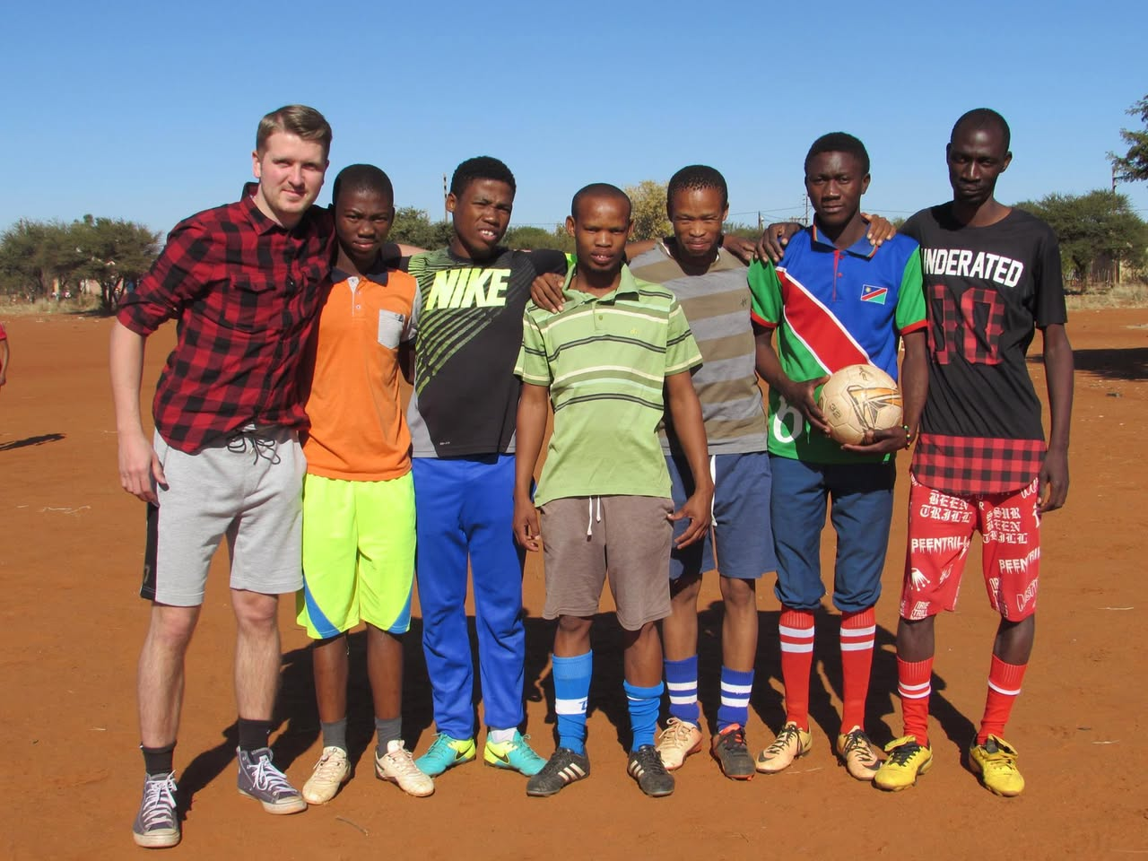

Slide 5
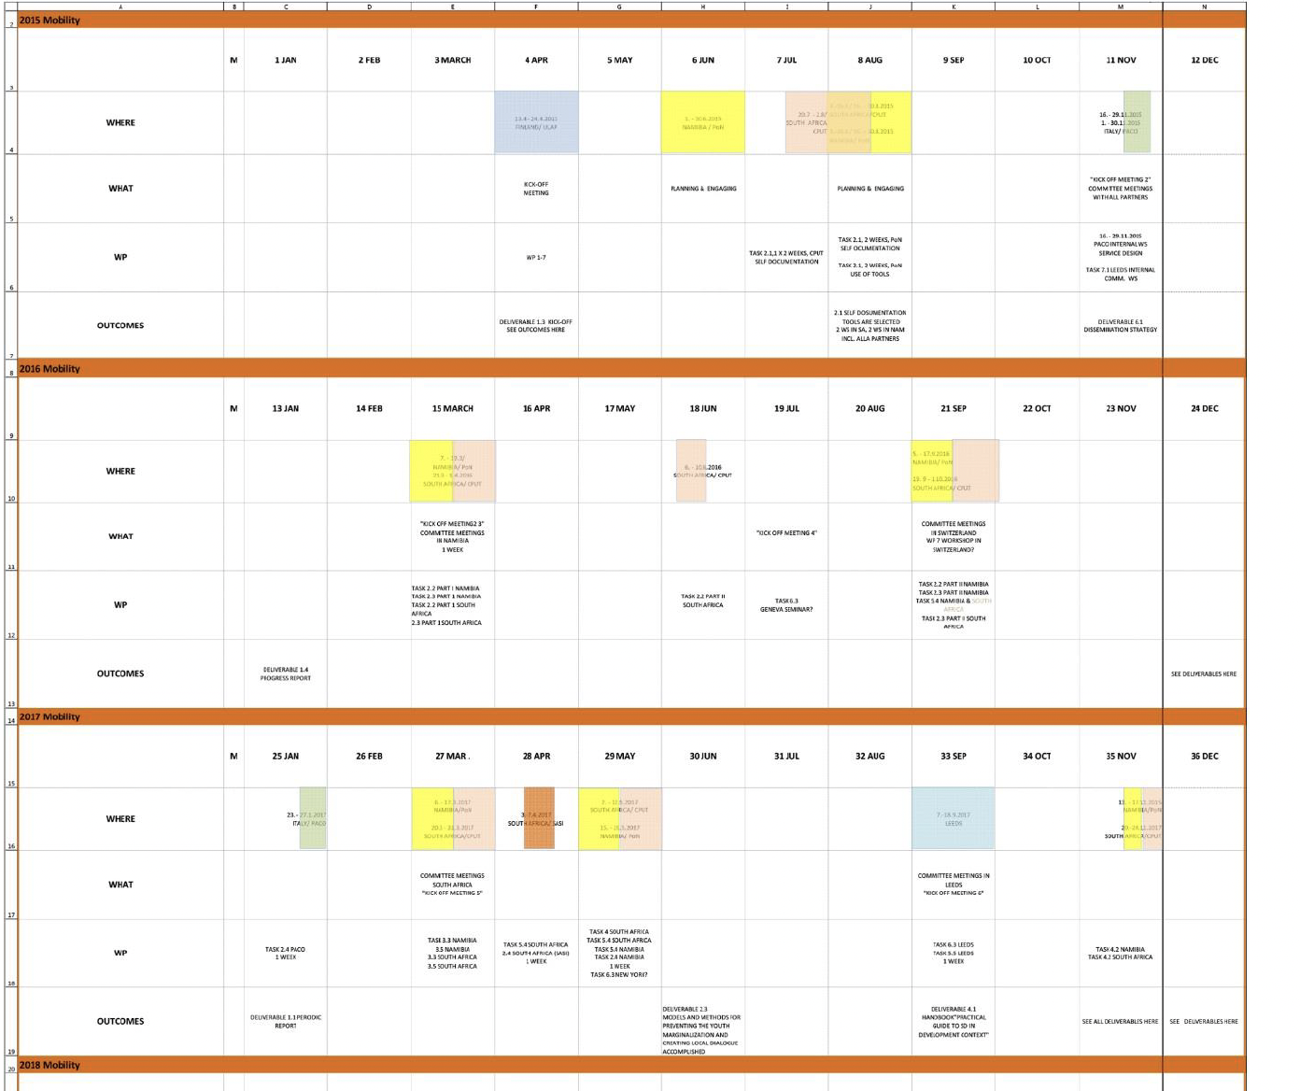
Managing 200 secondments
70 from University of Lapland

Slide 6
The Project
Guided by a service design approach, PARTY provides participatory development tools for marginalised youth in South Africa and Namibia. These were designed for daily use to help enhance regional democracy, increase equal opportunities and contribute to human development.
Young people in middle to lower income countries are often marginalised. Issues around levels of education, gender, self-esteem, geographic location and transport availability often compound this. One area where marginalisation is often most pronounced is with youth unemployment.
Acknowledging the complexity of issues contributing to youth unemployment, the EU-supported PARTY project(opens in new window) set out to create participatory tools for transformational change that could help youth address their unemployment in a proactive way.

Slide 7
Co-creating solutions
The San groups are just one of many indigenous populaces in South Africa and Namibia. PARTY focused on the San people as they face acute social, cultural and political challenges – exacerbating marginalisation – and are often among the poorest in their countries. The project first undertook research to establish the most ethical processes to follow. With African partners, the team worked throughout on the creation of ethical guidelines to ensure that all researchers worked with the same ethical orientation towards indigenous issues.

Slide 8
Guidelines
These guidelines – which are being continually updated – will offer a much-needed tool for future researchers. A series of workshops were organised, initially for the San youth and latterly for possible stakeholders, to help engage participants, understand their needs and set the parameters for the design of successful participatory tools.
PARTY developed art-based methods for empowerment, resulting in exhibitions alongside an online handbook(opens in new window) of methods and tools used in the project. This later was designed as a resource for other projects and is already being adopted by partners

Slide 9
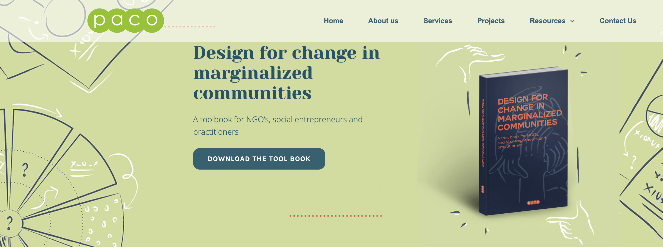

https://www.pacollaborative.com/toolbook/

Slide 10
Local action
The project sparked local actions, with Radio Youth Footprints being a good example. The initiative was created in close collaboration with the youth from the local community and XK FM(opens in new window), the local radio station. XK FM provides news and information to the !Xun and Khwe San communities in their mother tongue. Radio Youth Footprints hopes to see more local young people become involved with the station’s work, giving them the chance to develop new skills. A pilot trial will be conducted by XK FM

Slide 11
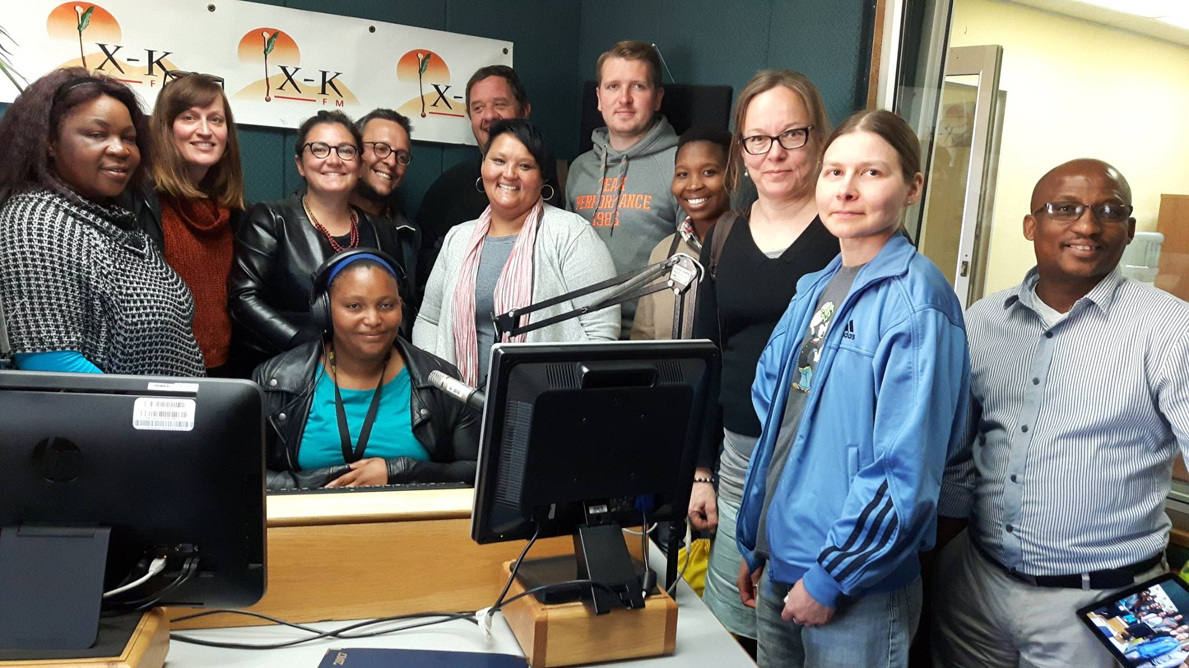

Slide 12
Deliverables
New innovative technological solutions and concepts created and disseminated
Operational communication model established Academic and practical presentations in workshops, seminars and conferences
New practises between the youth and stakeholders and outlines for new service structures
Recommendations for multi-stakeholders to develop marginalised indigenous youth with their involvement
Models and methods for preventing the youth marginalisation and creating local dialogue accomplished

Slide 13
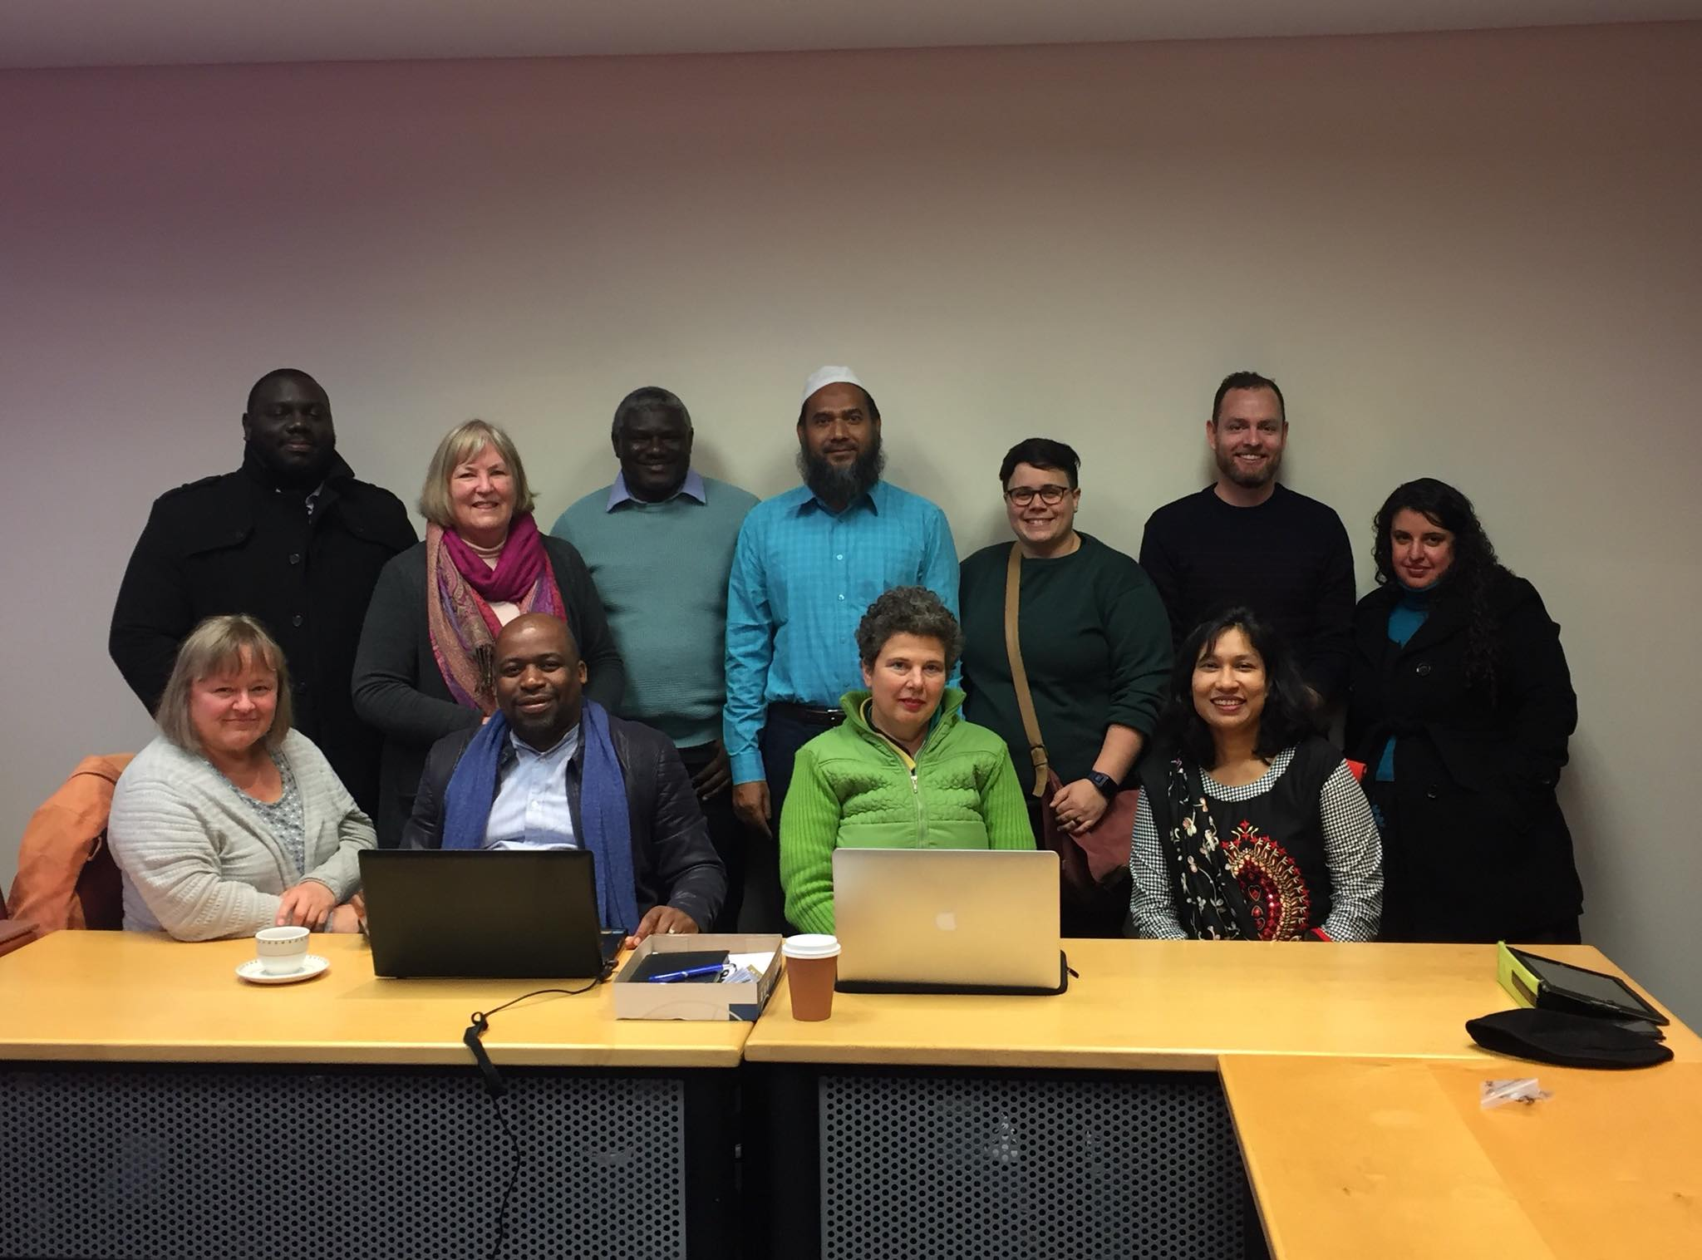

Slide 14
Deliverables
Continuation strategy document for embedding the tools and methods
Cross-sectoral model for knowledge transfer
Roadmap how to utilise new service design methods when developing new tools to improve local participation and democracy.
Dissemination strategy

Slide 15
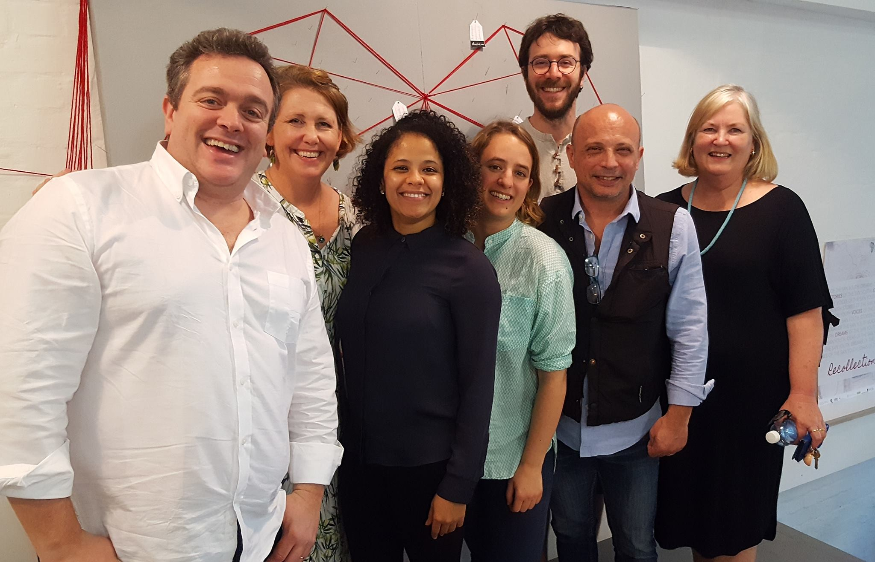

Slide 16
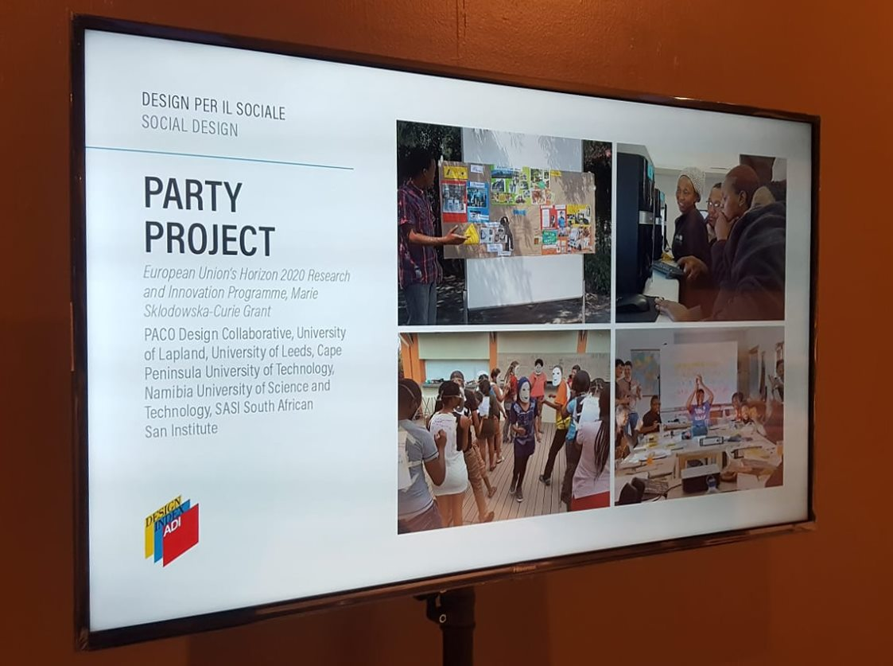


Slide 17
